Slide 1
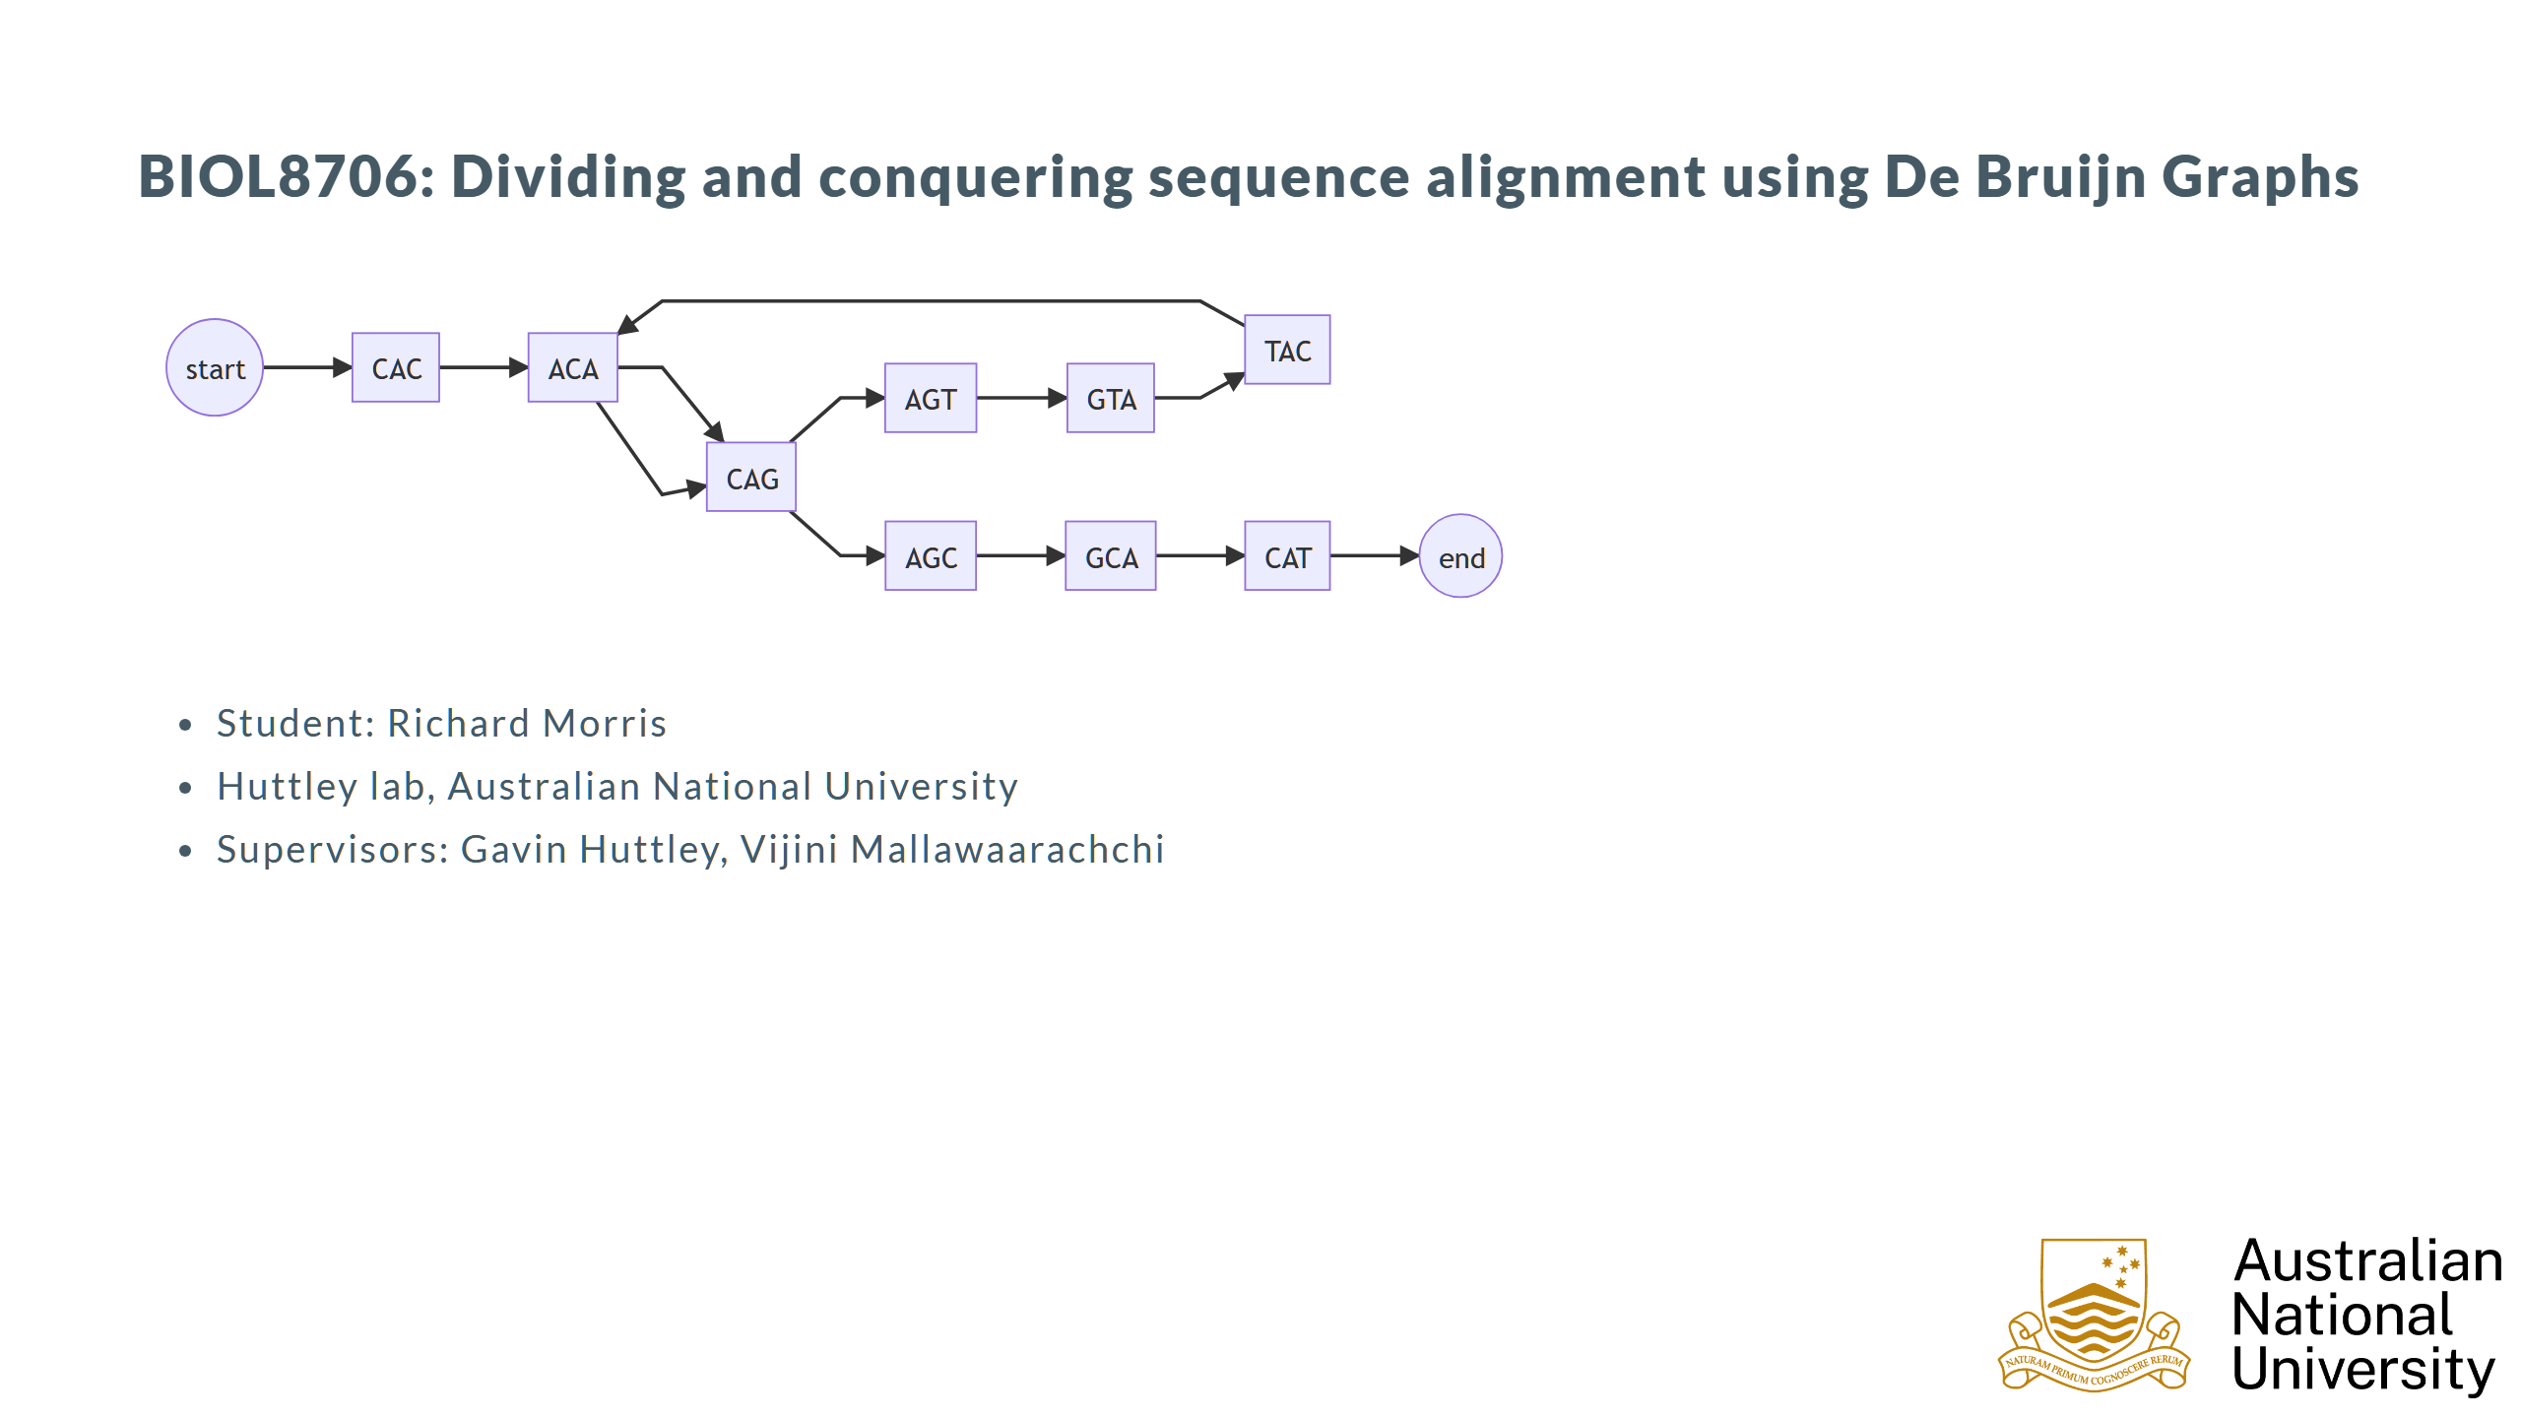

Slide 2
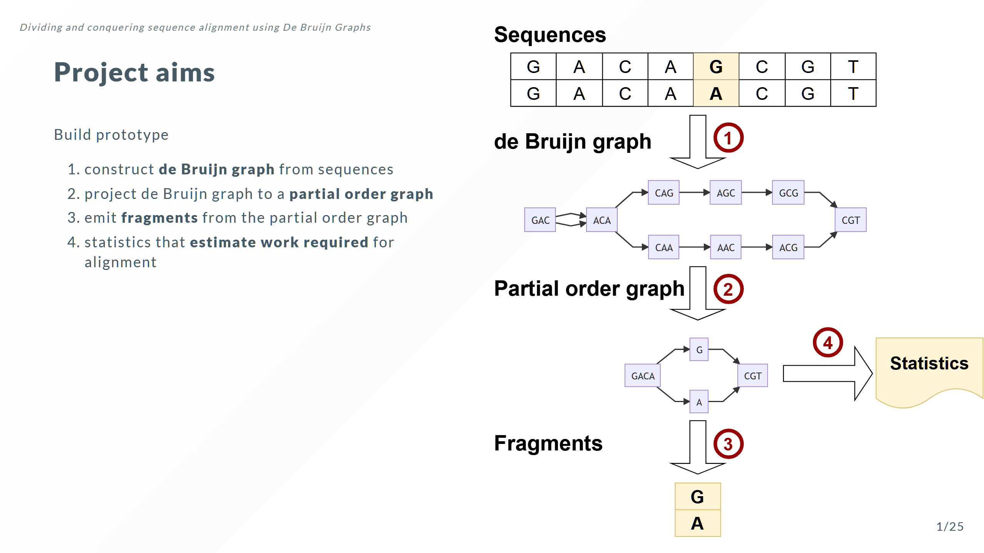

Slide 3
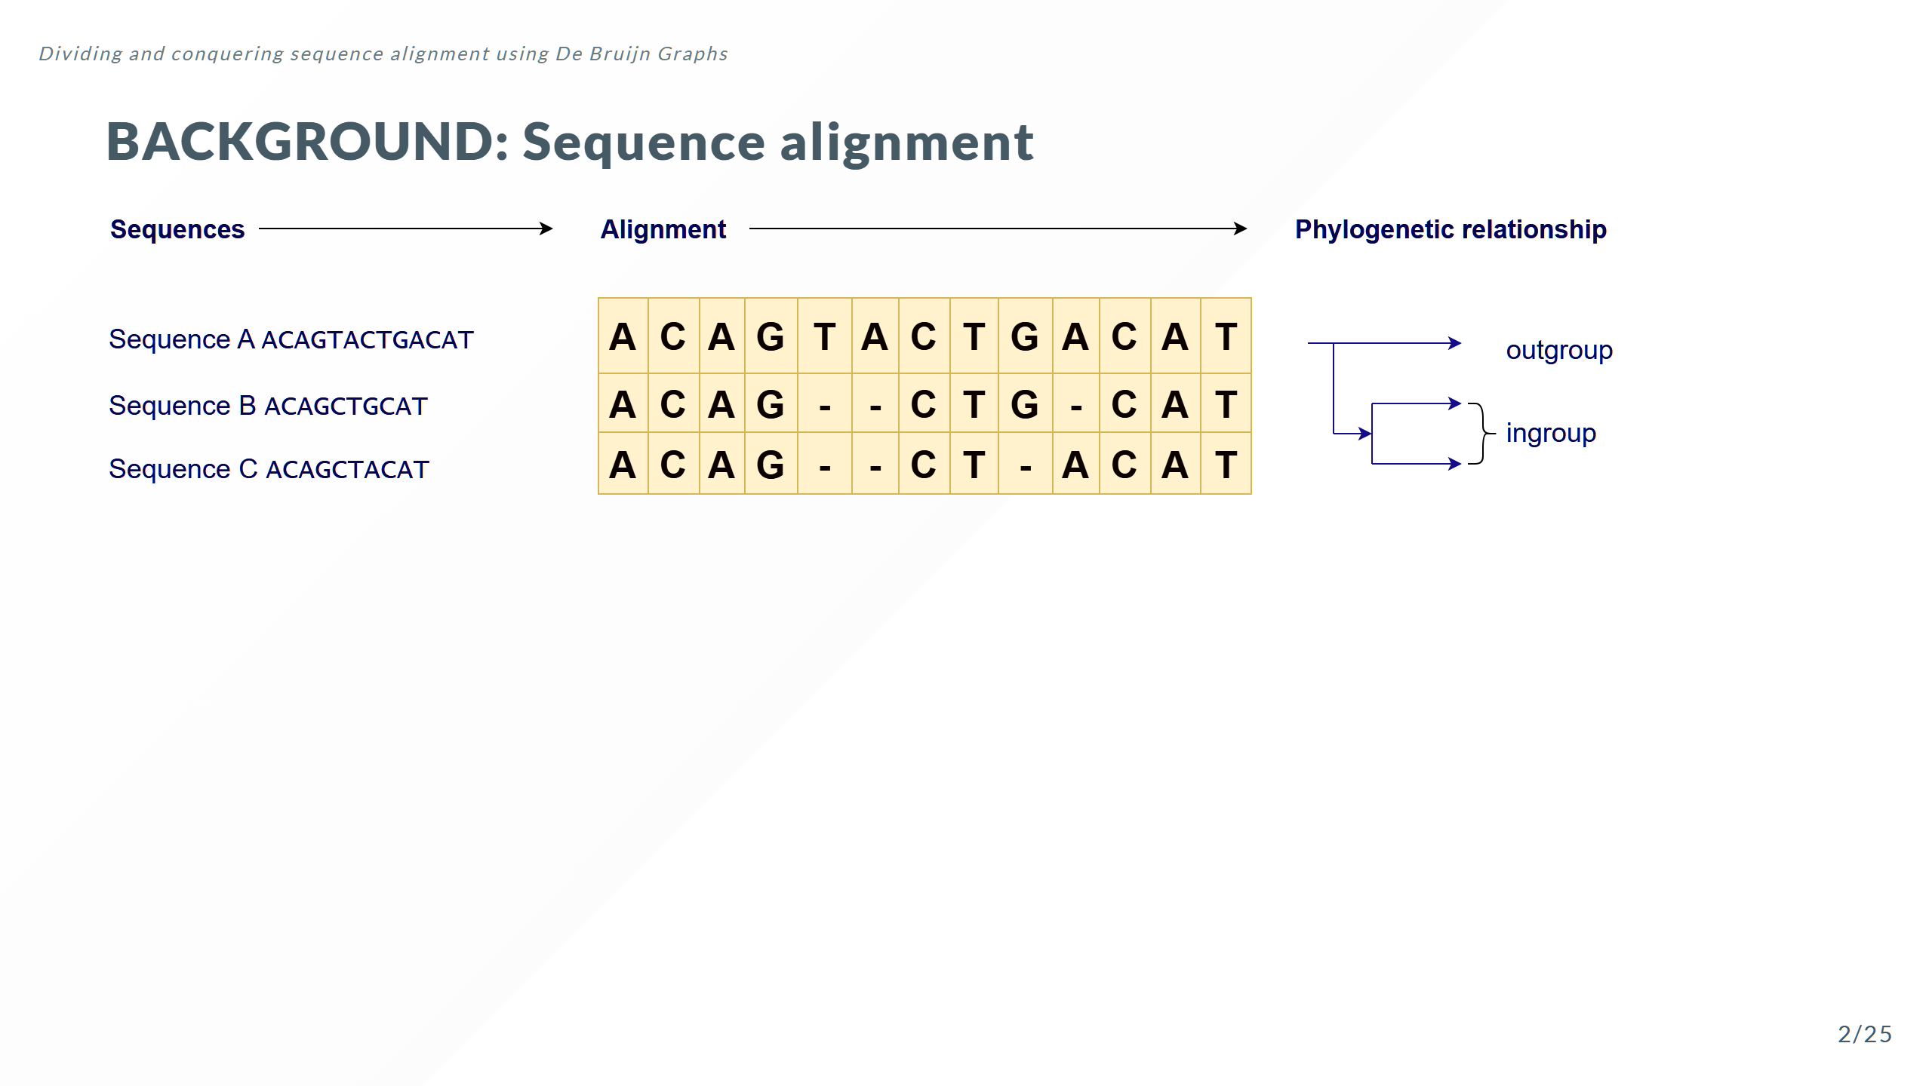

Slide 4
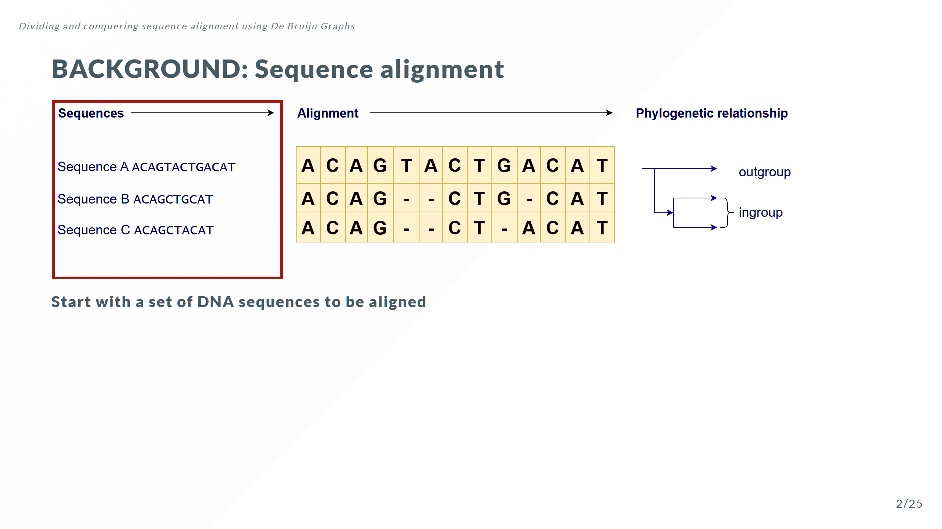

Slide 5
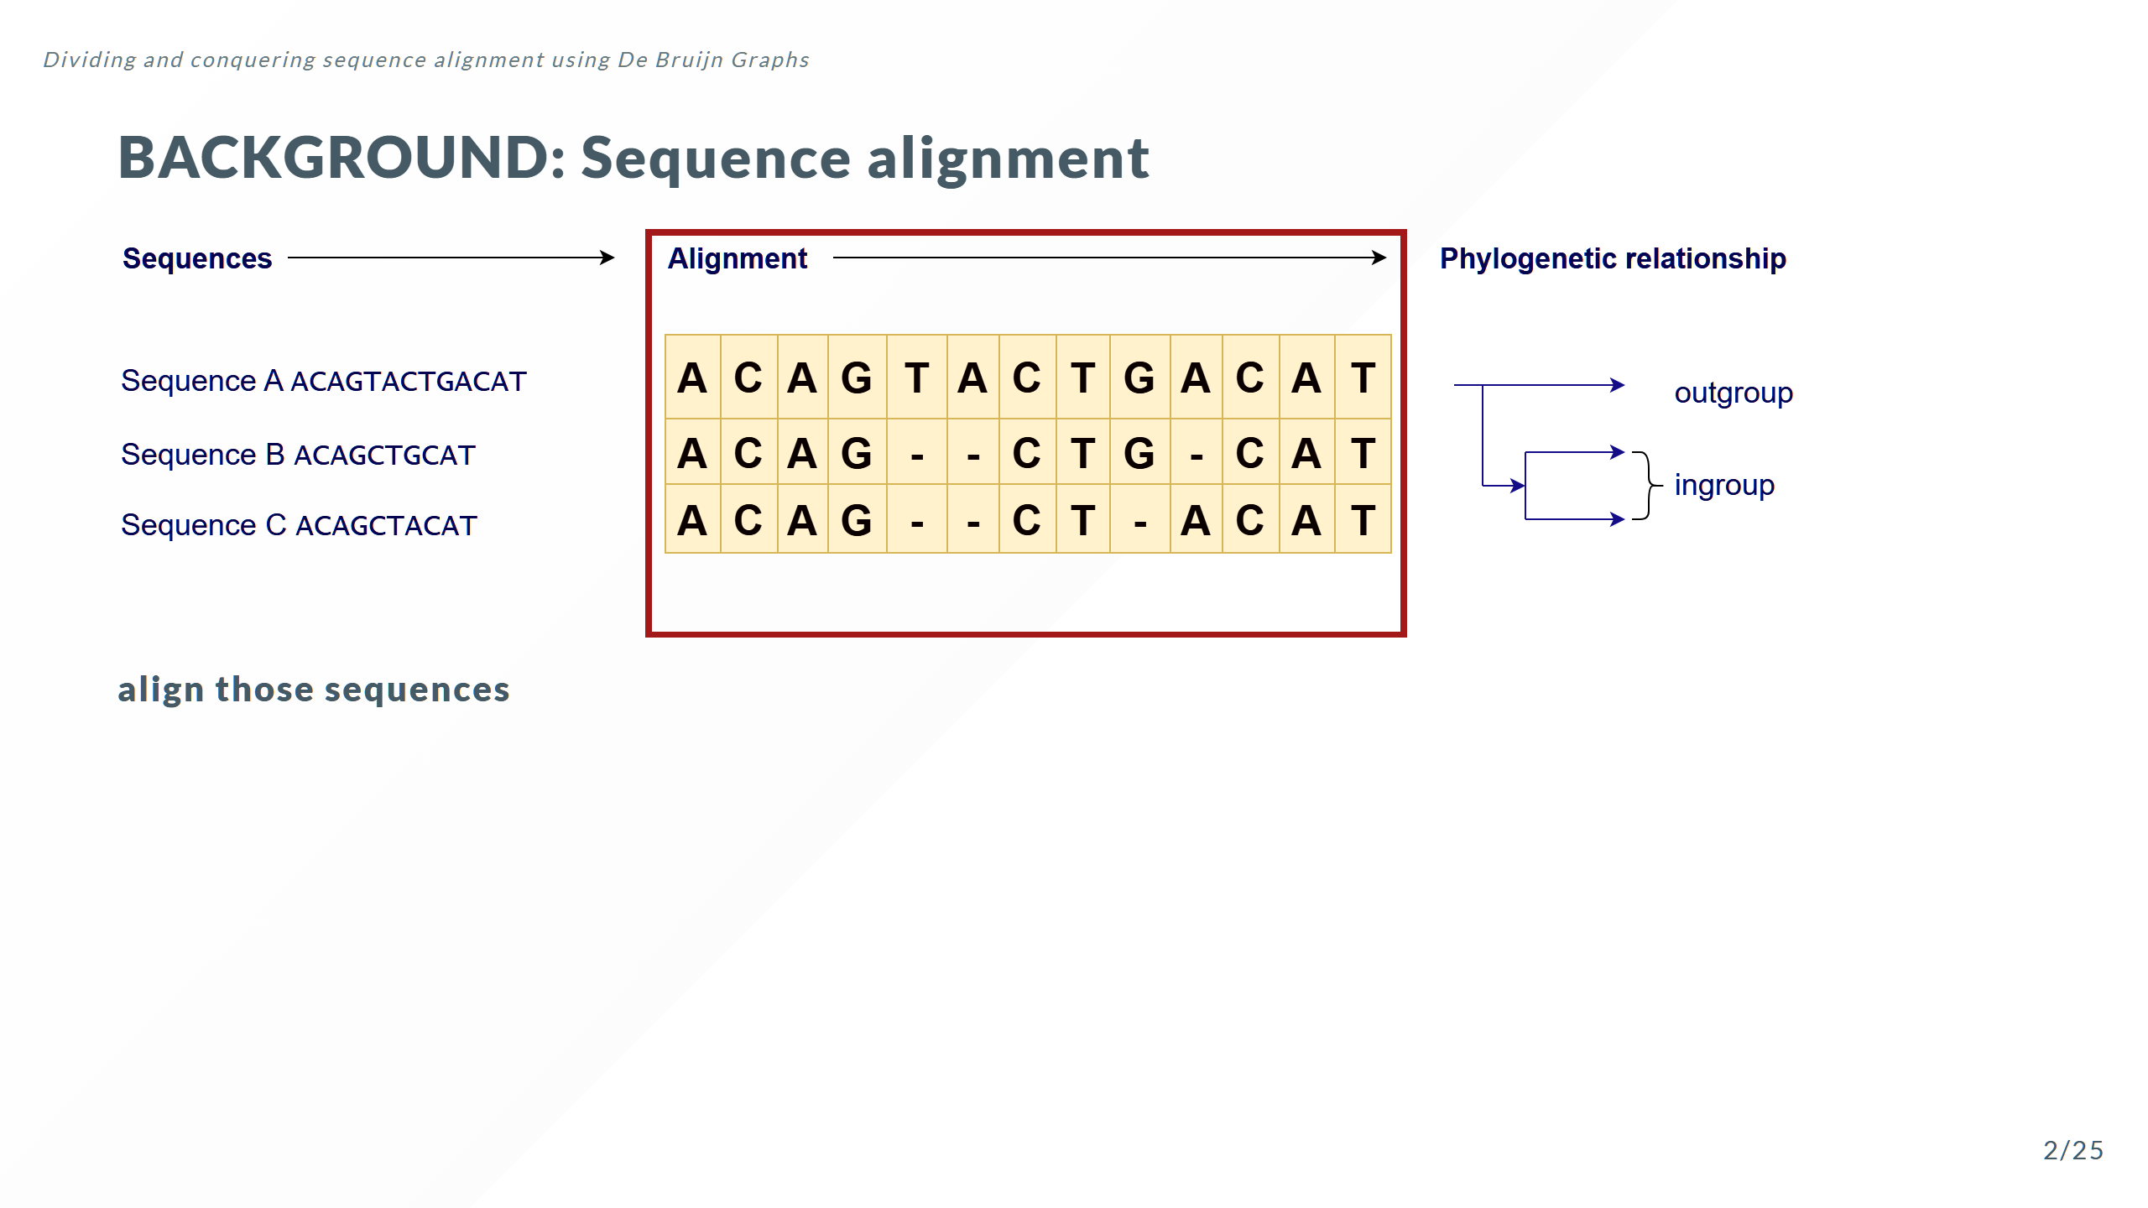
Notes:
Note these sequences are all different lengths

Slide 6
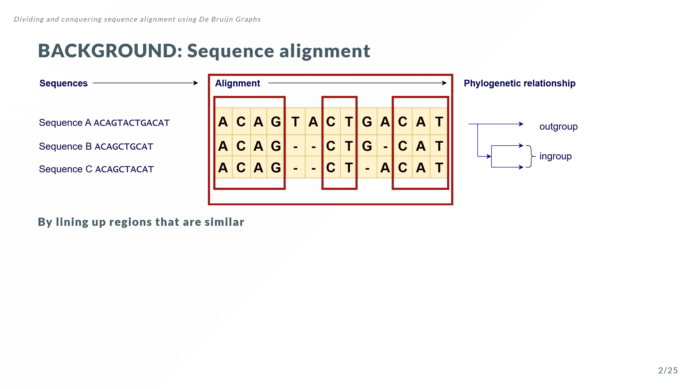

Slide 7
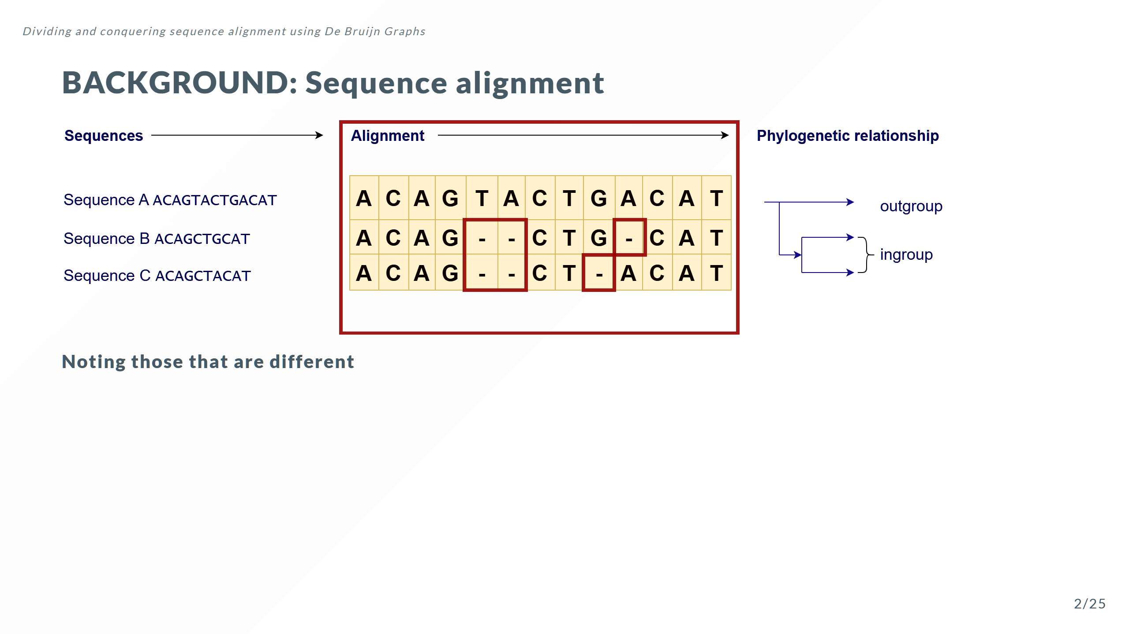

Slide 8
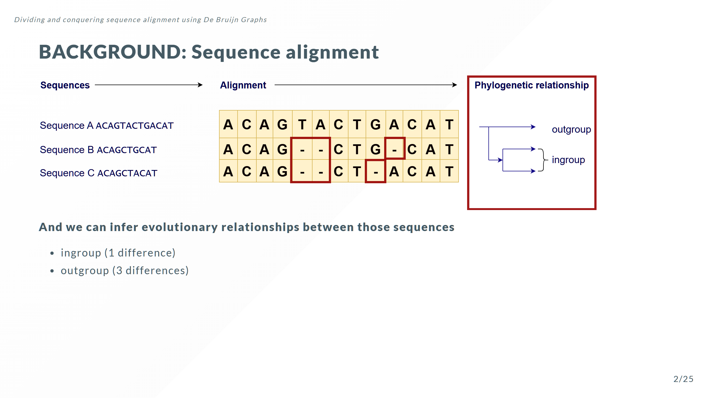
Notes:
In this case I constructed this hypothetical example where the only differences are in these deletion events In this case I constructed this hypothetical example where the only differences are in these deletion events

Slide 9
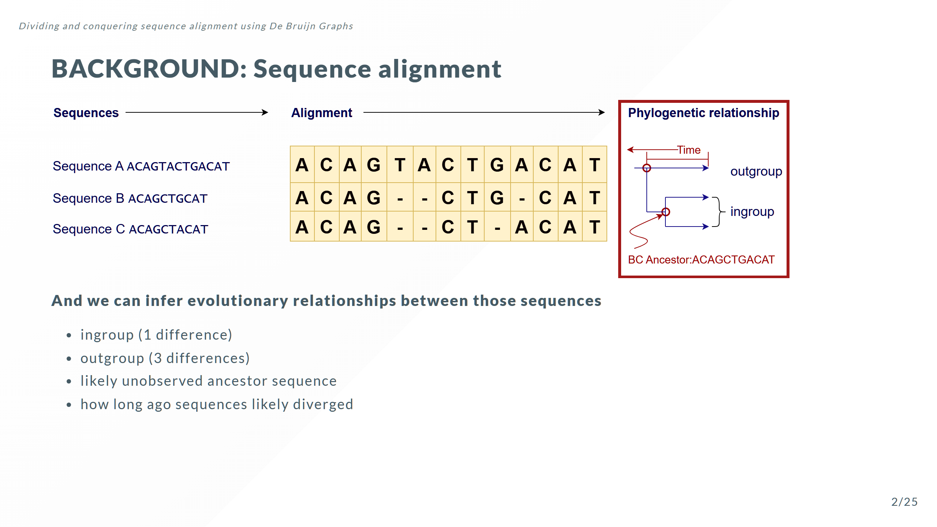

Slide 10
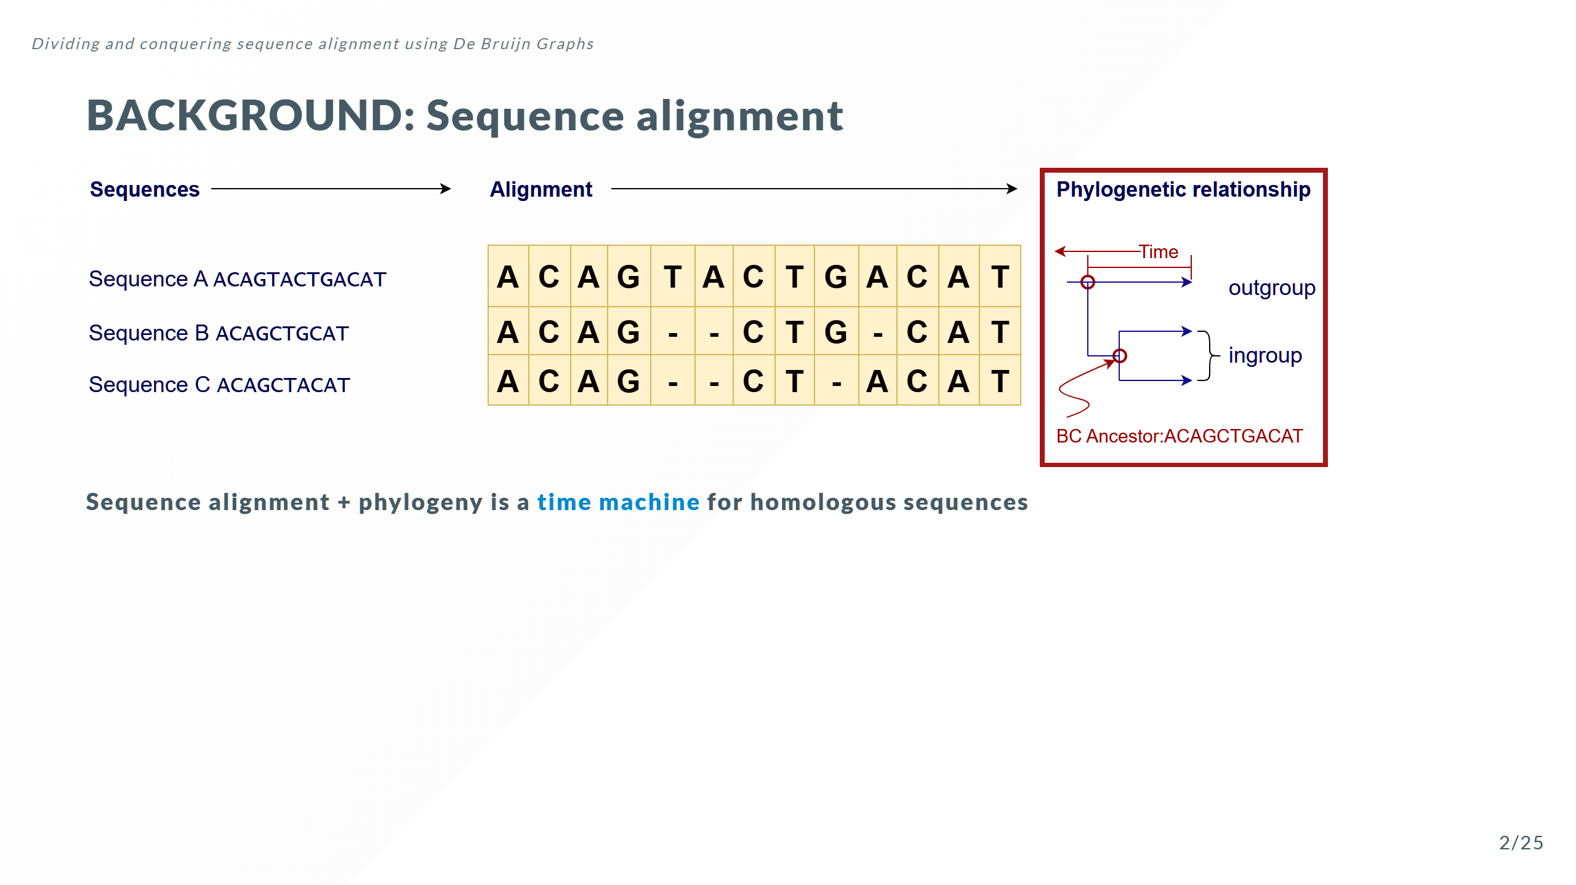
Notes:
... that descend from common ancestors

Slide 11
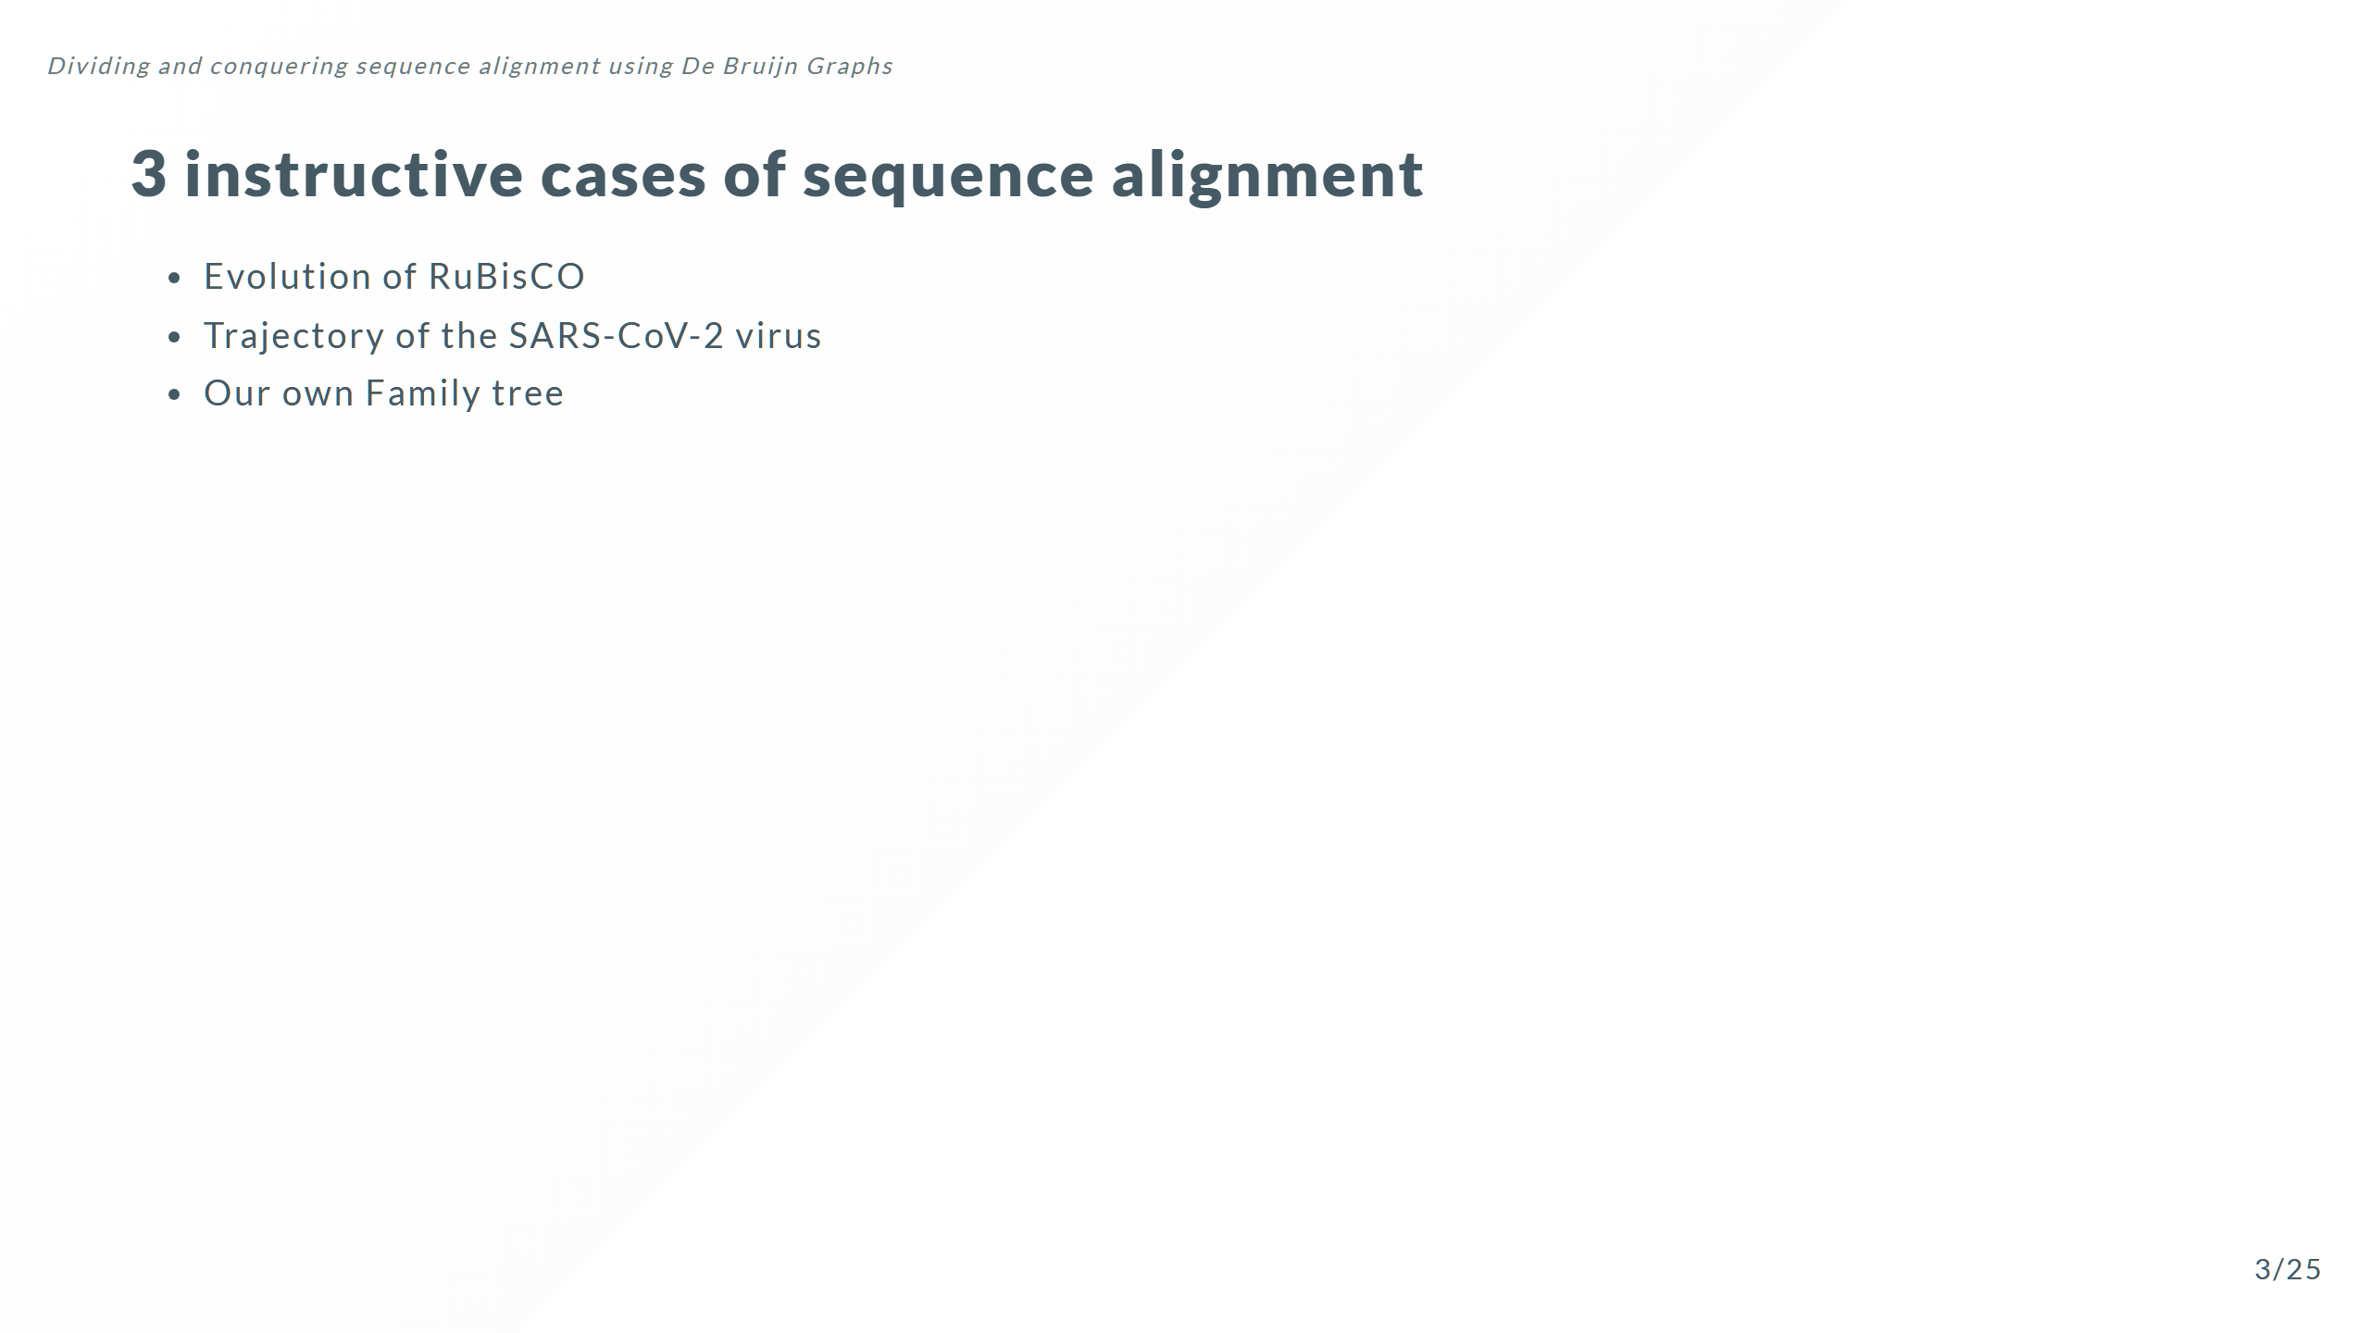
Notes:
These examples are not just random useful things to know but they highlight the computational problem that motivates the need to find a better way to do sequence alignment

Slide 12
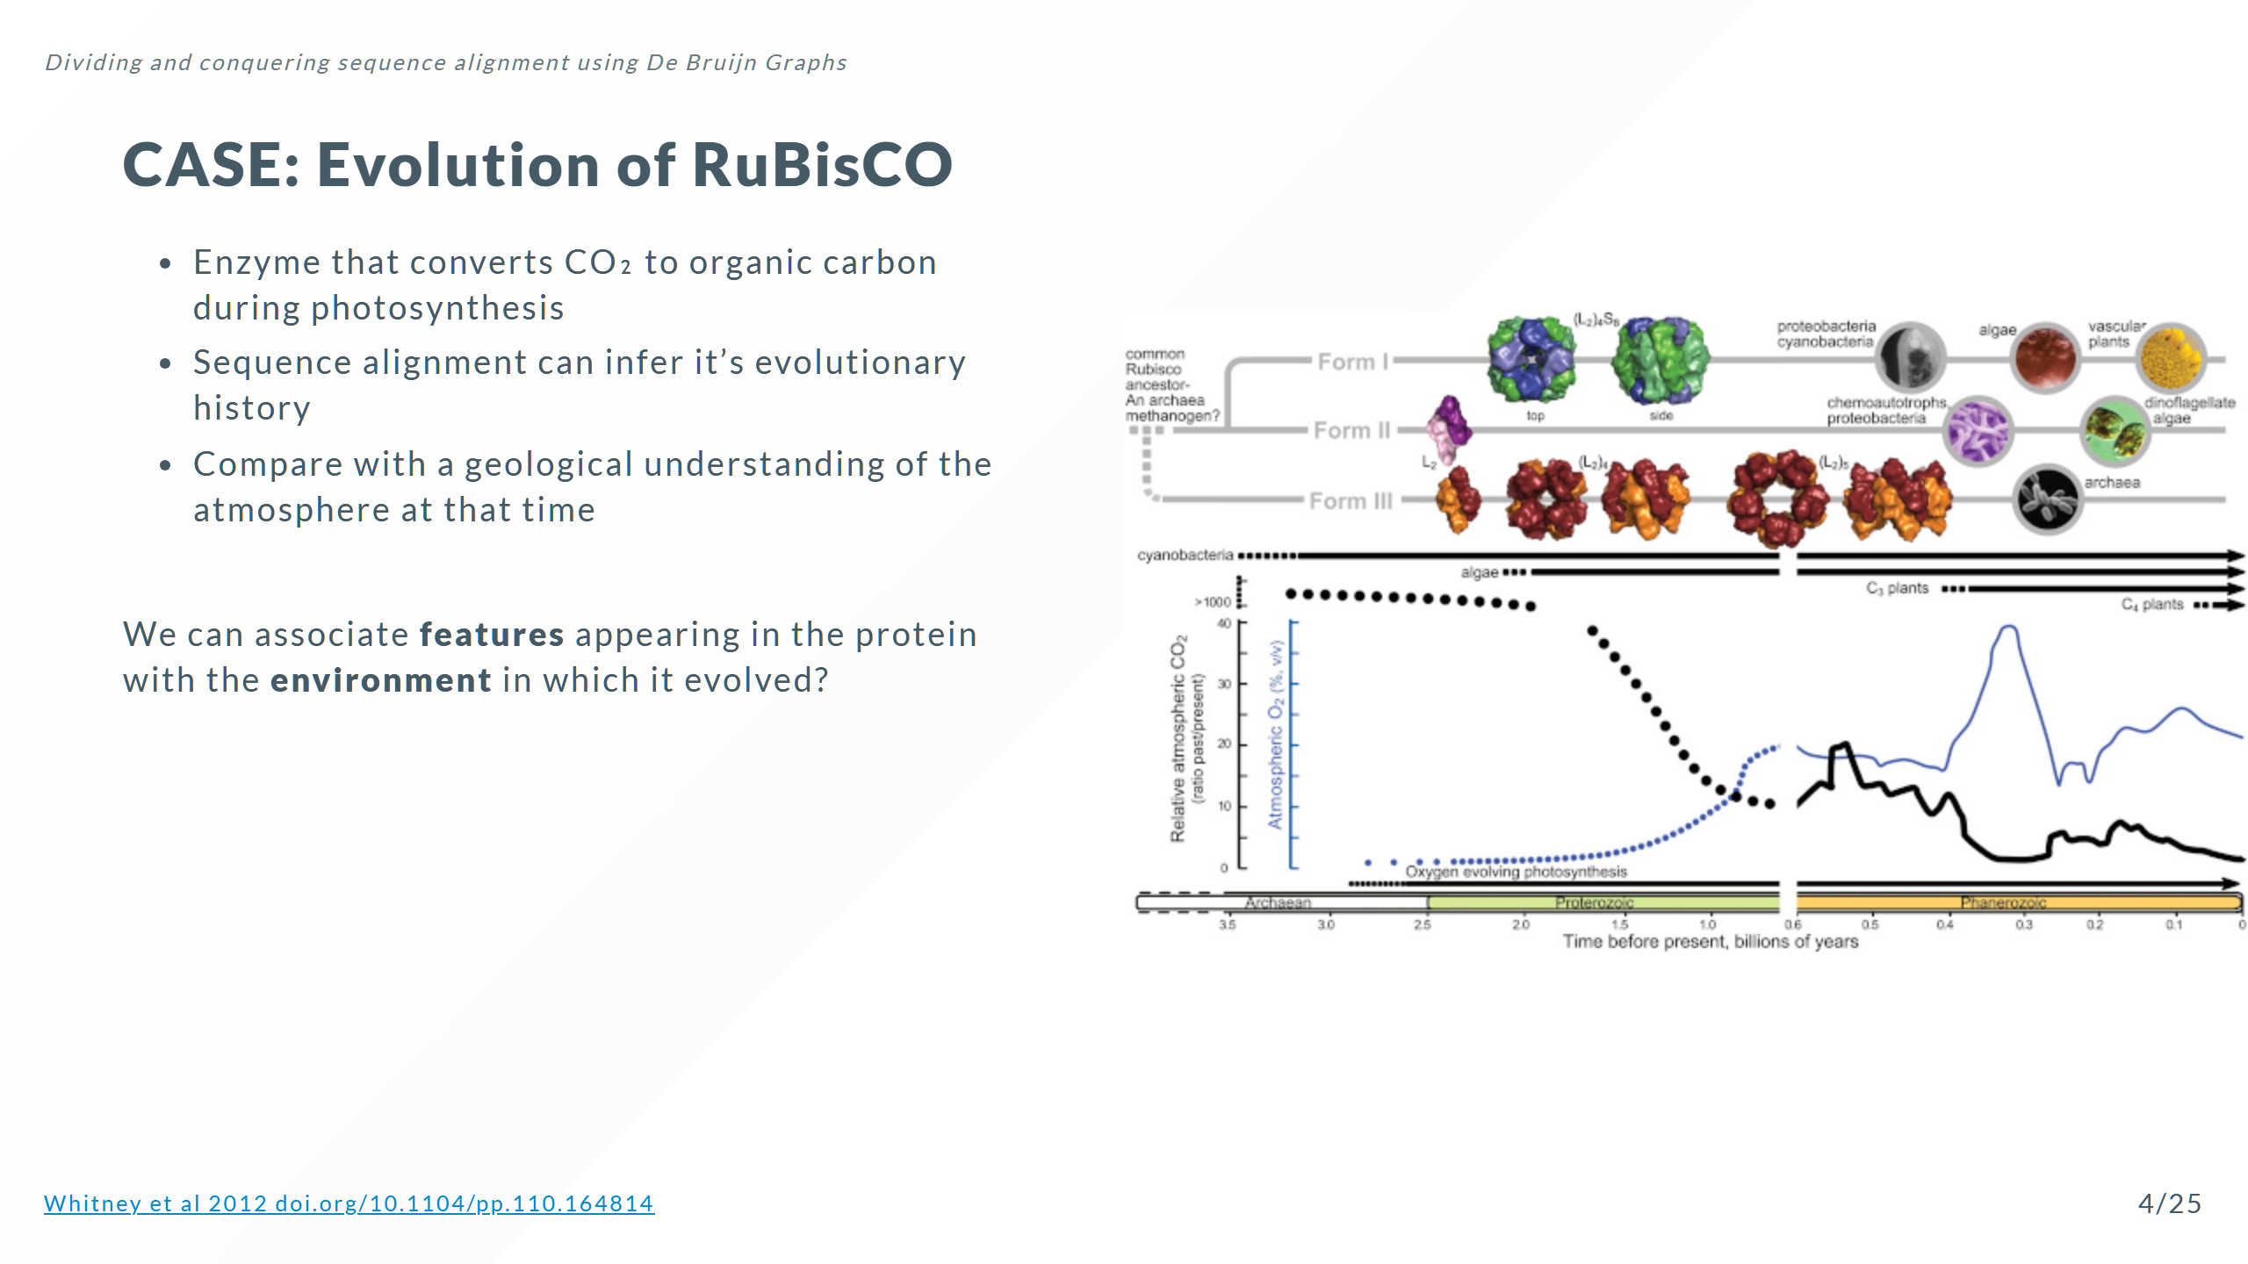
Notes:
This will tell us important things like RuBisCO innovations in response to different partial pressures of O₂ and CO₂

Slide 13
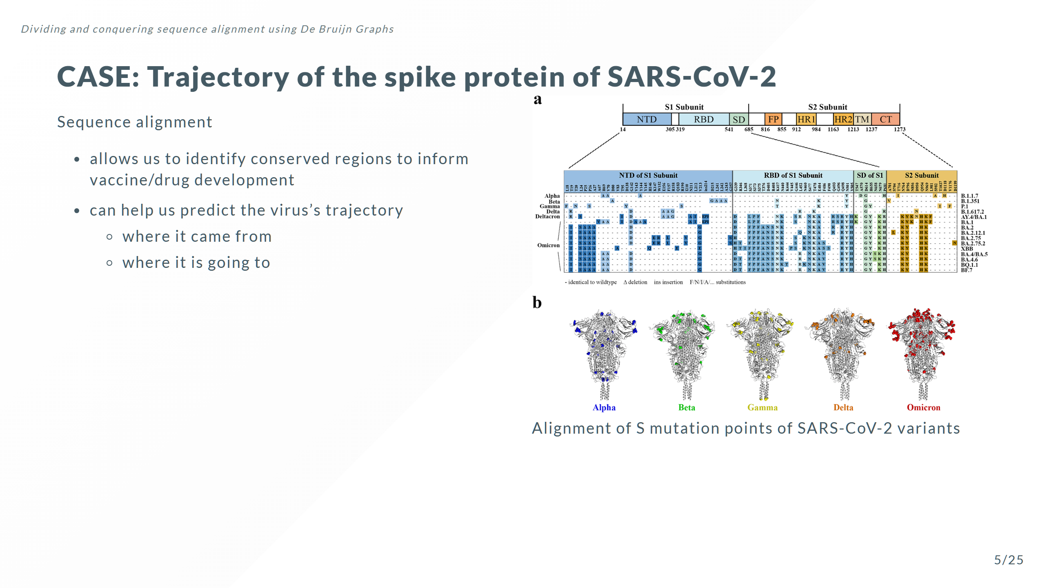

Slide 14
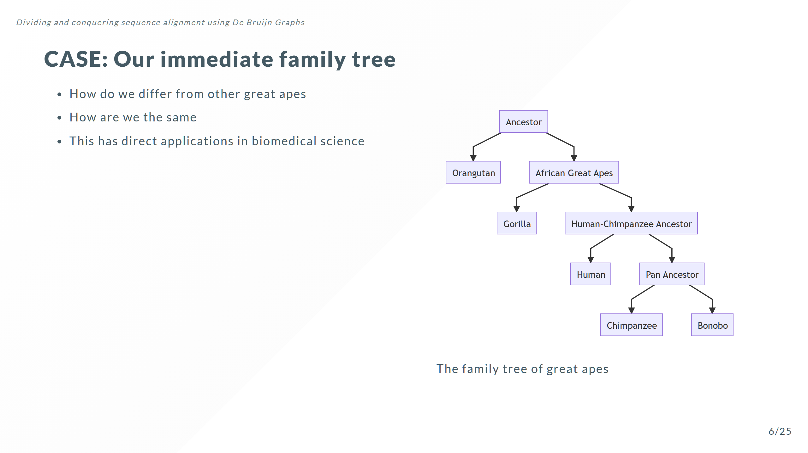
Notes:
This ability to decompose history can be applied to proteins like RuBisCO, it can be applied to viruses, it can be applied to our own evolution. Alignment is integral to all of these

Slide 15
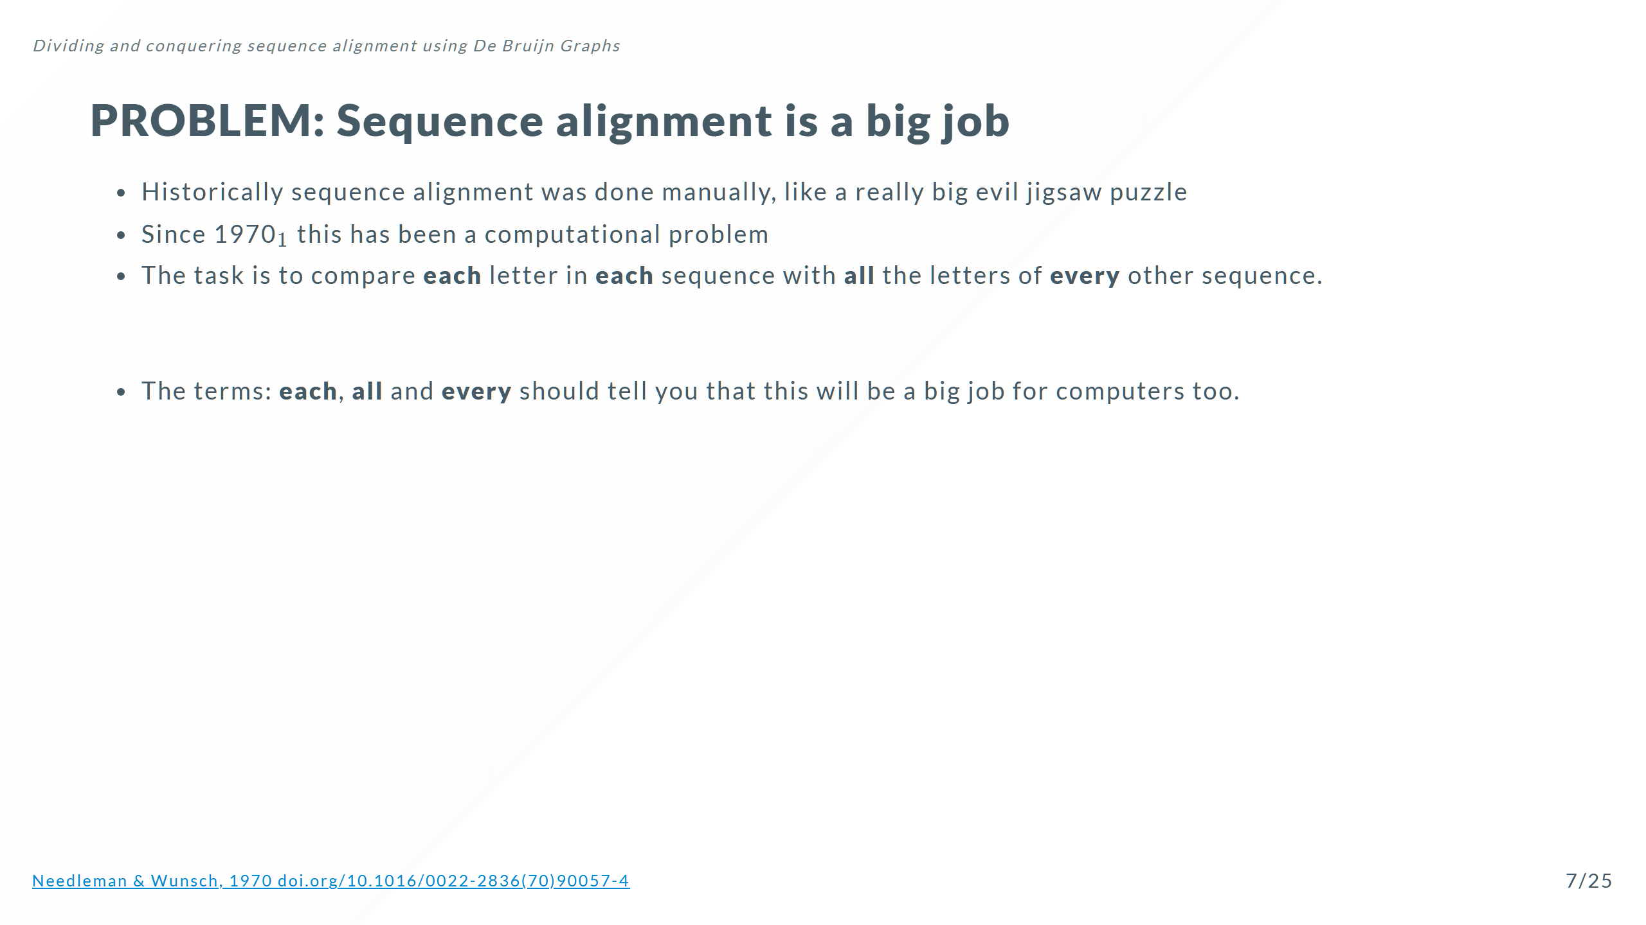

Slide 16
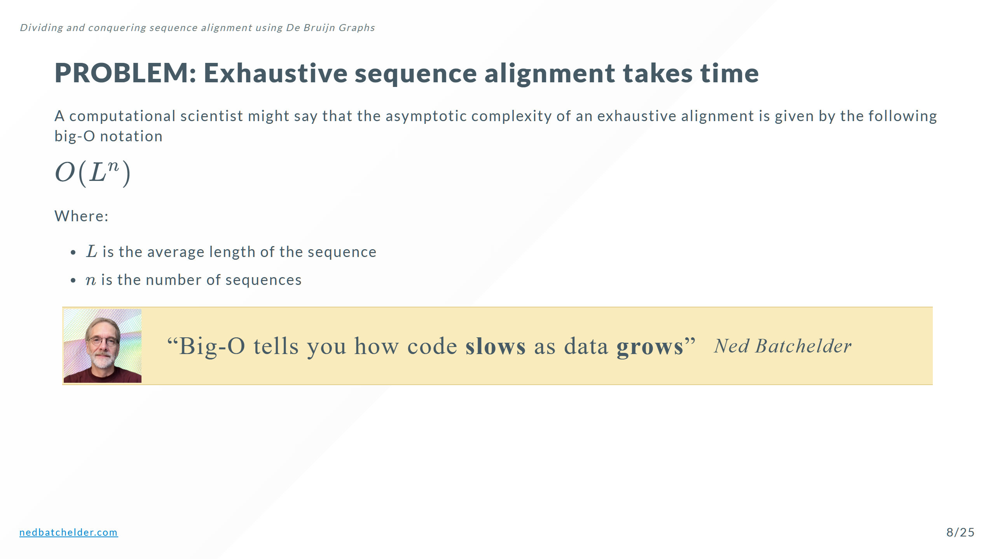

Slide 17
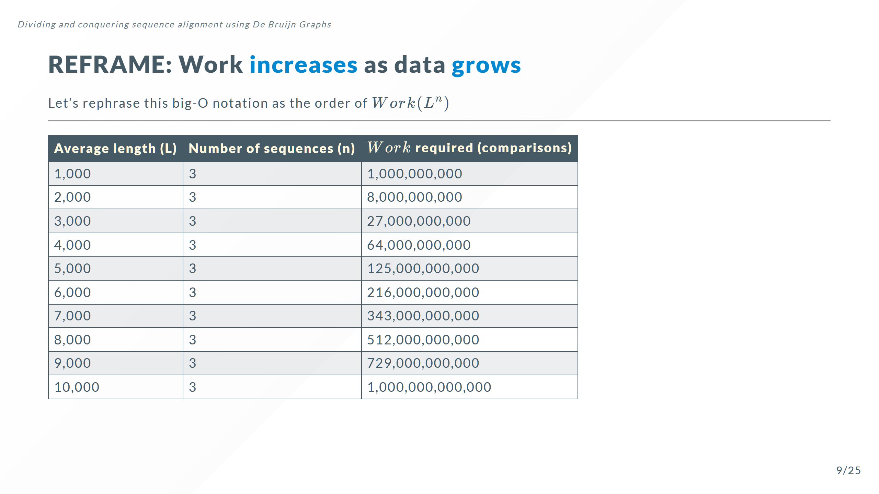

Slide 18
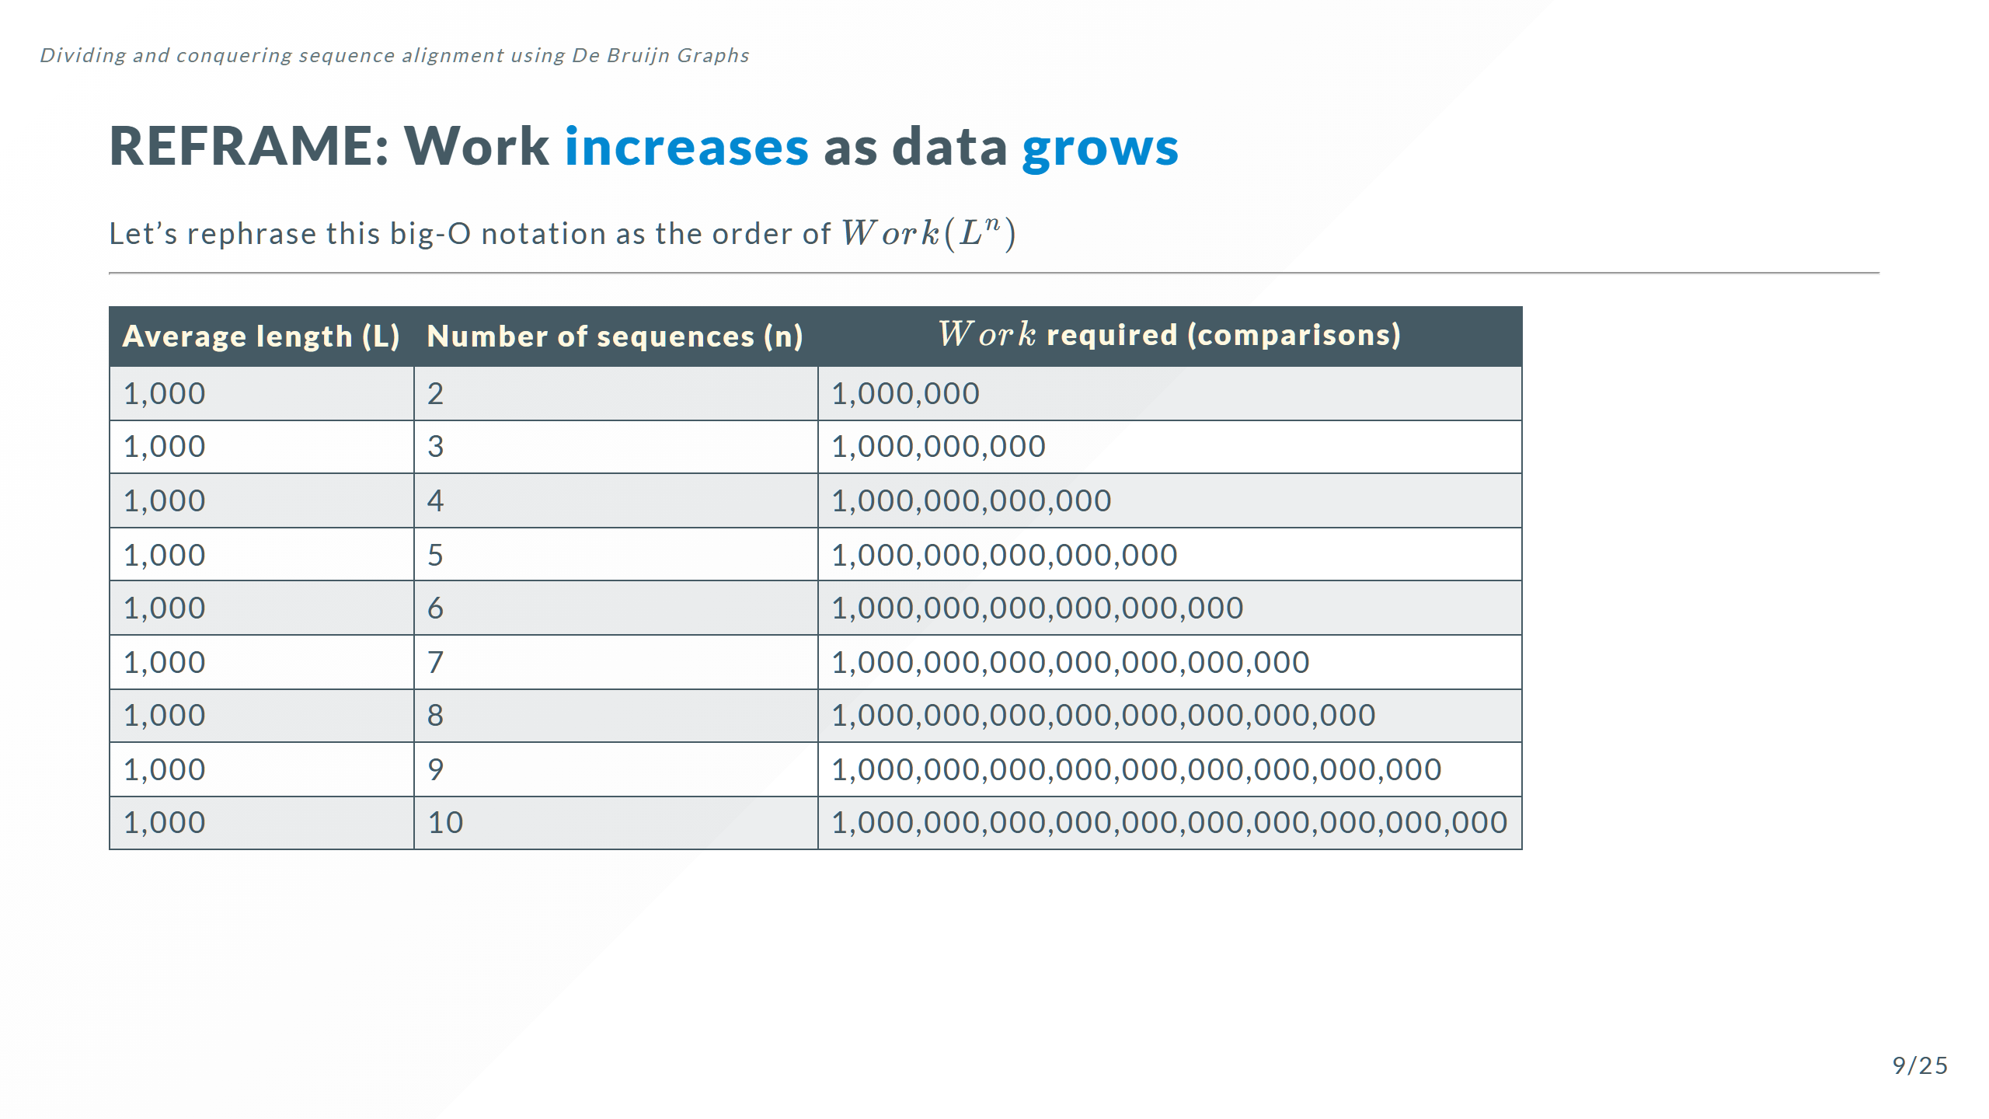
Notes:
I want you to notice this is just 10 sequences

Slide 19
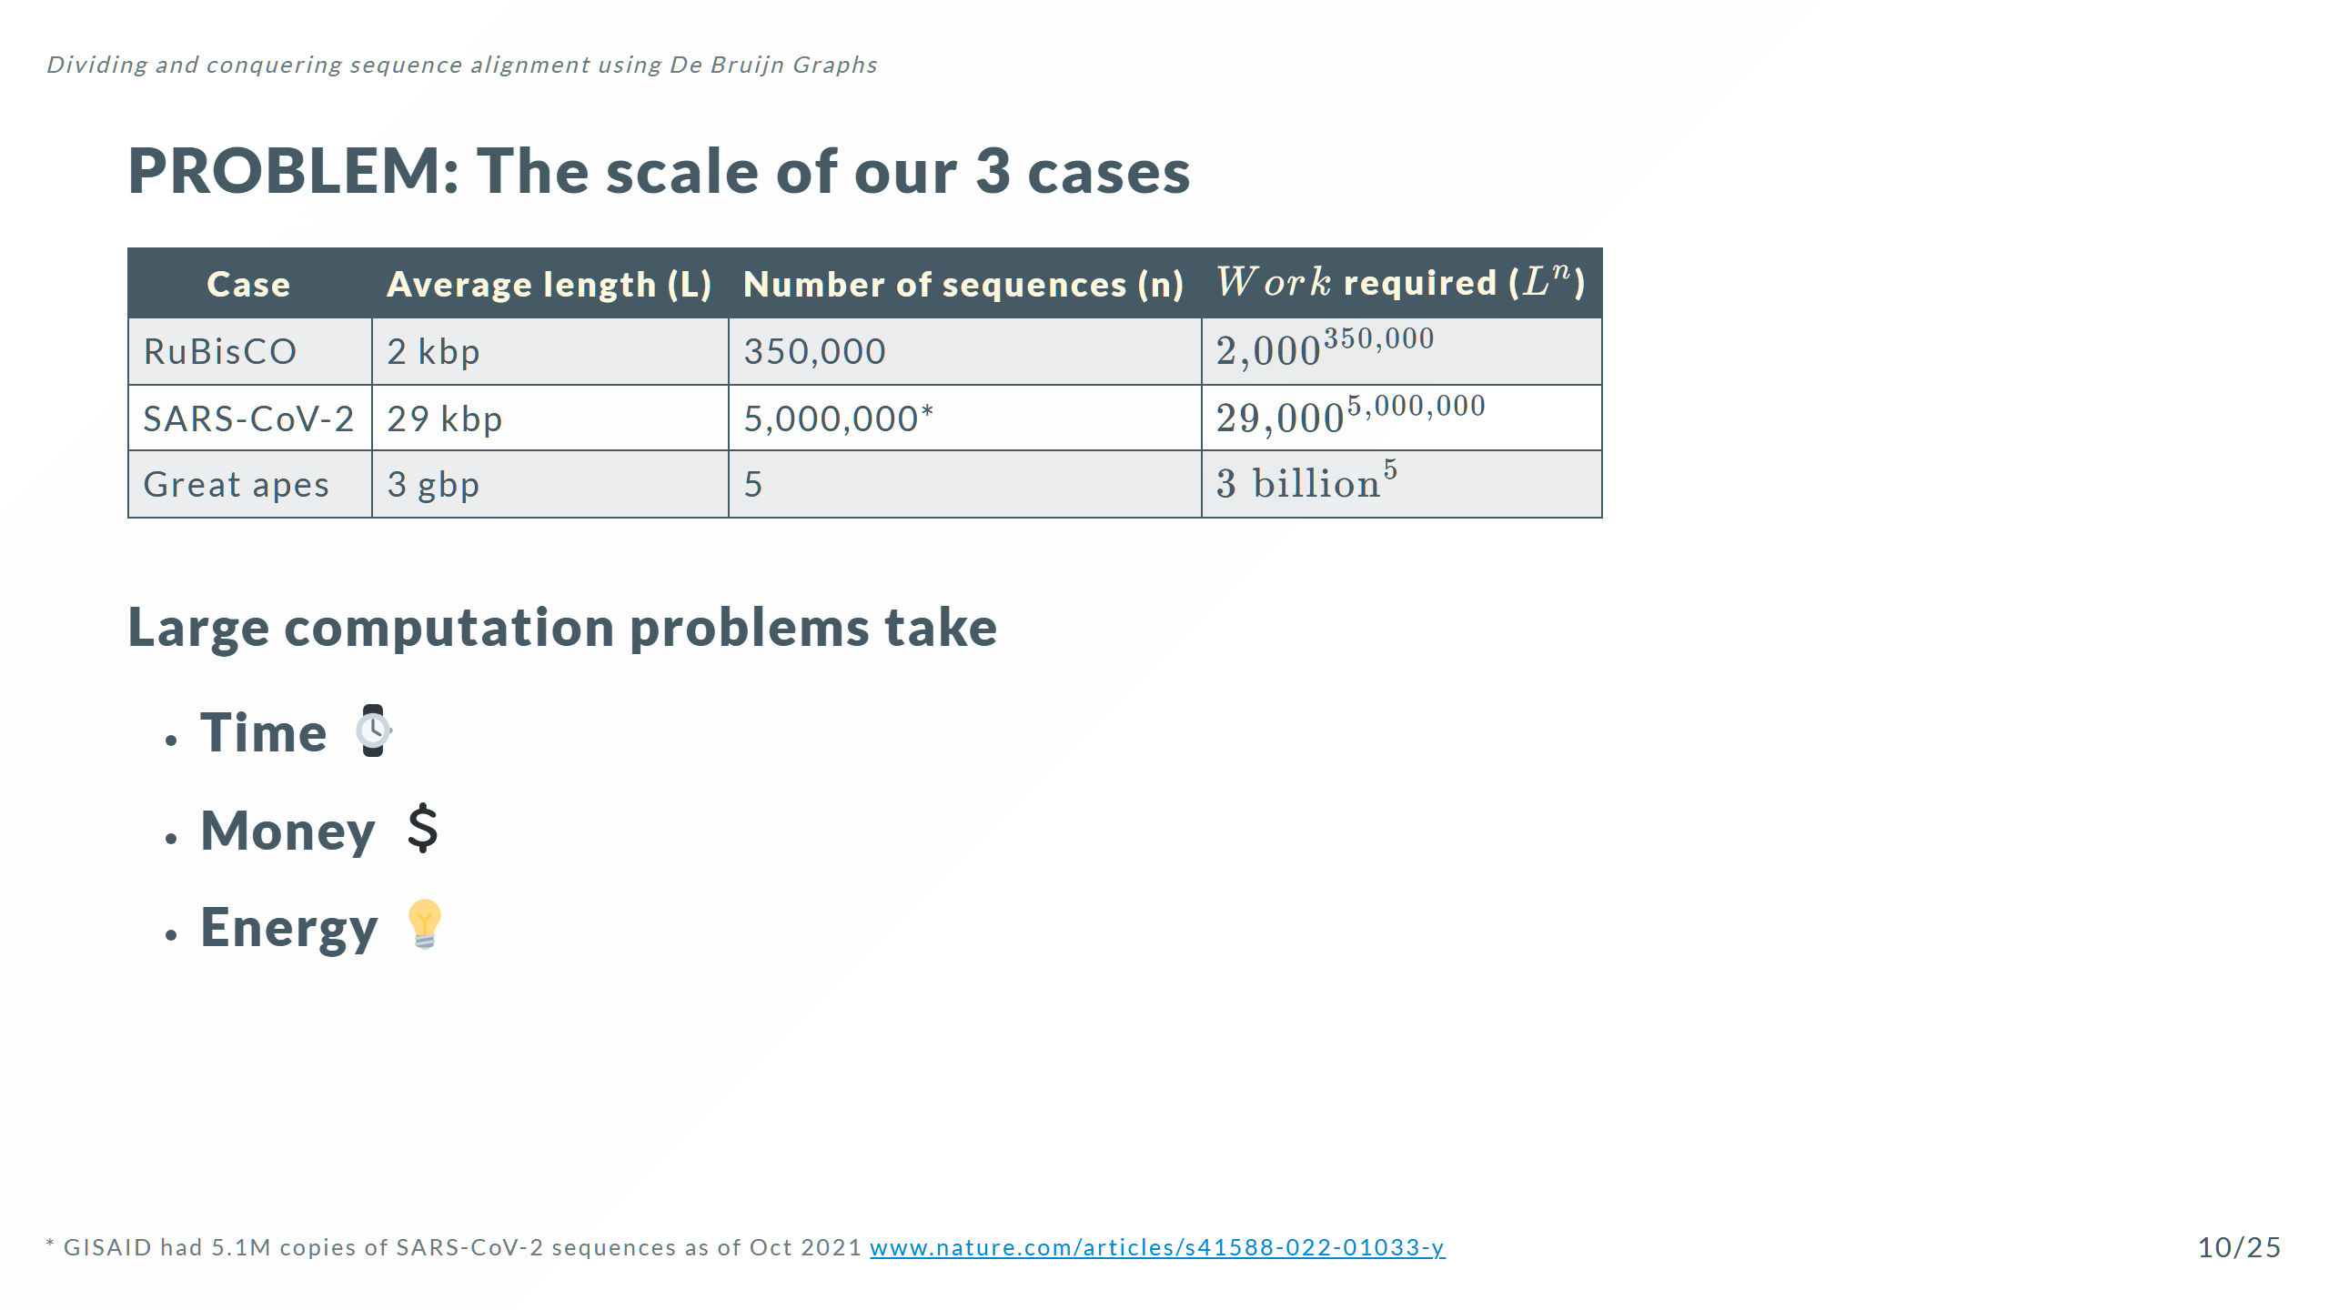
Notes:
Note: The genes that produce the 2 subunits of RuBisCO are ~1500 and ~500 bp respectively but the genomes of species that can make RuBisCO can be 1.5 mbp - 150 gbp long

Slide 20


Slide 21


Slide 22
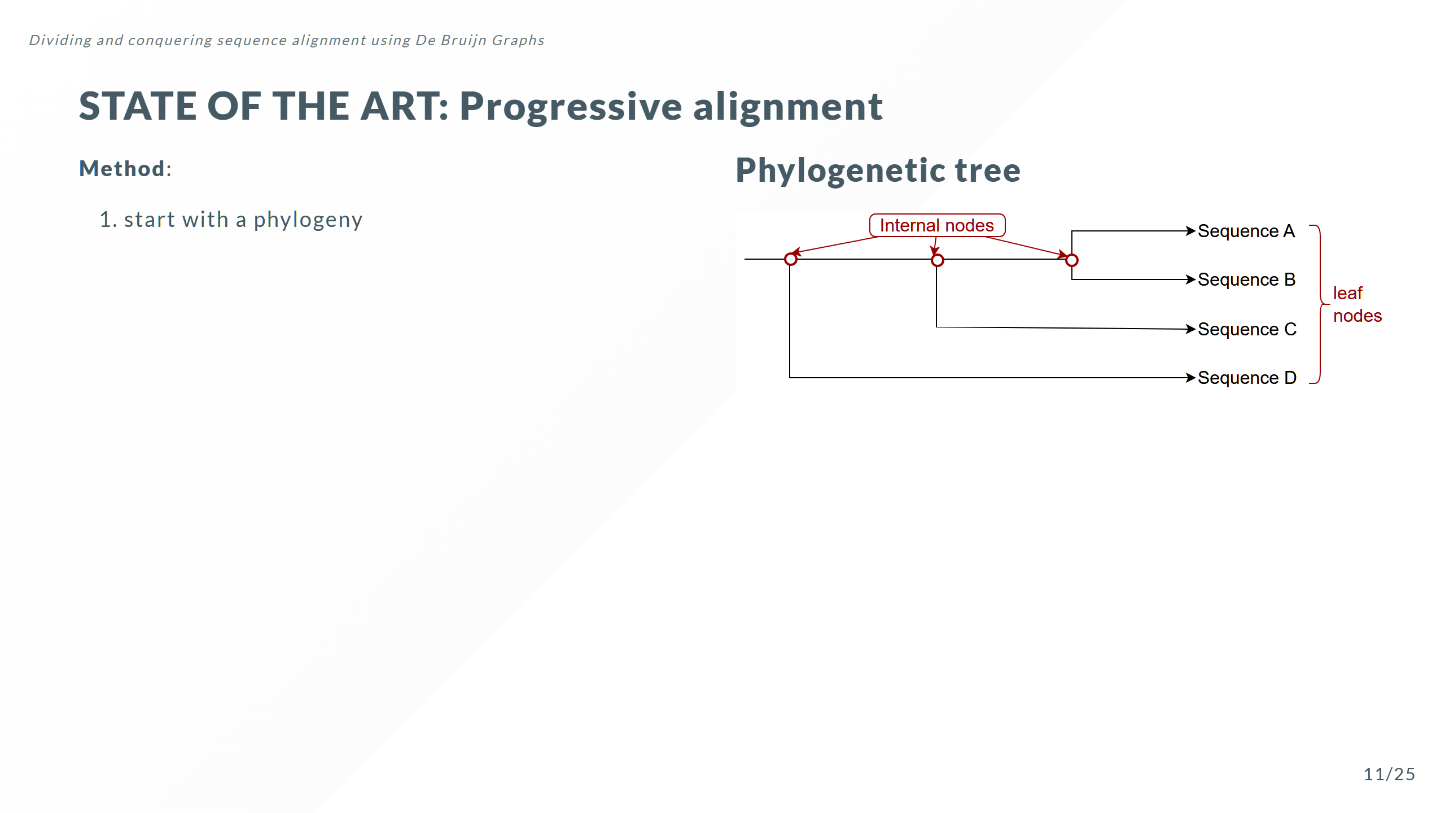

Slide 23
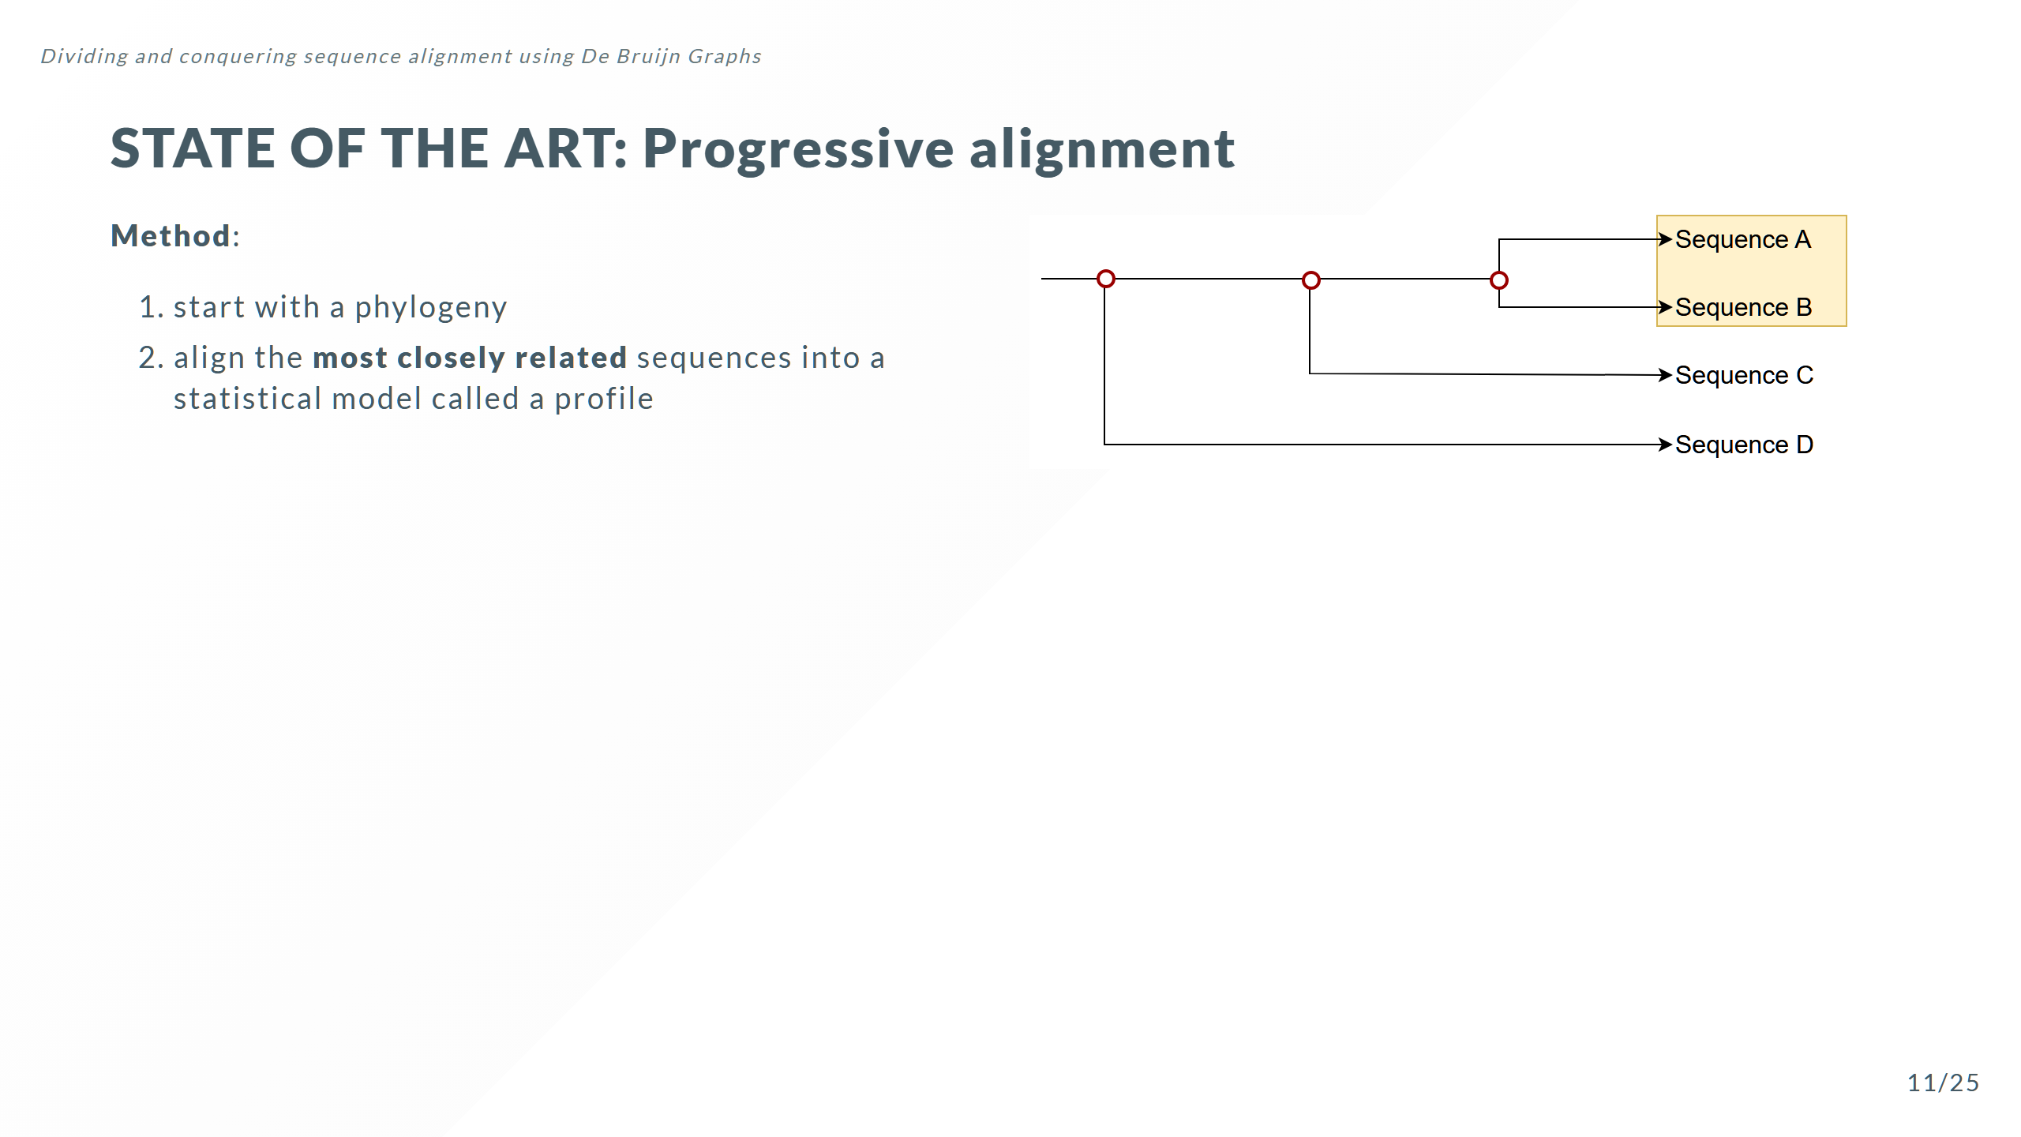

Slide 24
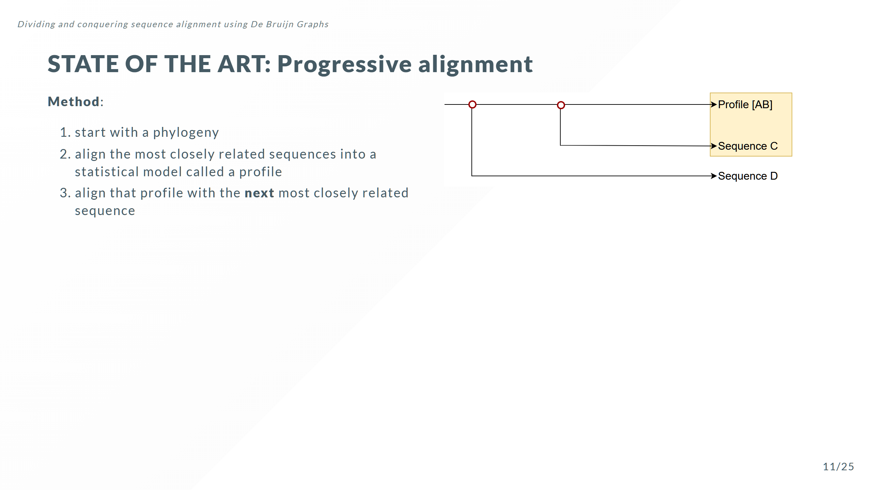

Slide 25
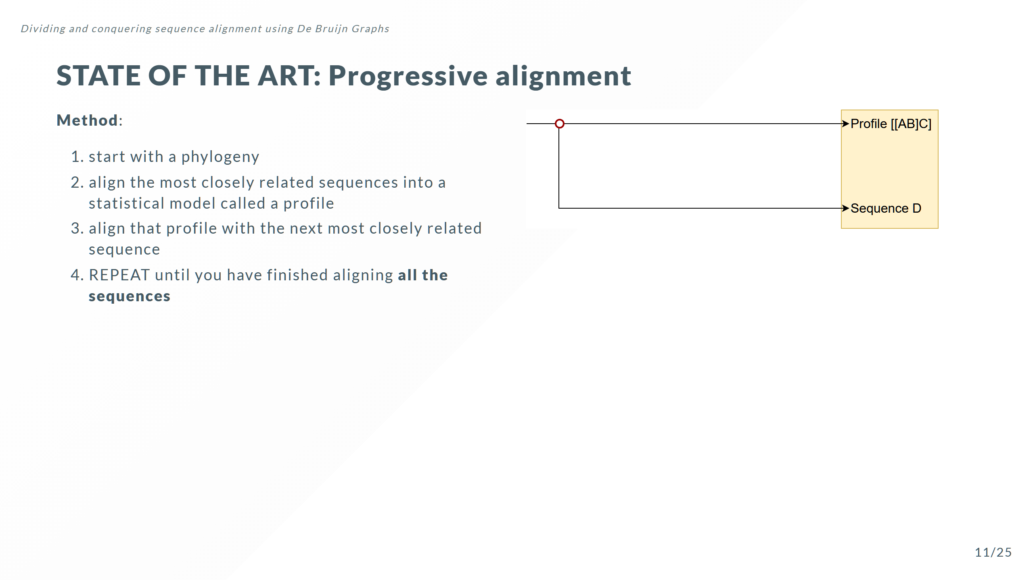

Slide 26
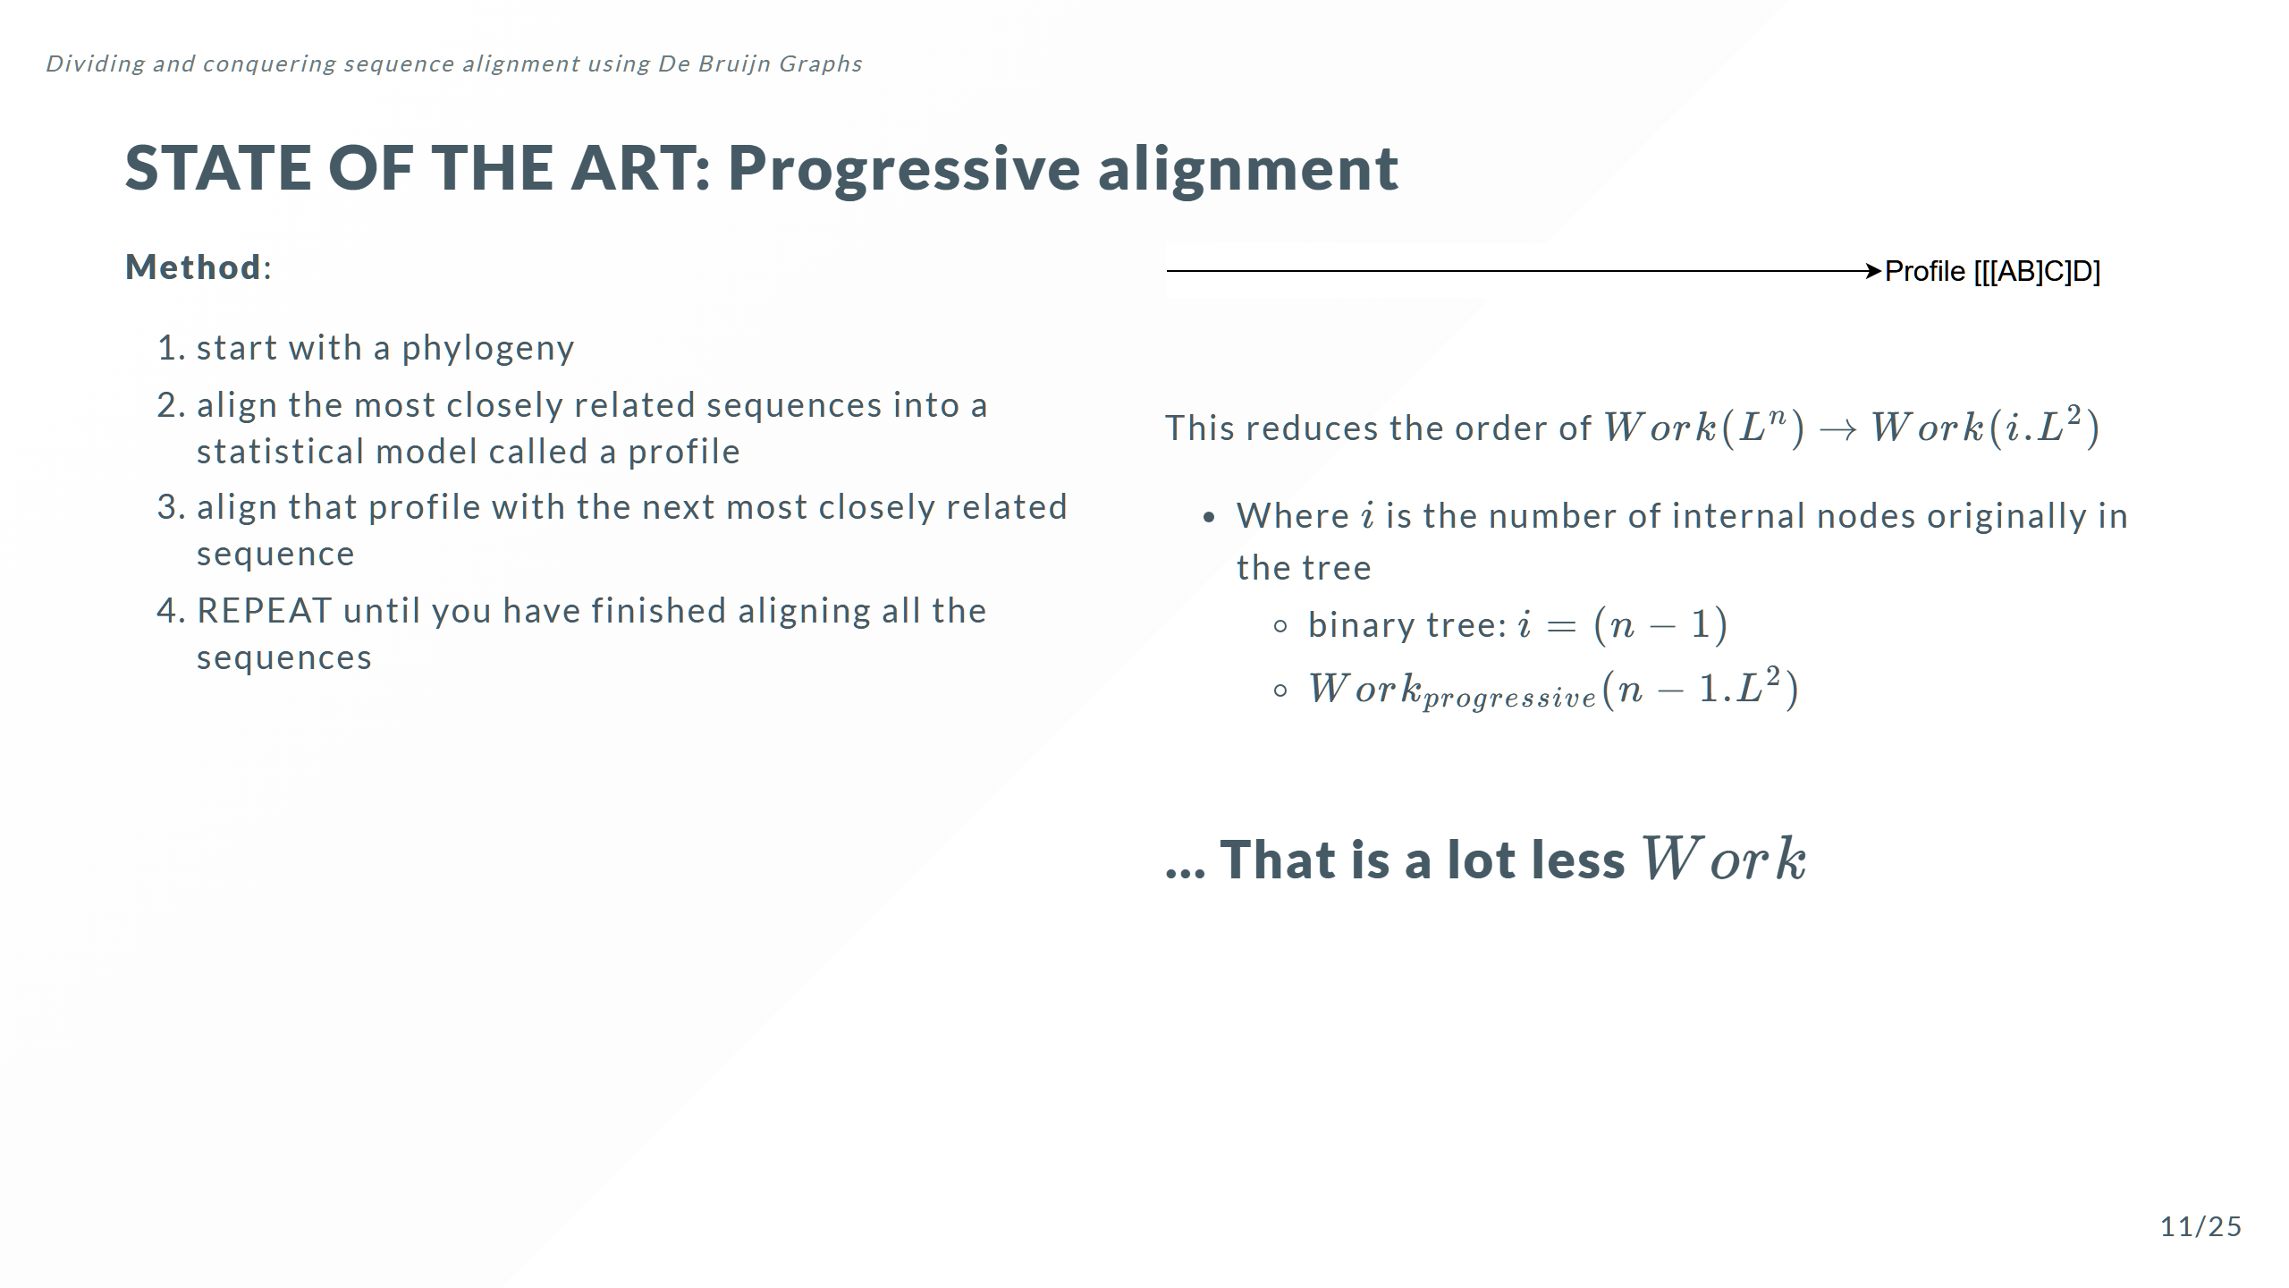
Notes:
Progressive alignment with a guide tree is used because it gives better results because insertion deletion events occur on the tree. So the statistical performance of this approach is better than alternative methods.

Slide 27
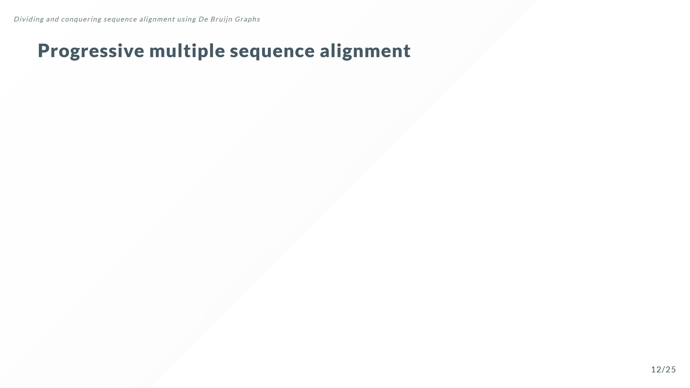

Slide 28


Slide 29
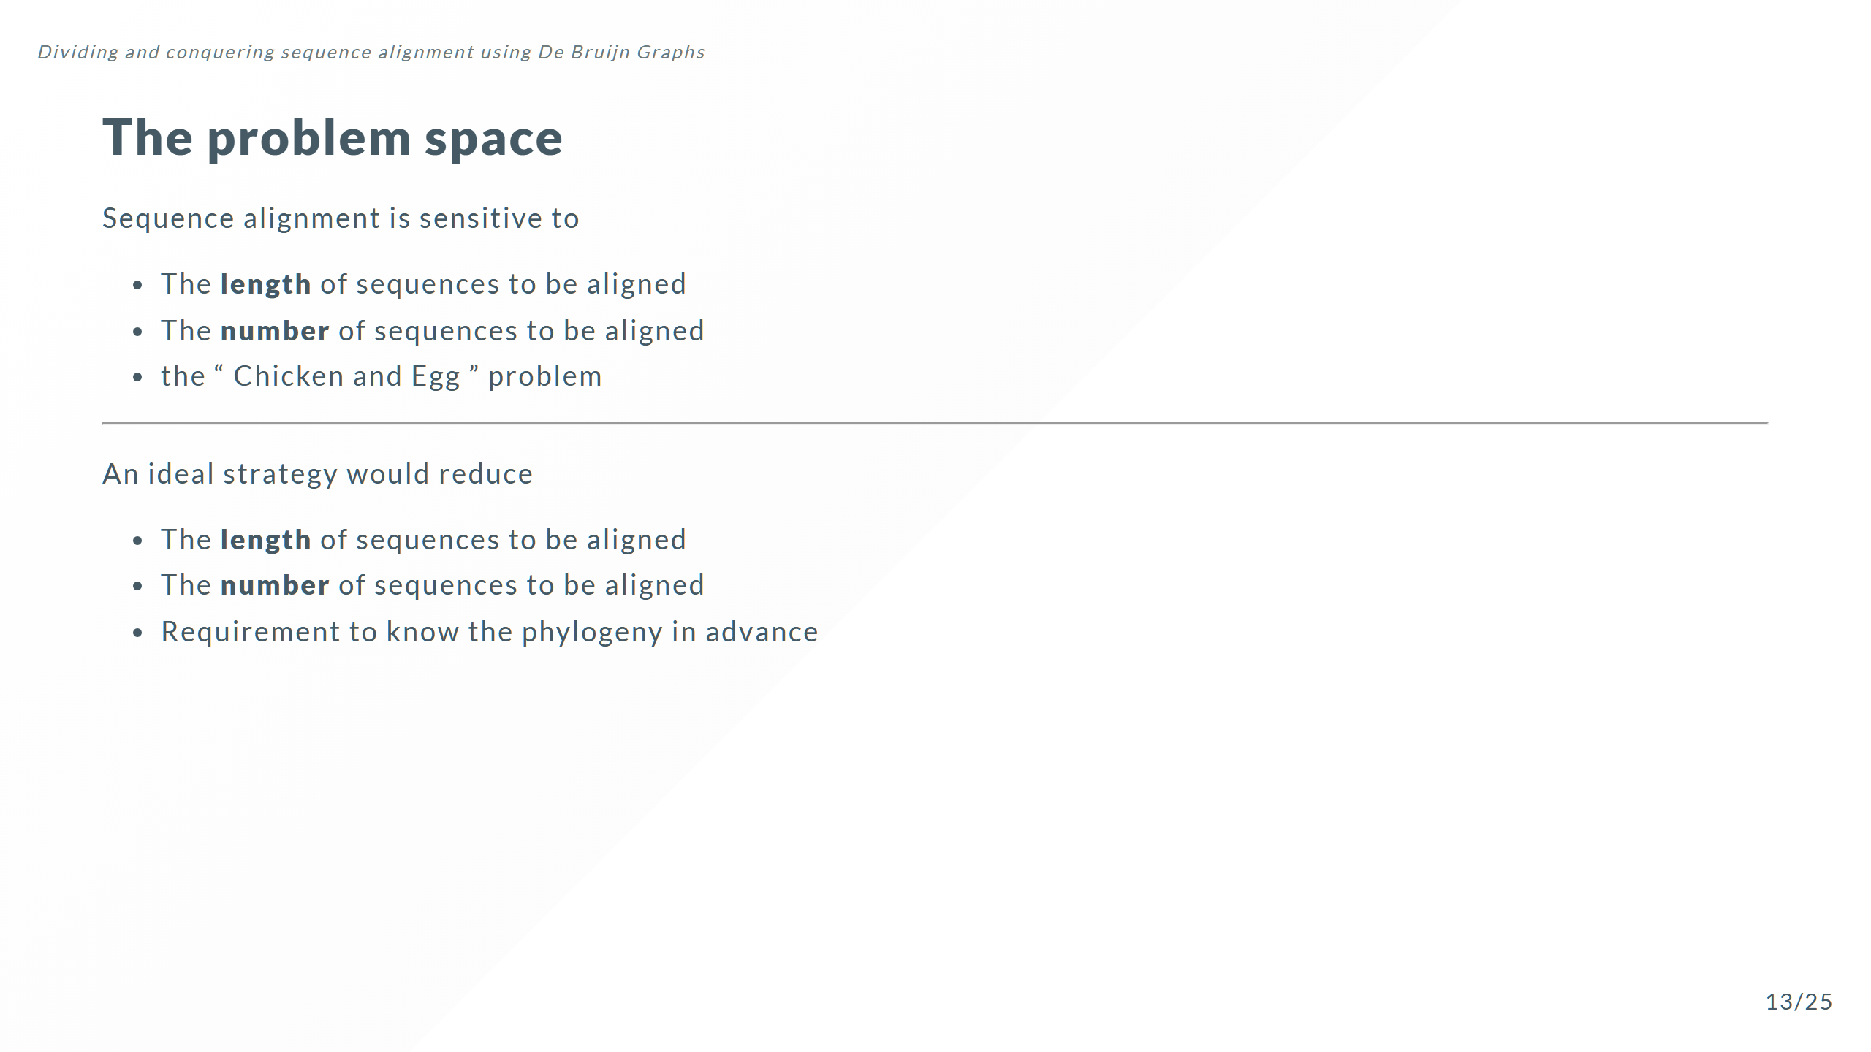
Notes:
Can we reproduce the same statistical behaviour while doing less work

Slide 30
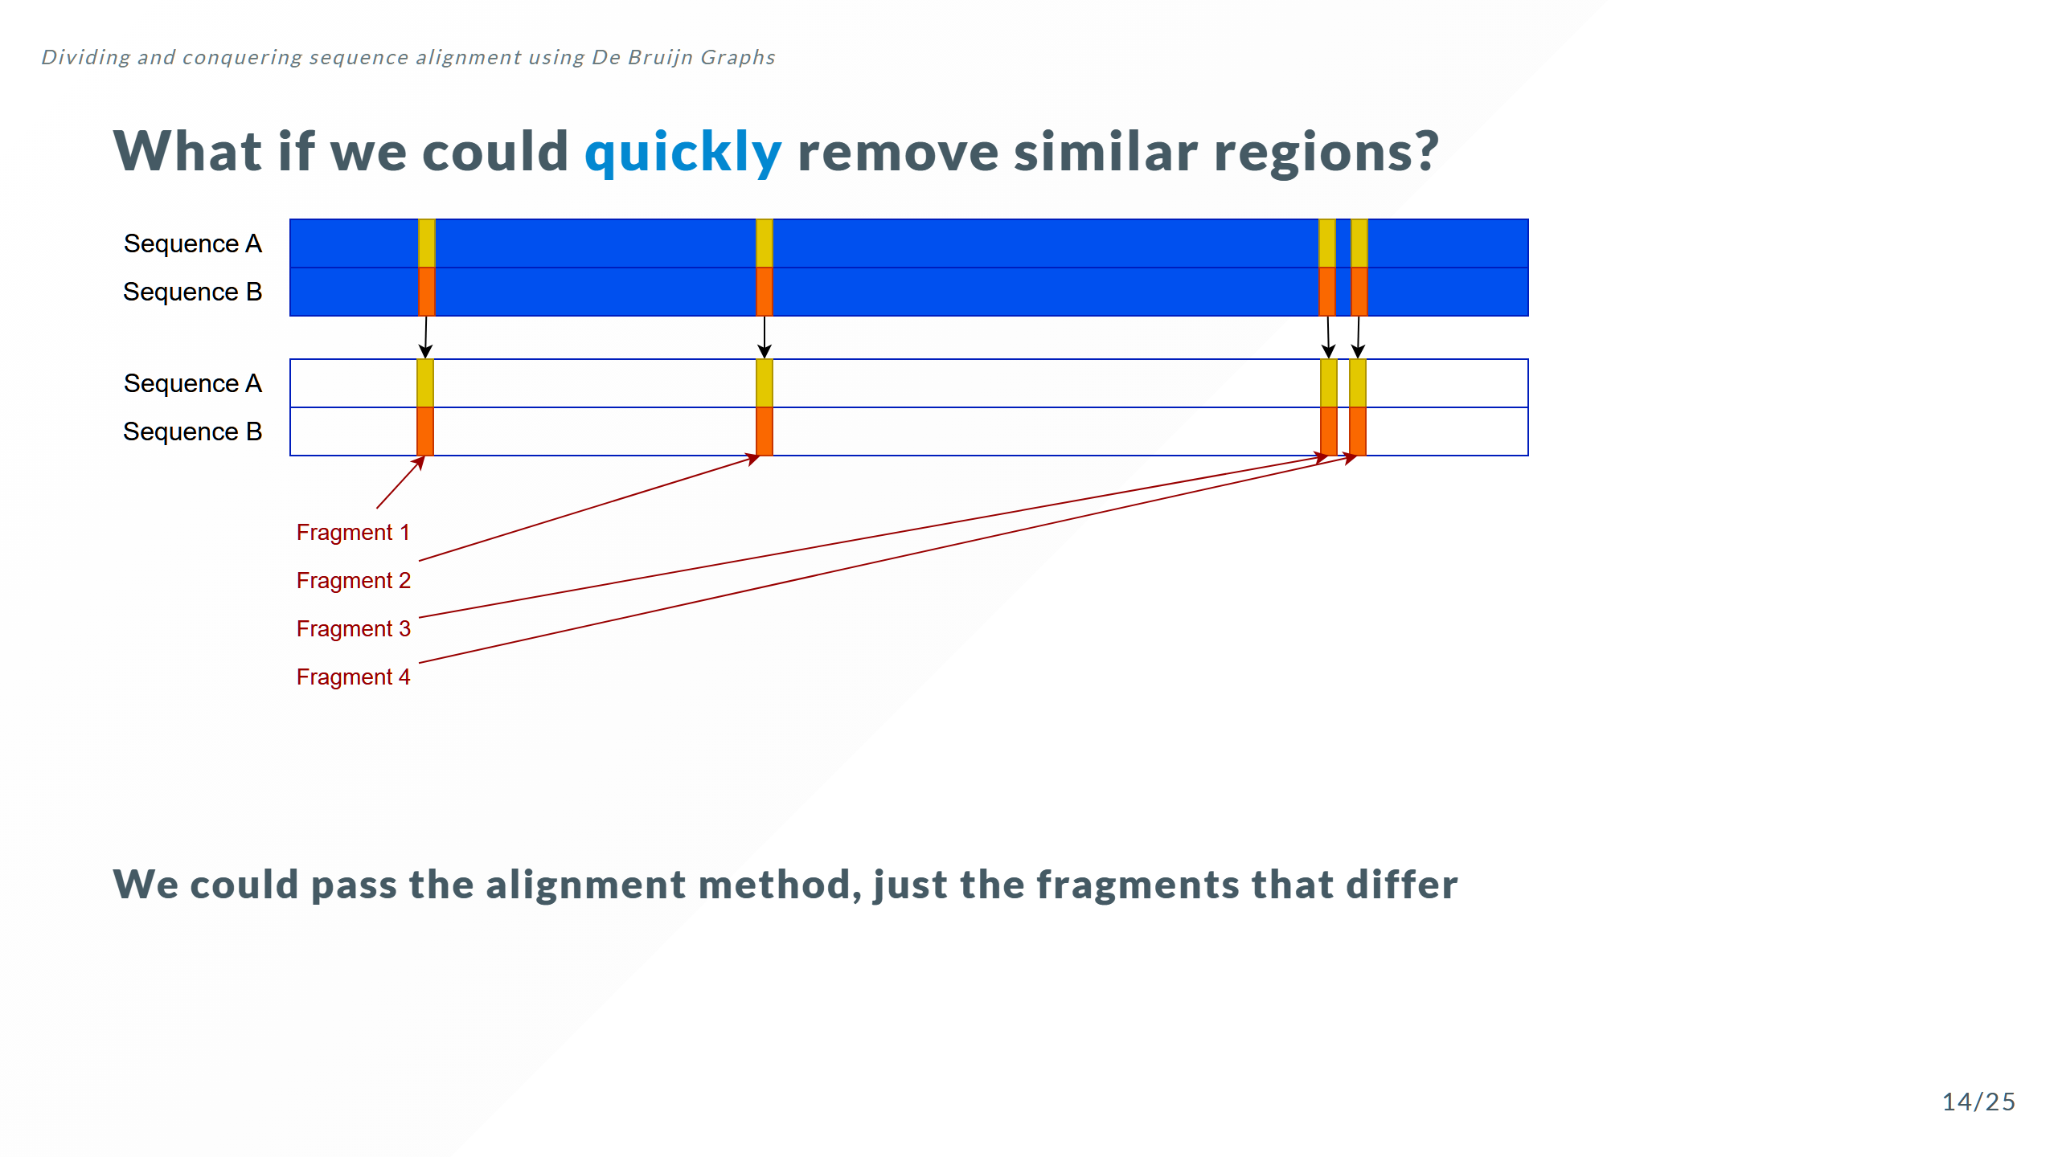

Slide 31
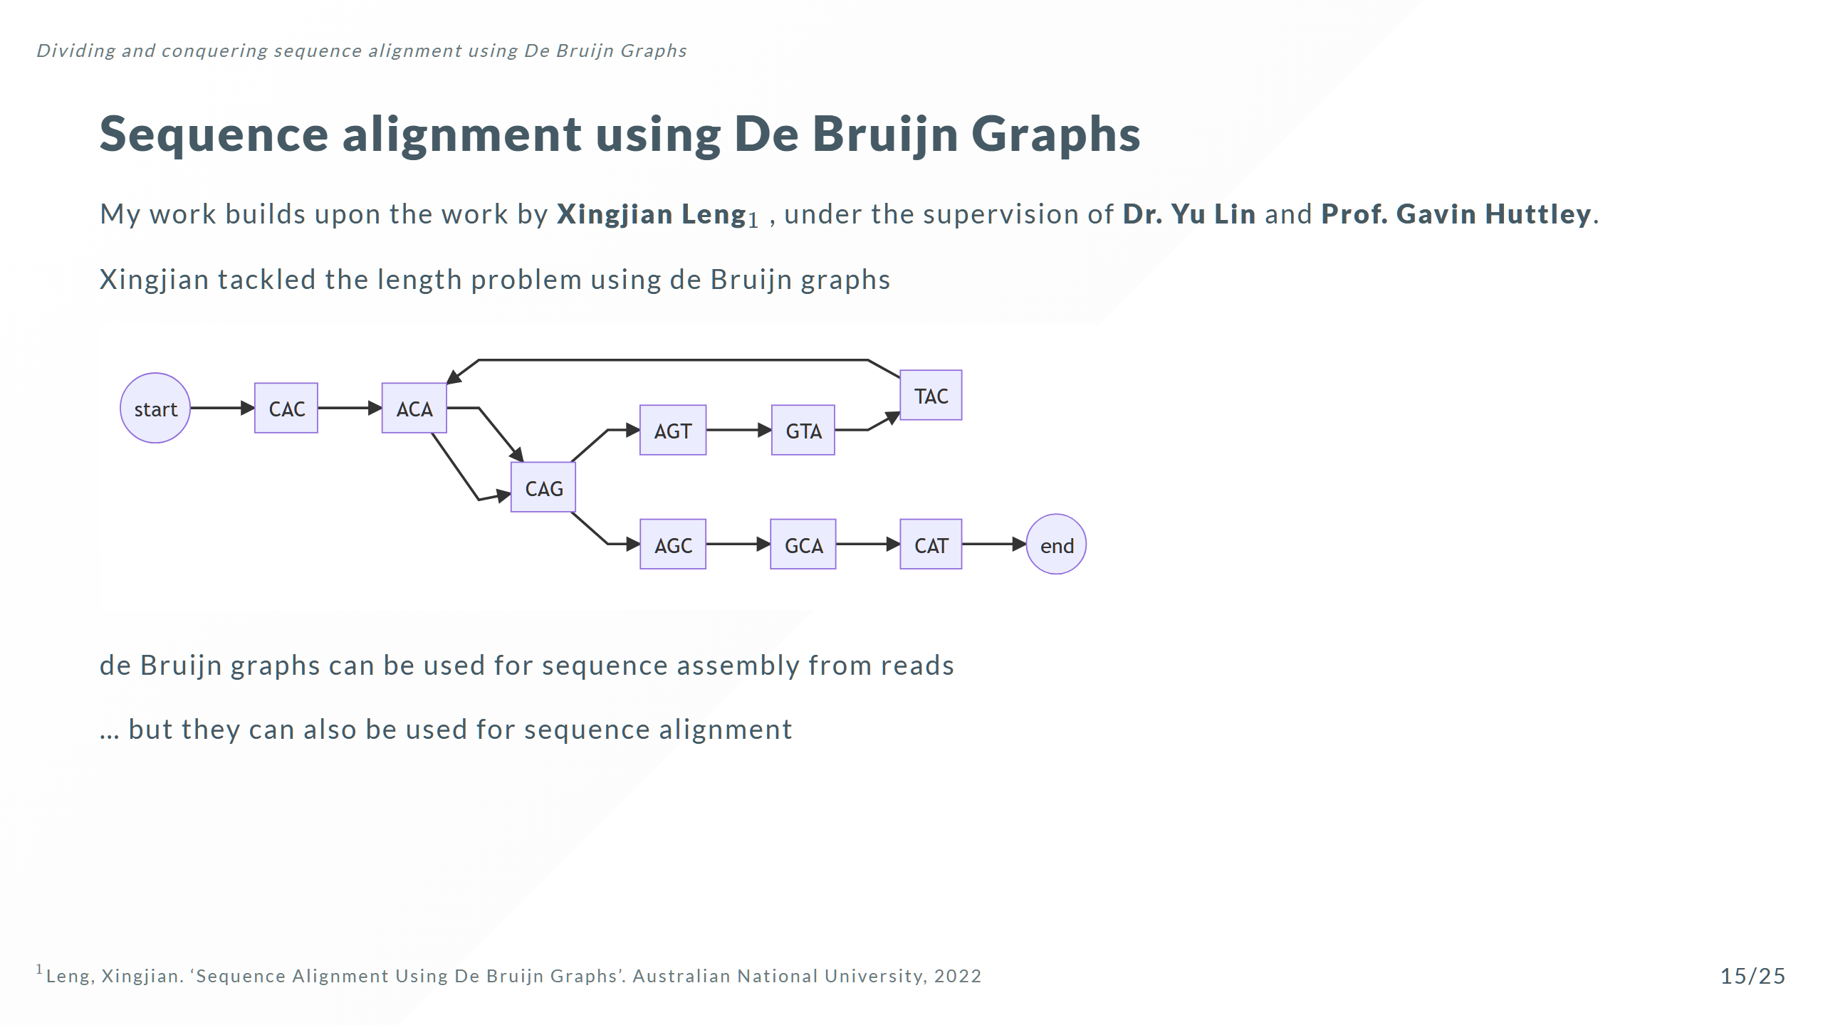

Slide 32
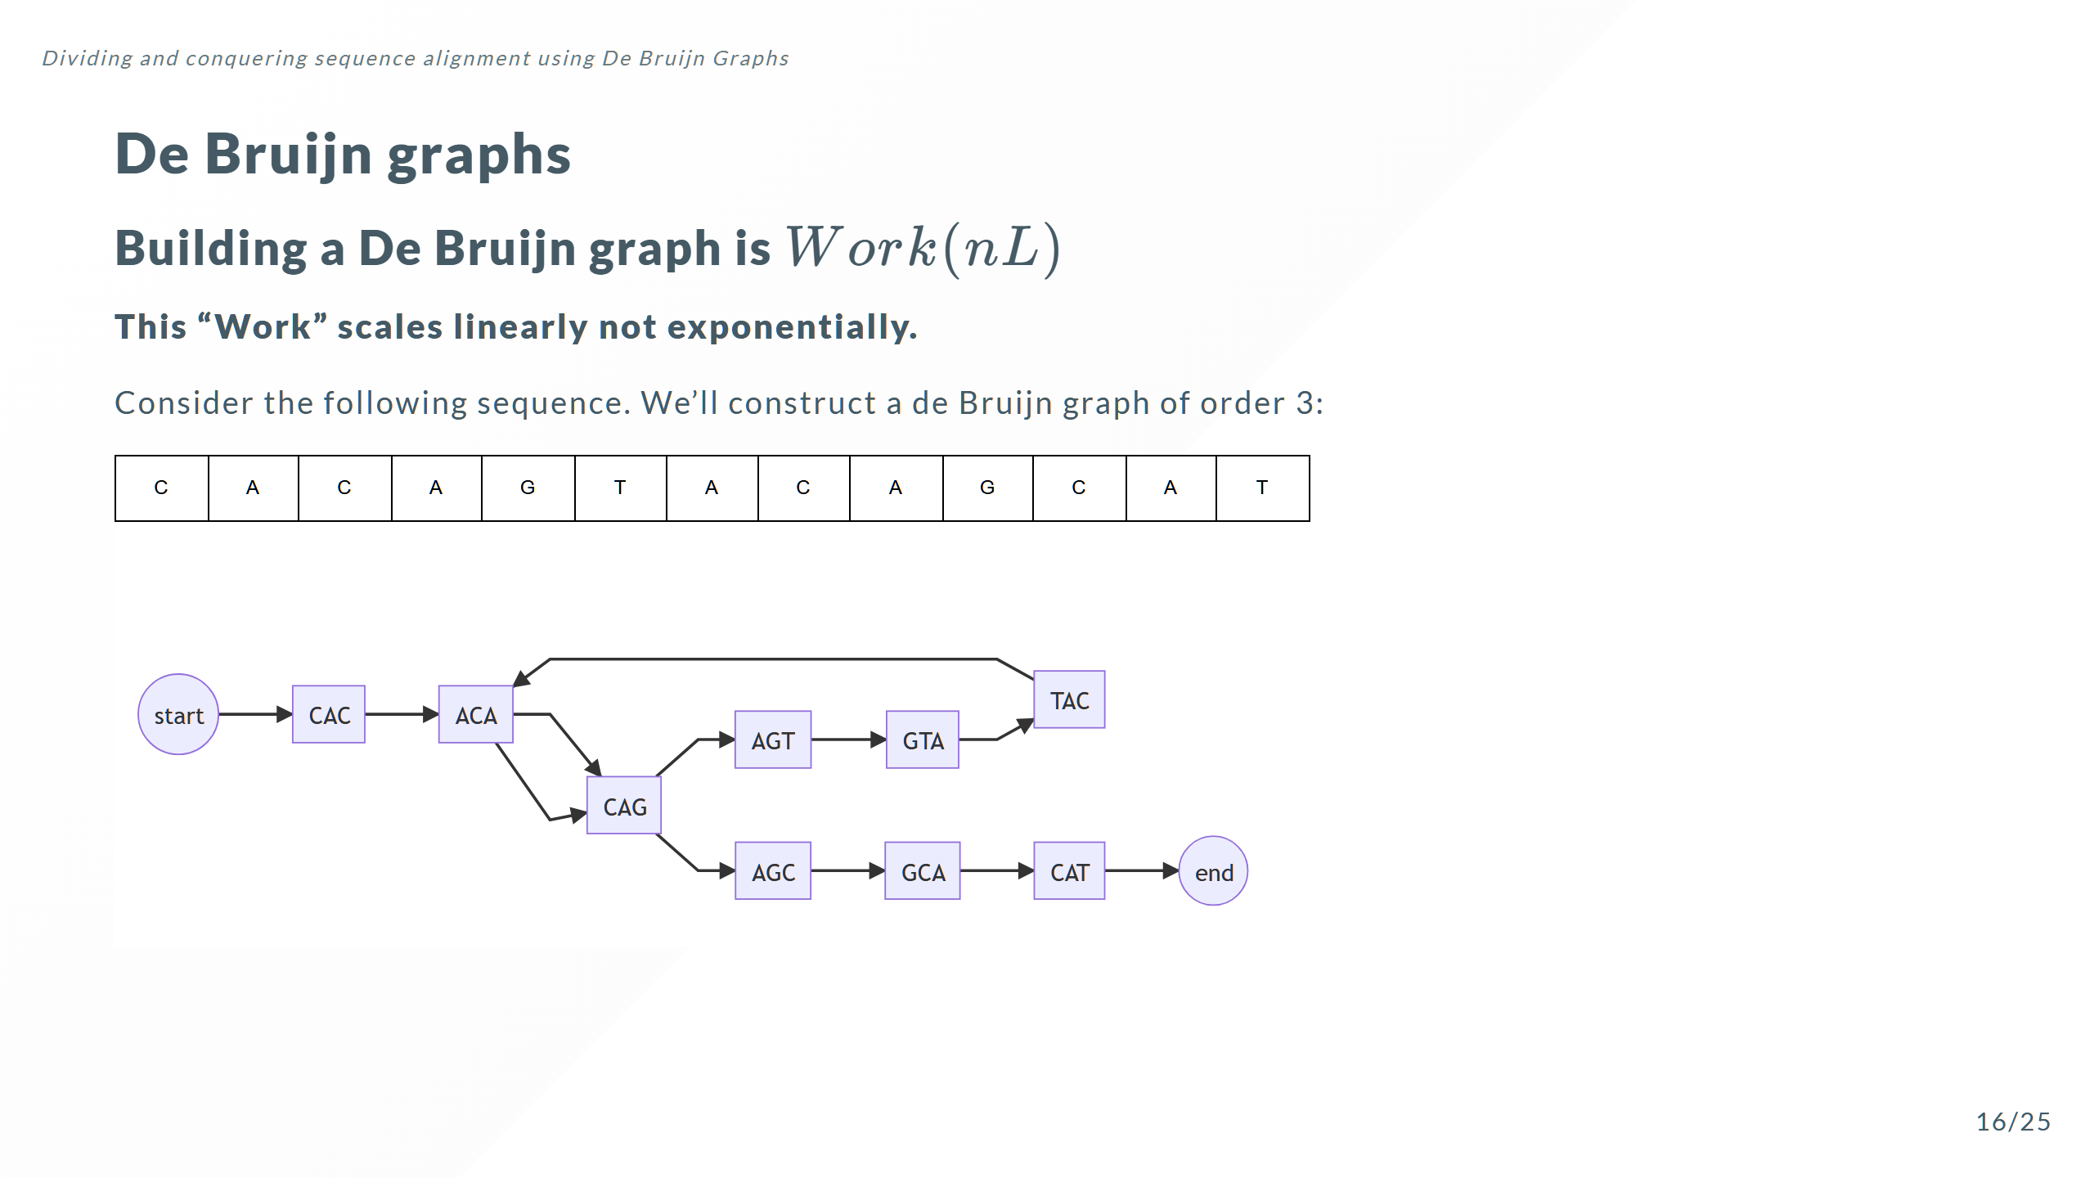

Slide 33
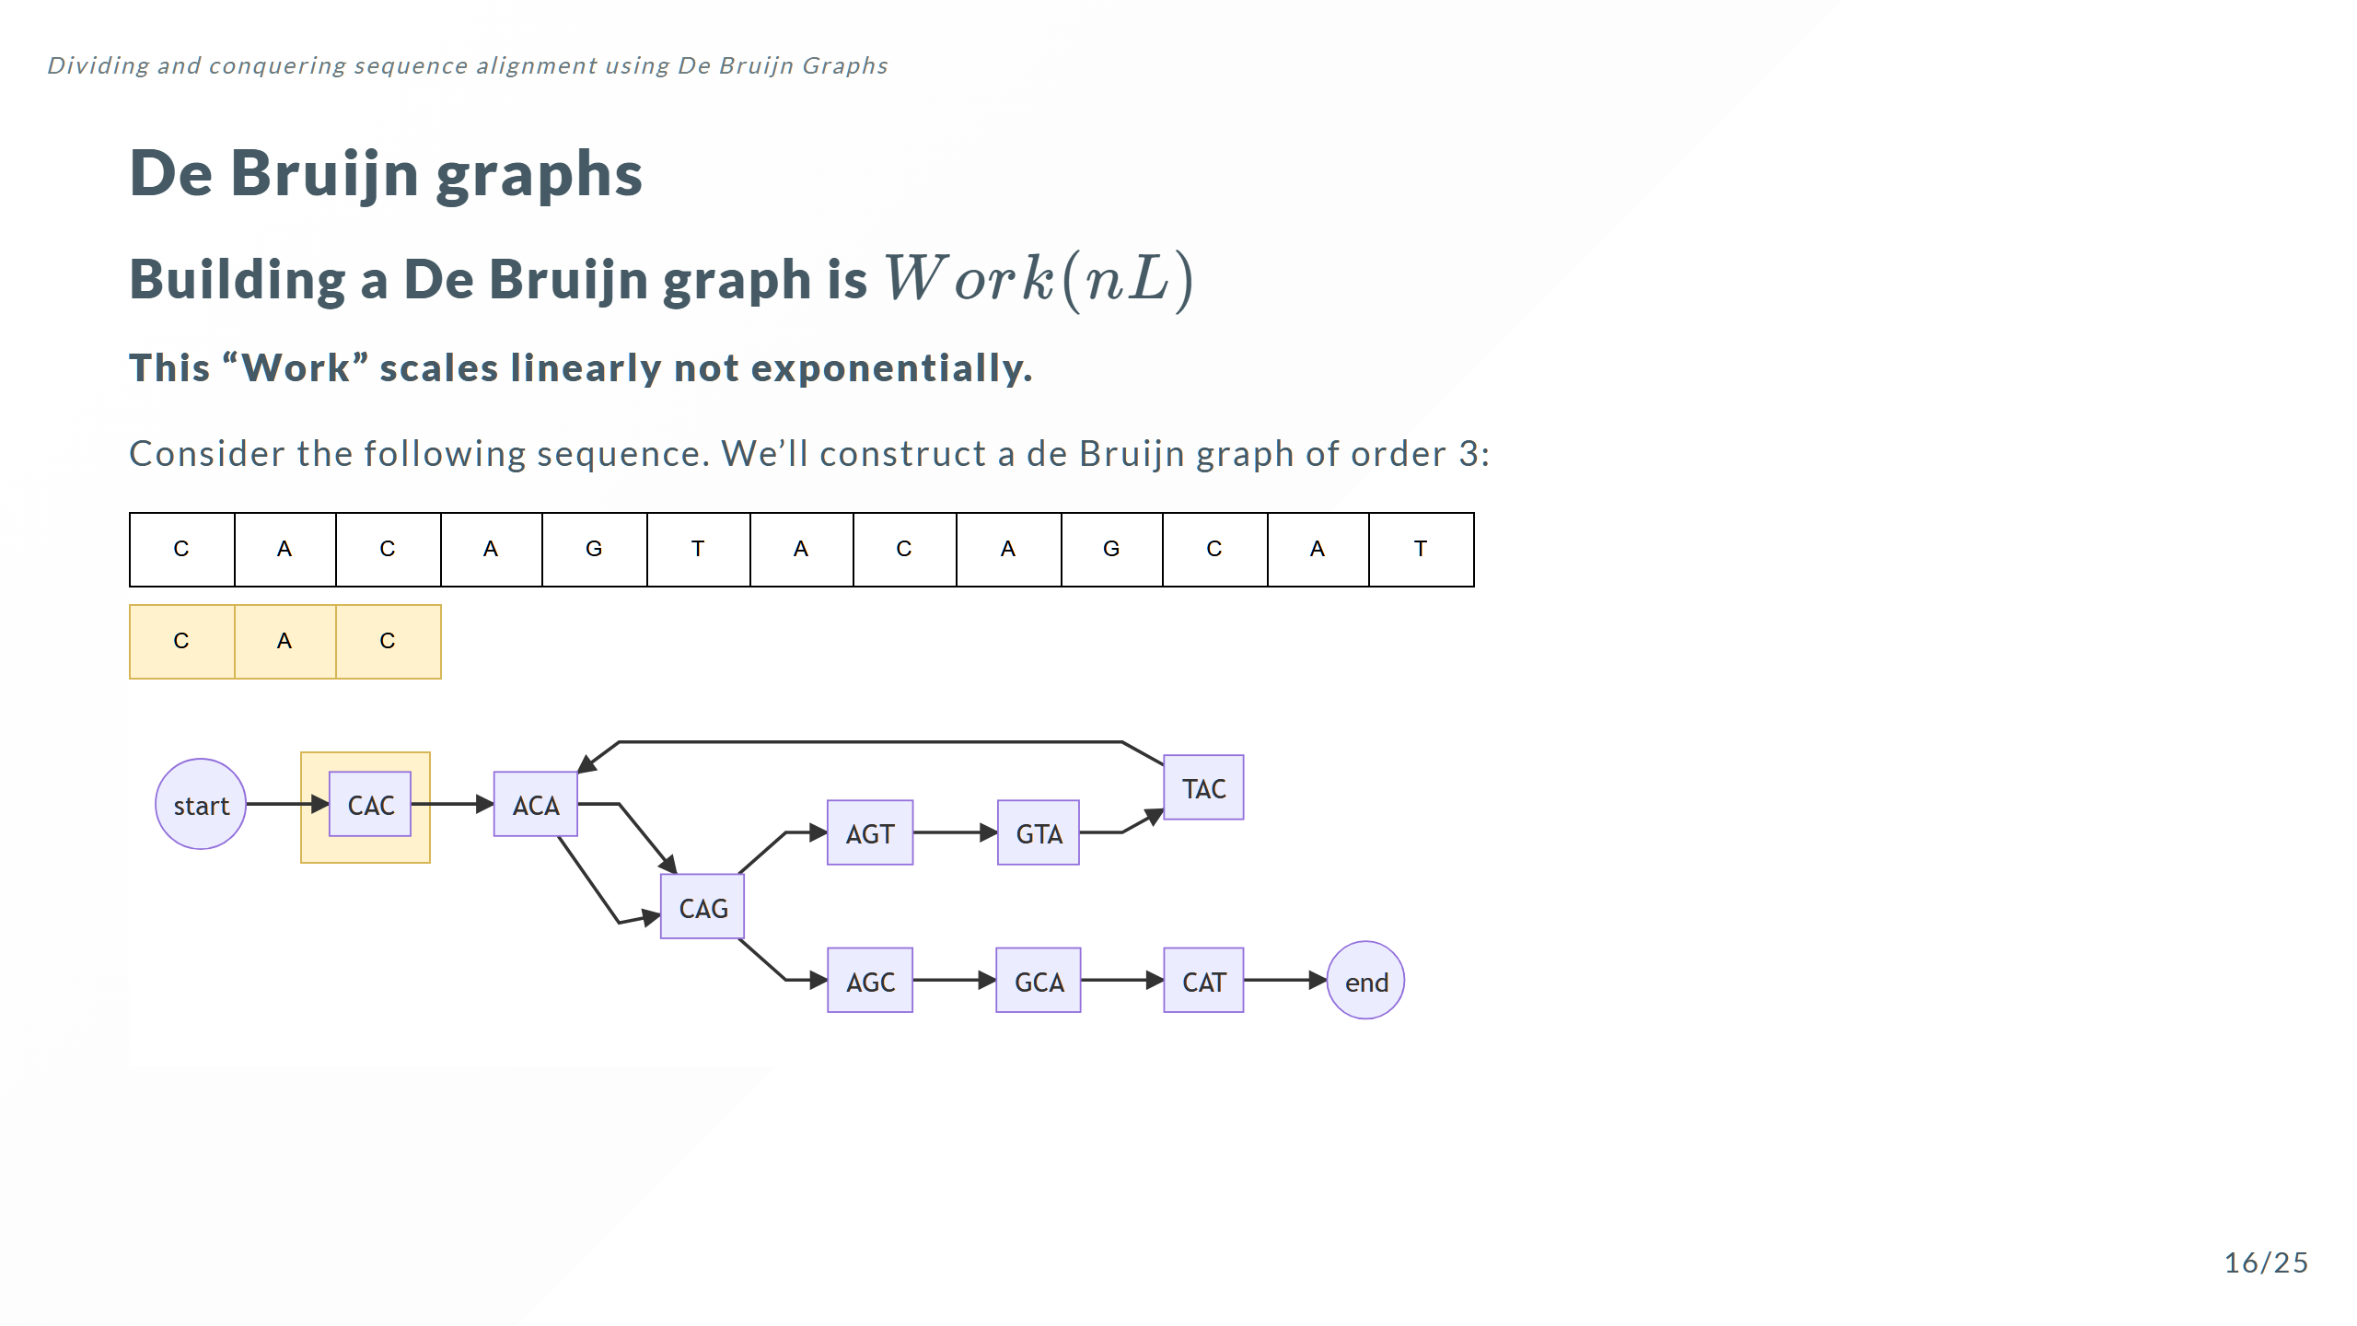

Slide 34
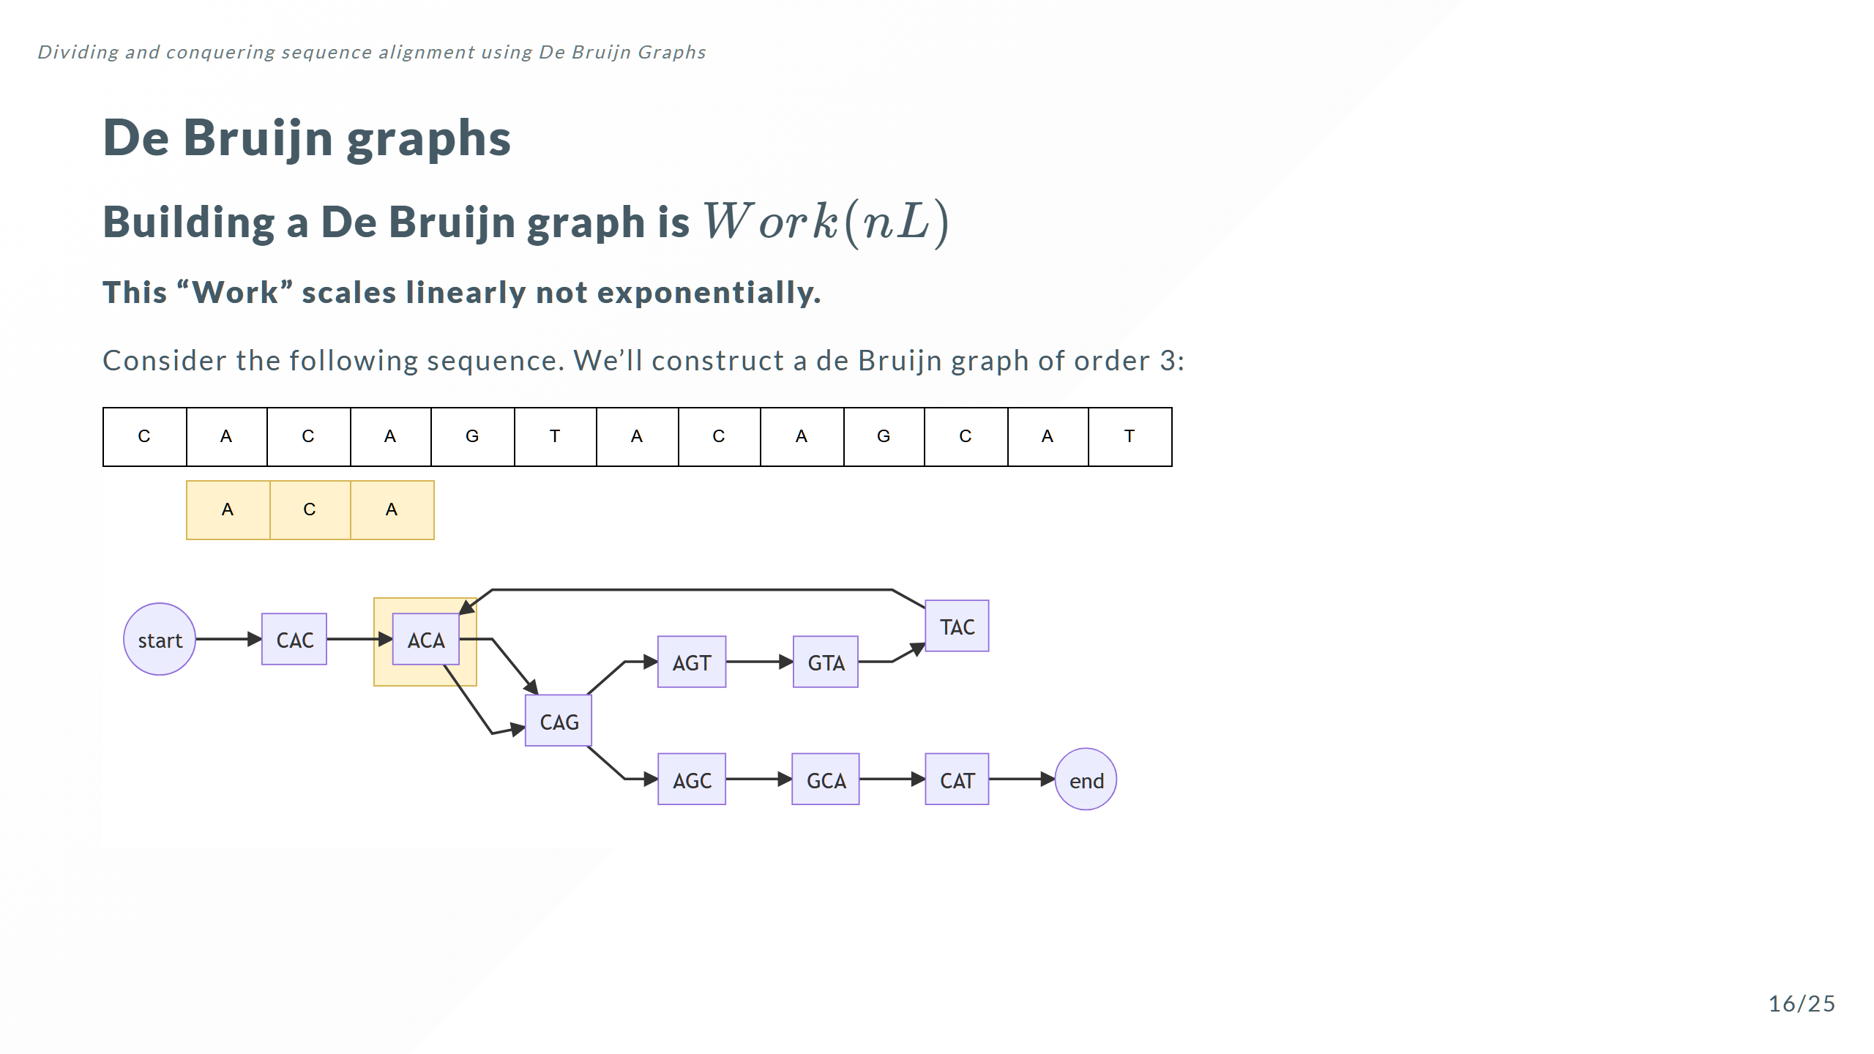

Slide 35
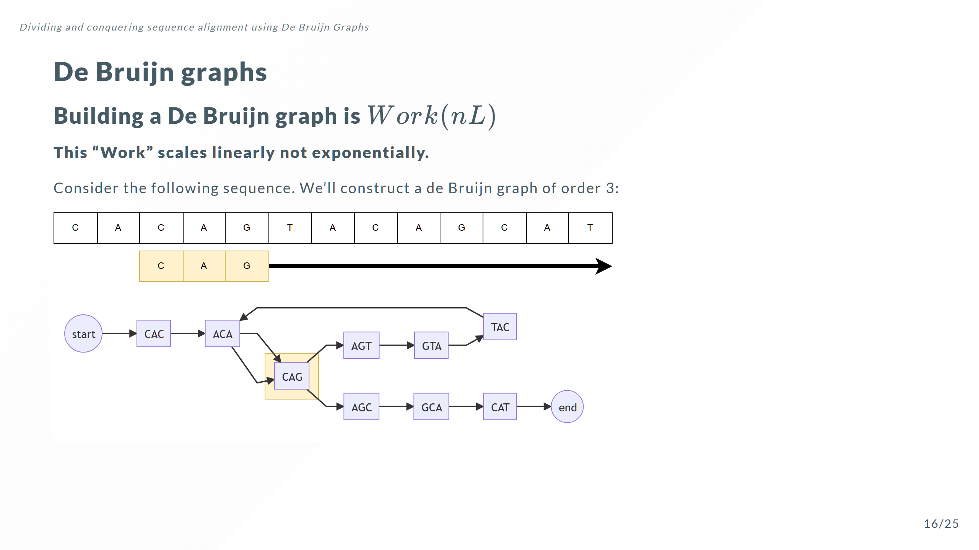

Slide 36
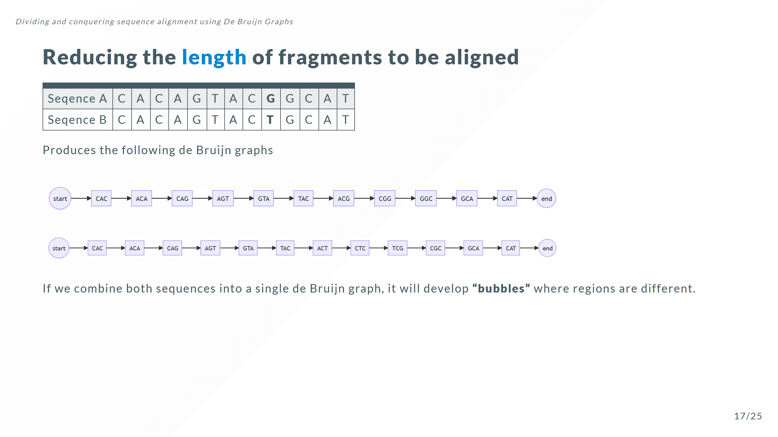

Slide 37
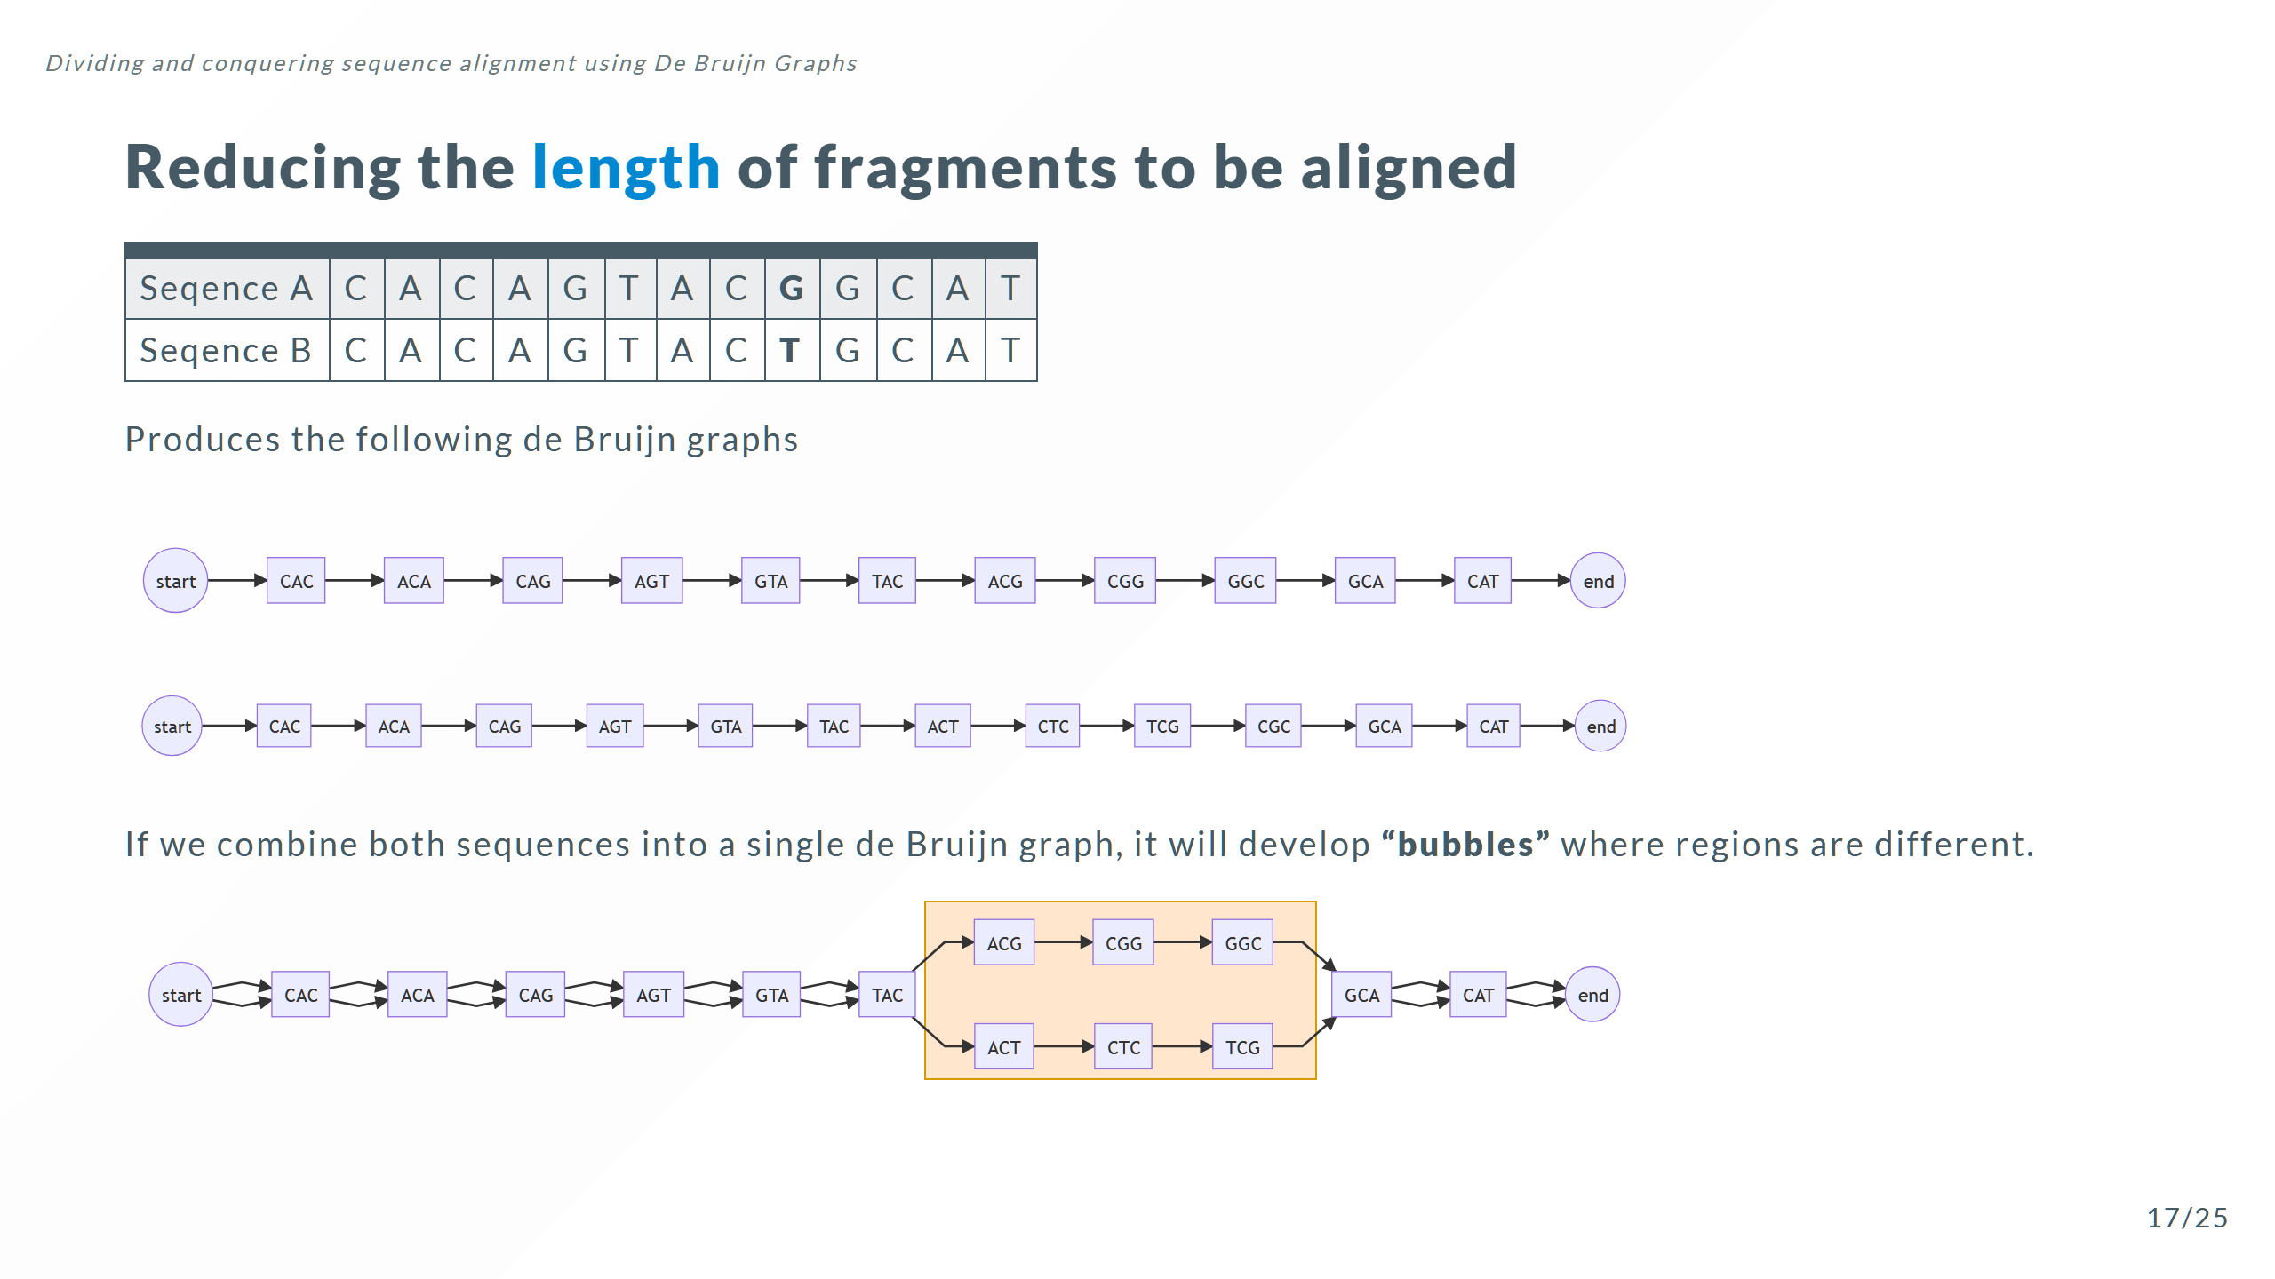

Slide 38
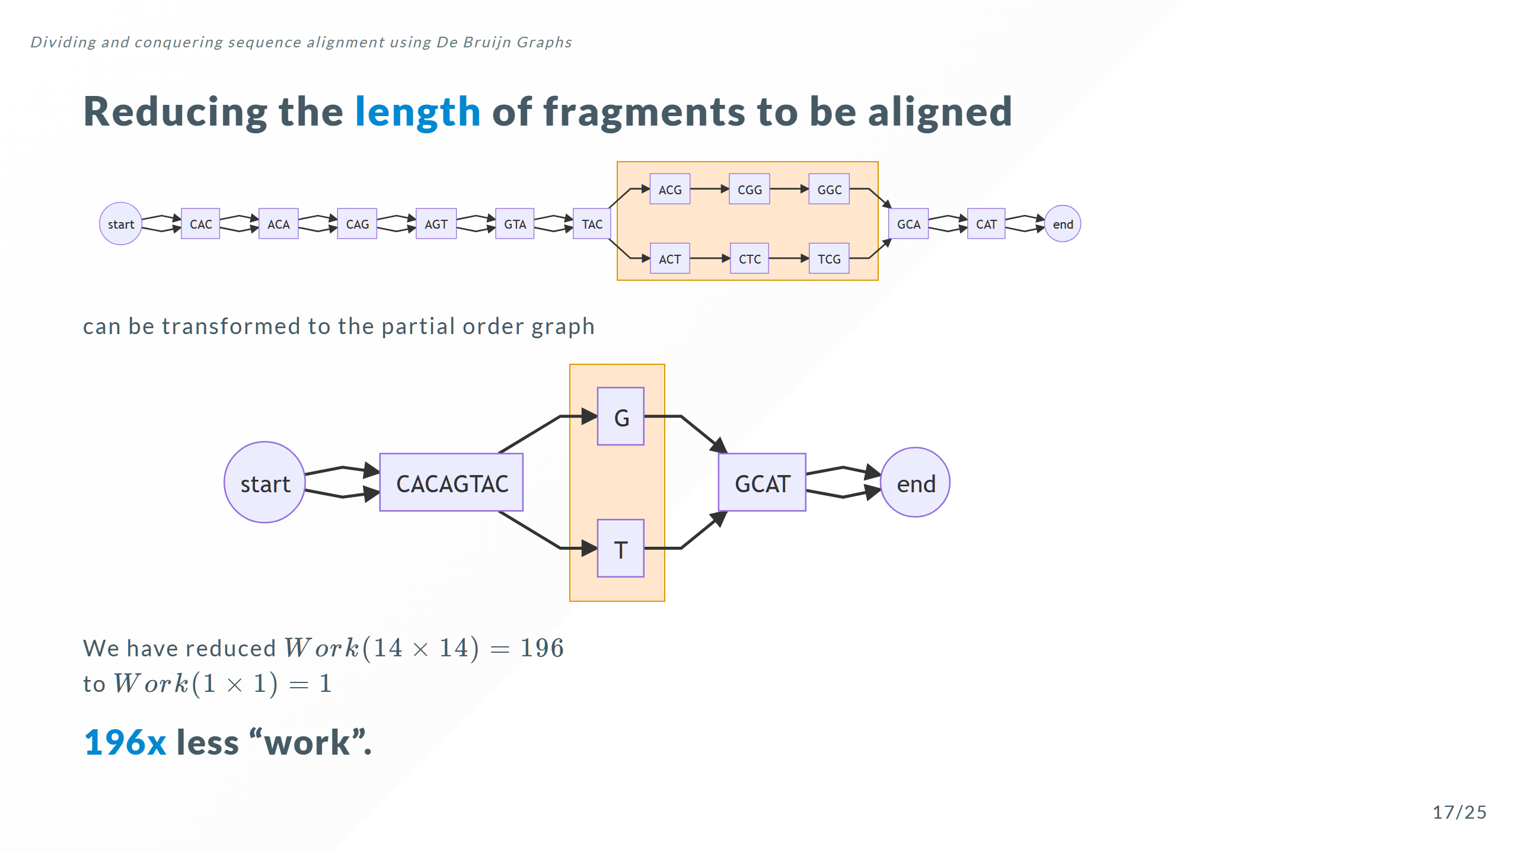

Slide 39
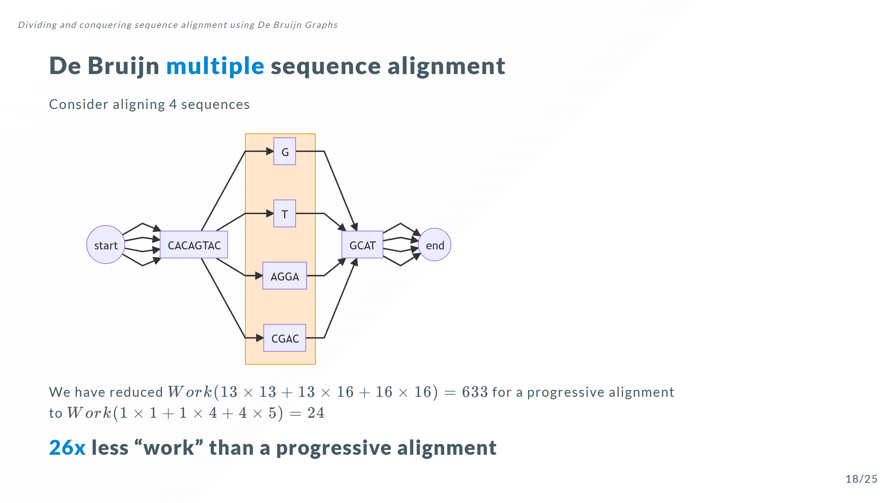
Notes:
It is interesting that the more sequences you add, the greater the potential advantage of using a de Bruijn graph

Slide 40
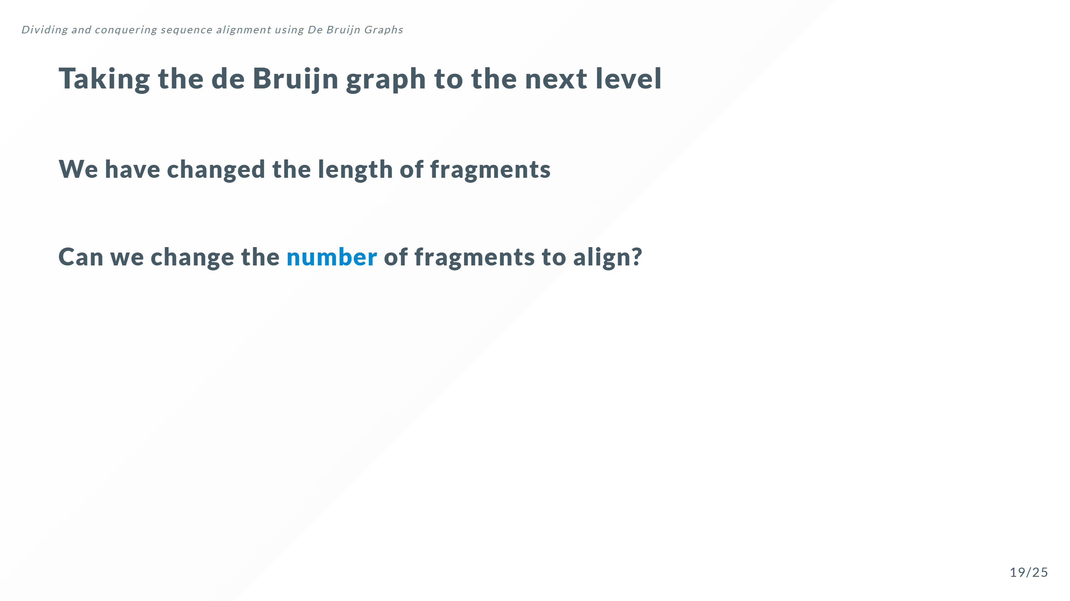

Slide 41
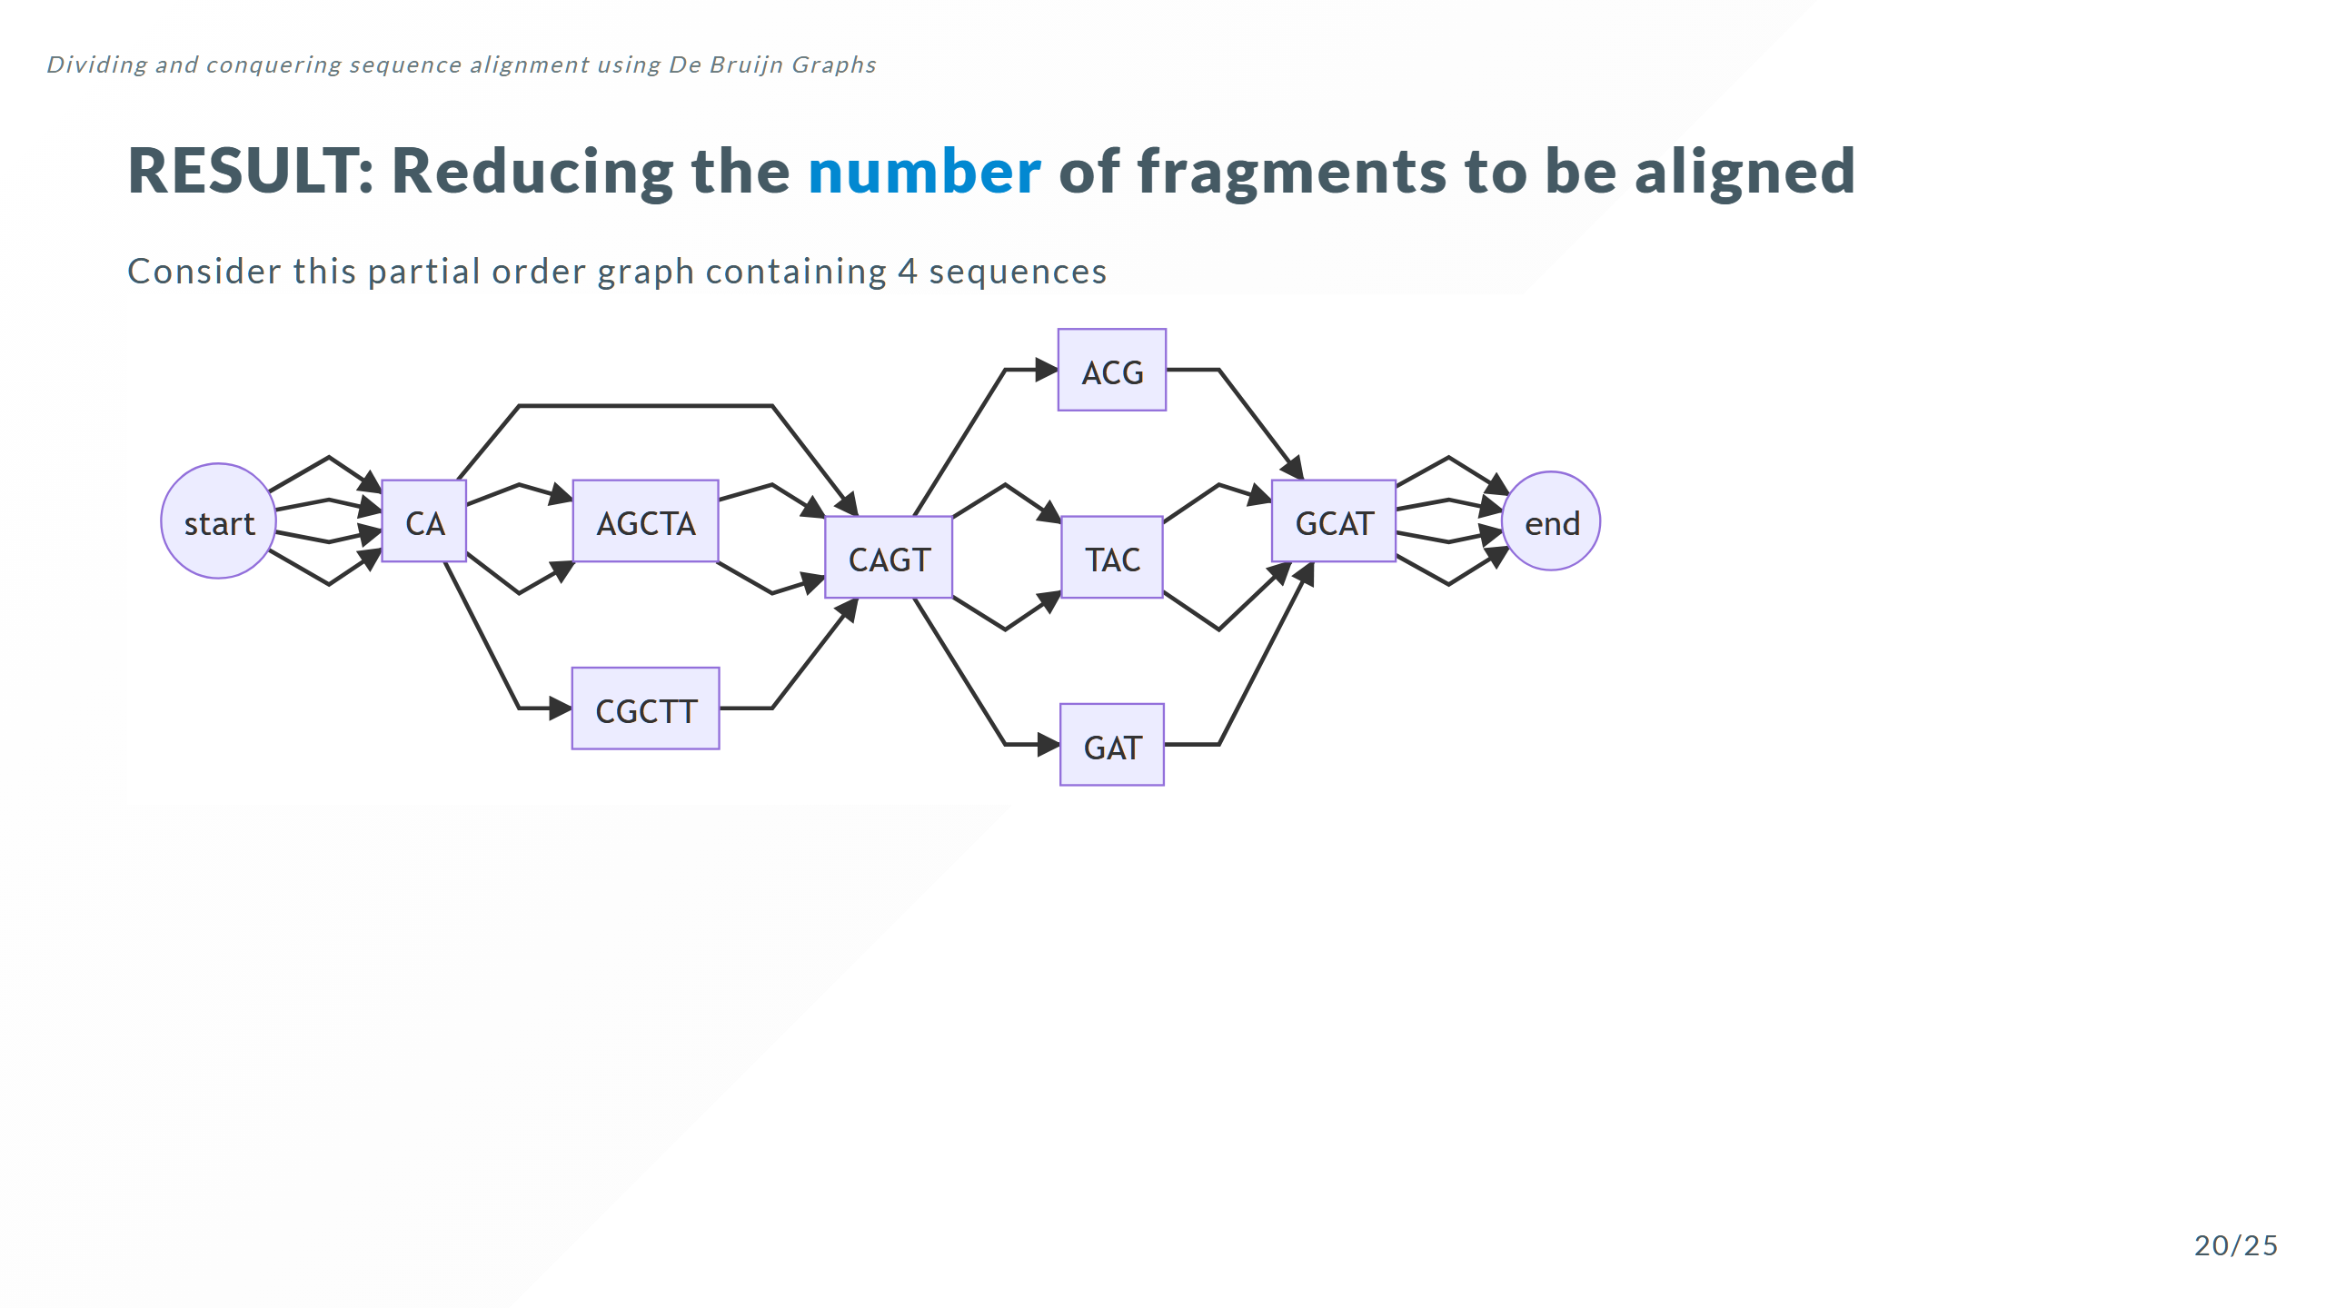

Slide 42
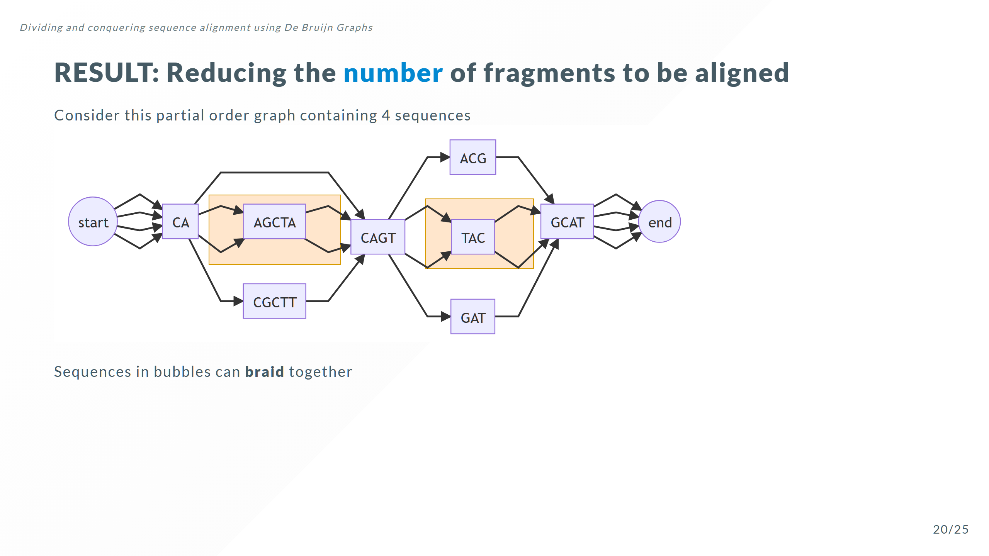

Slide 43
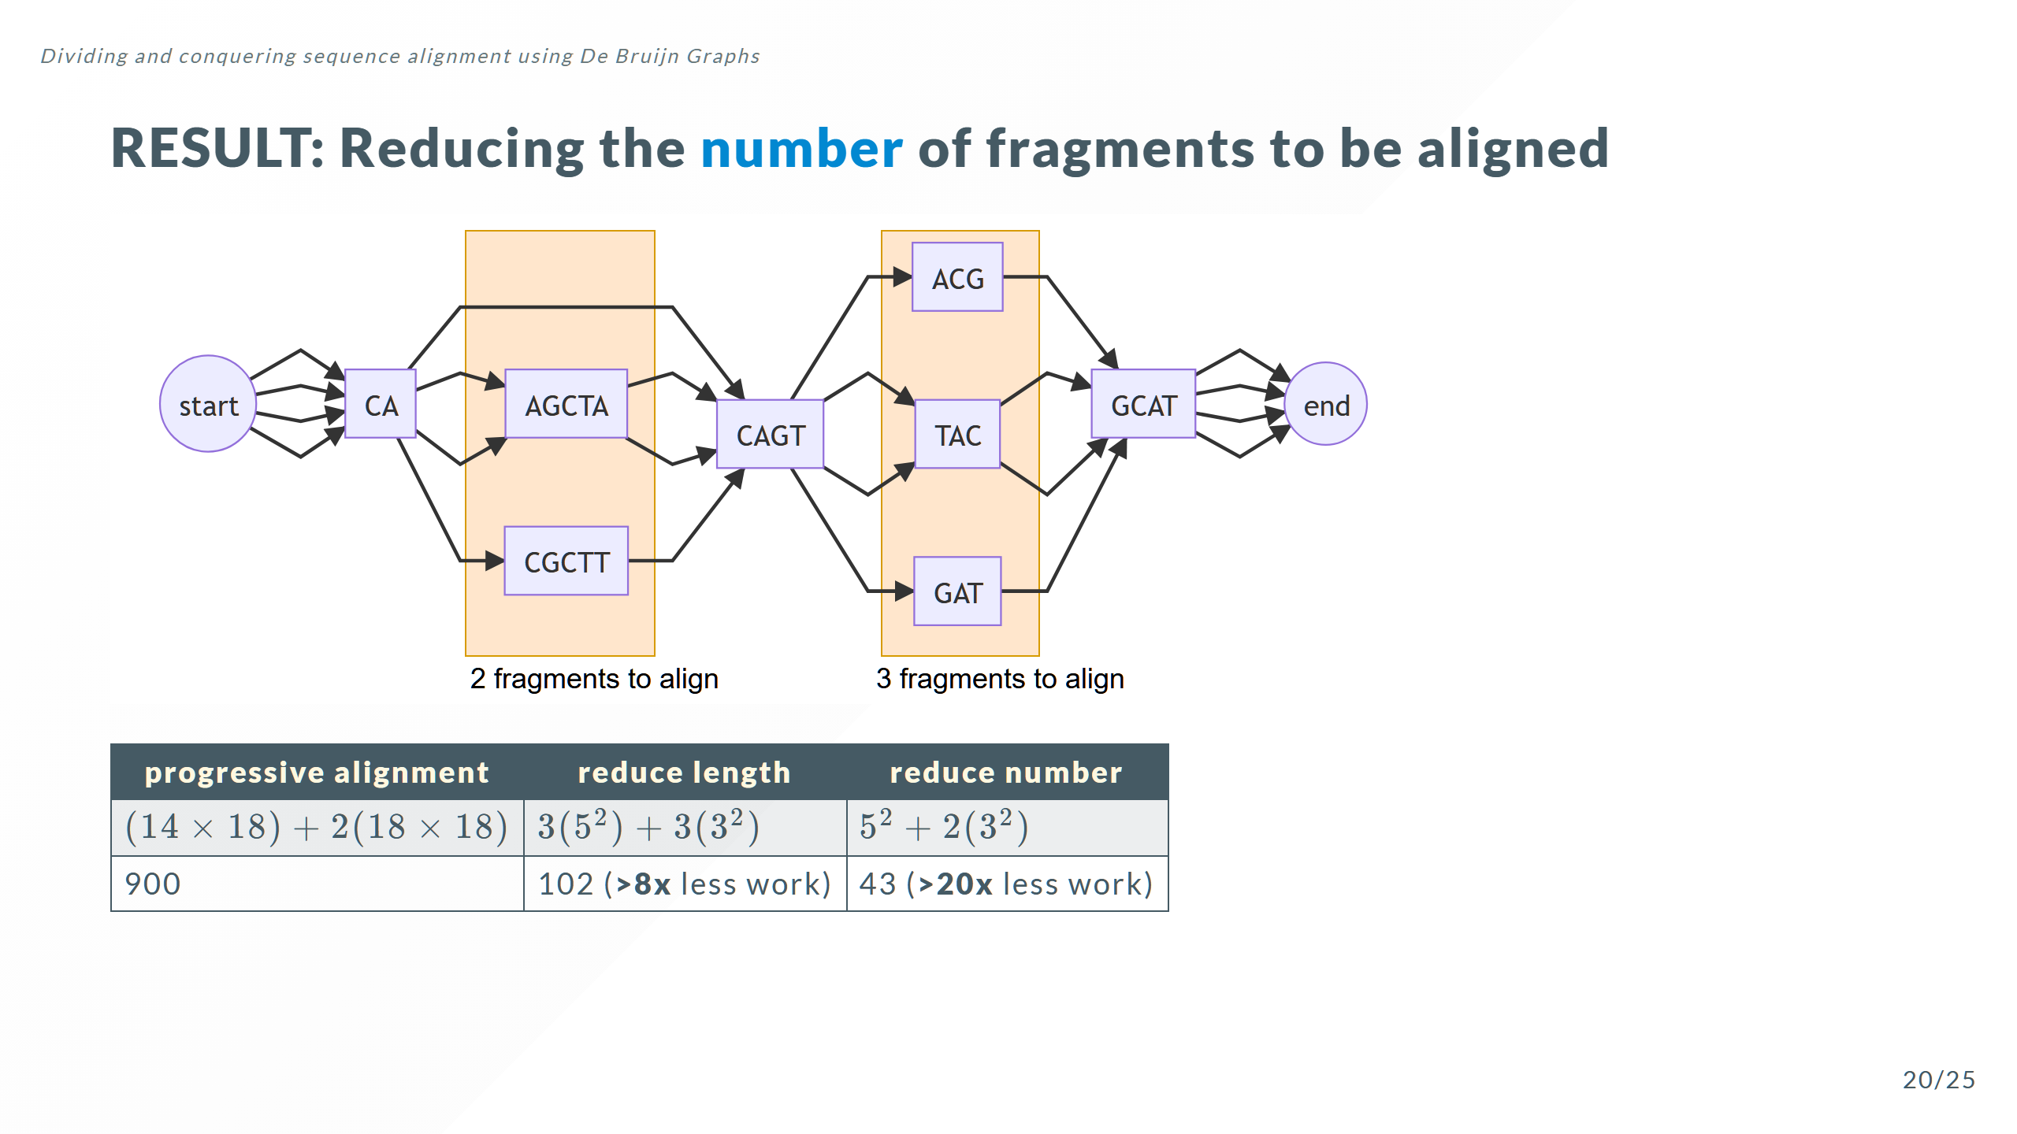

Slide 44
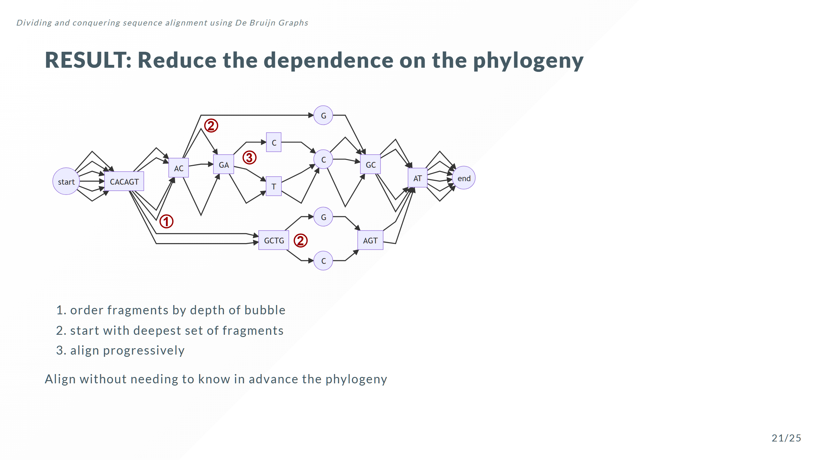

Slide 45
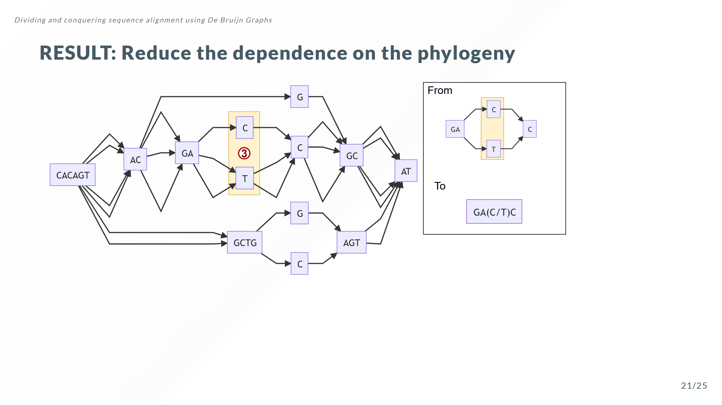

Slide 46
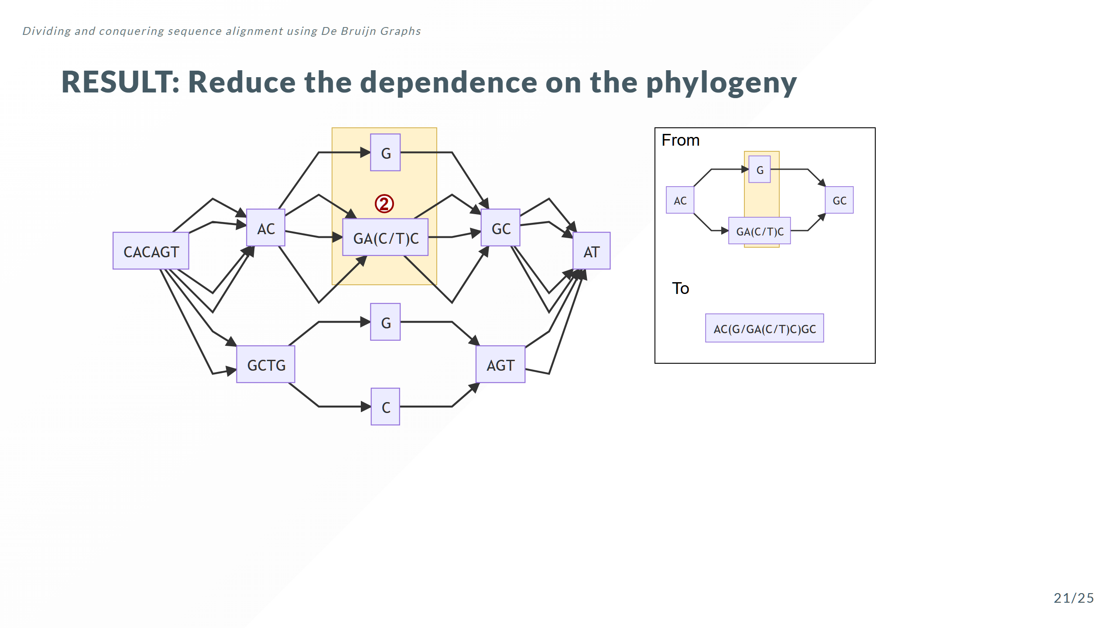

Slide 47
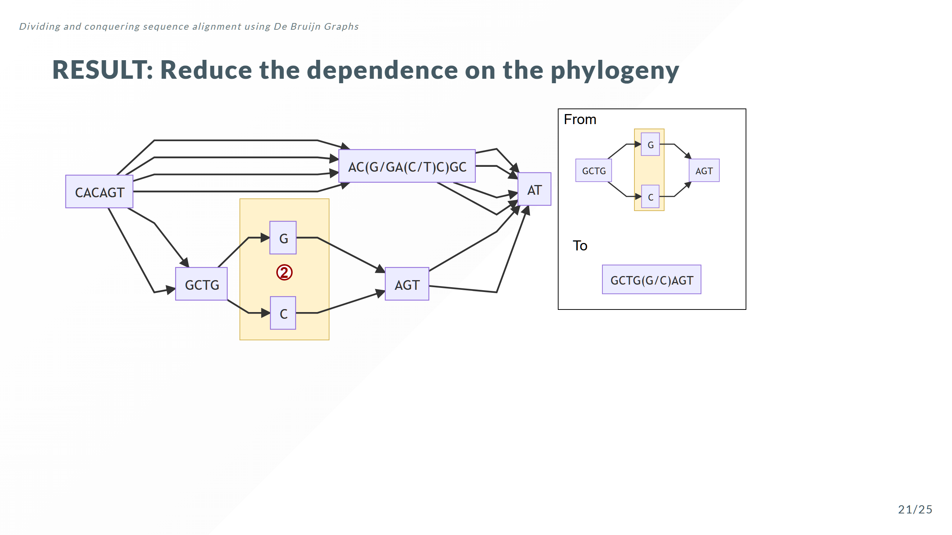

Slide 48
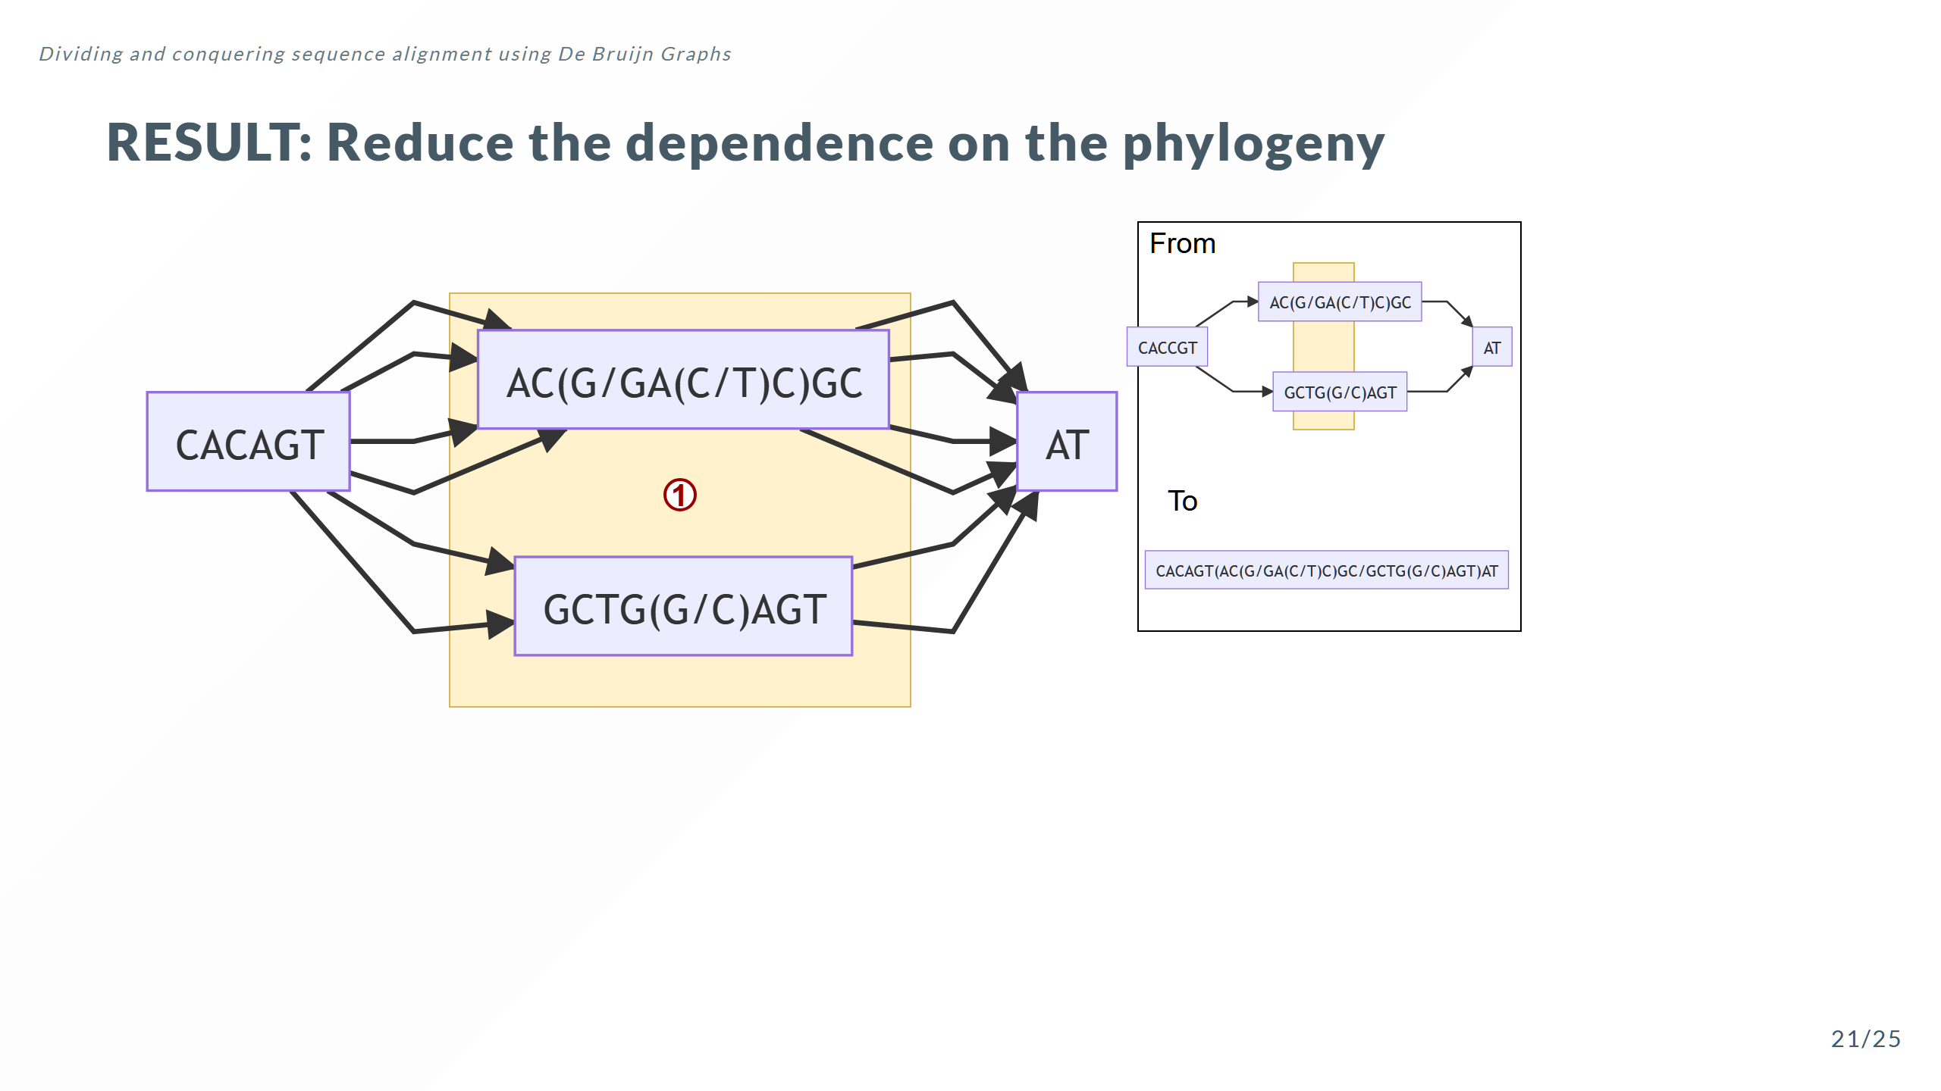

Slide 49
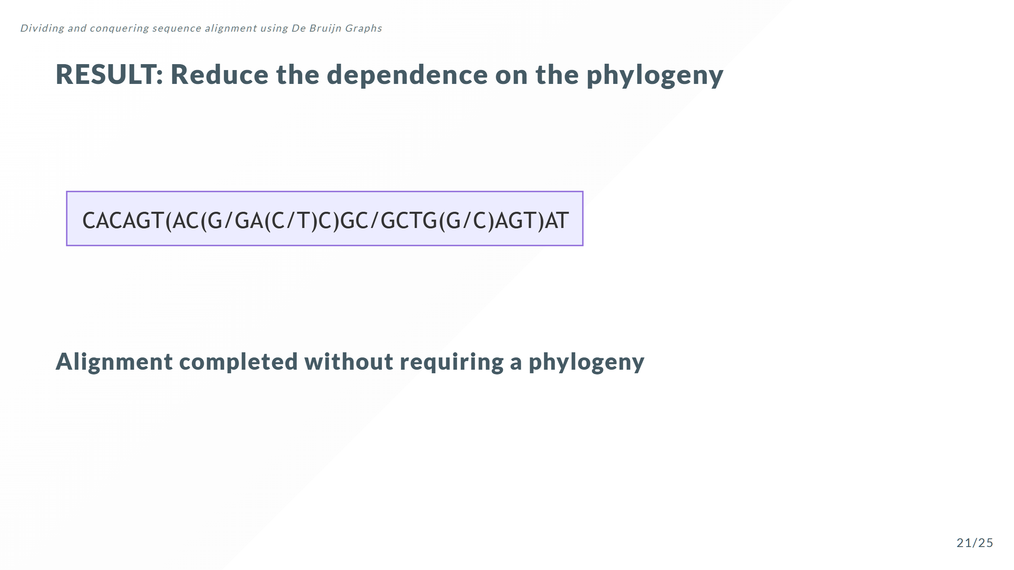

Slide 50
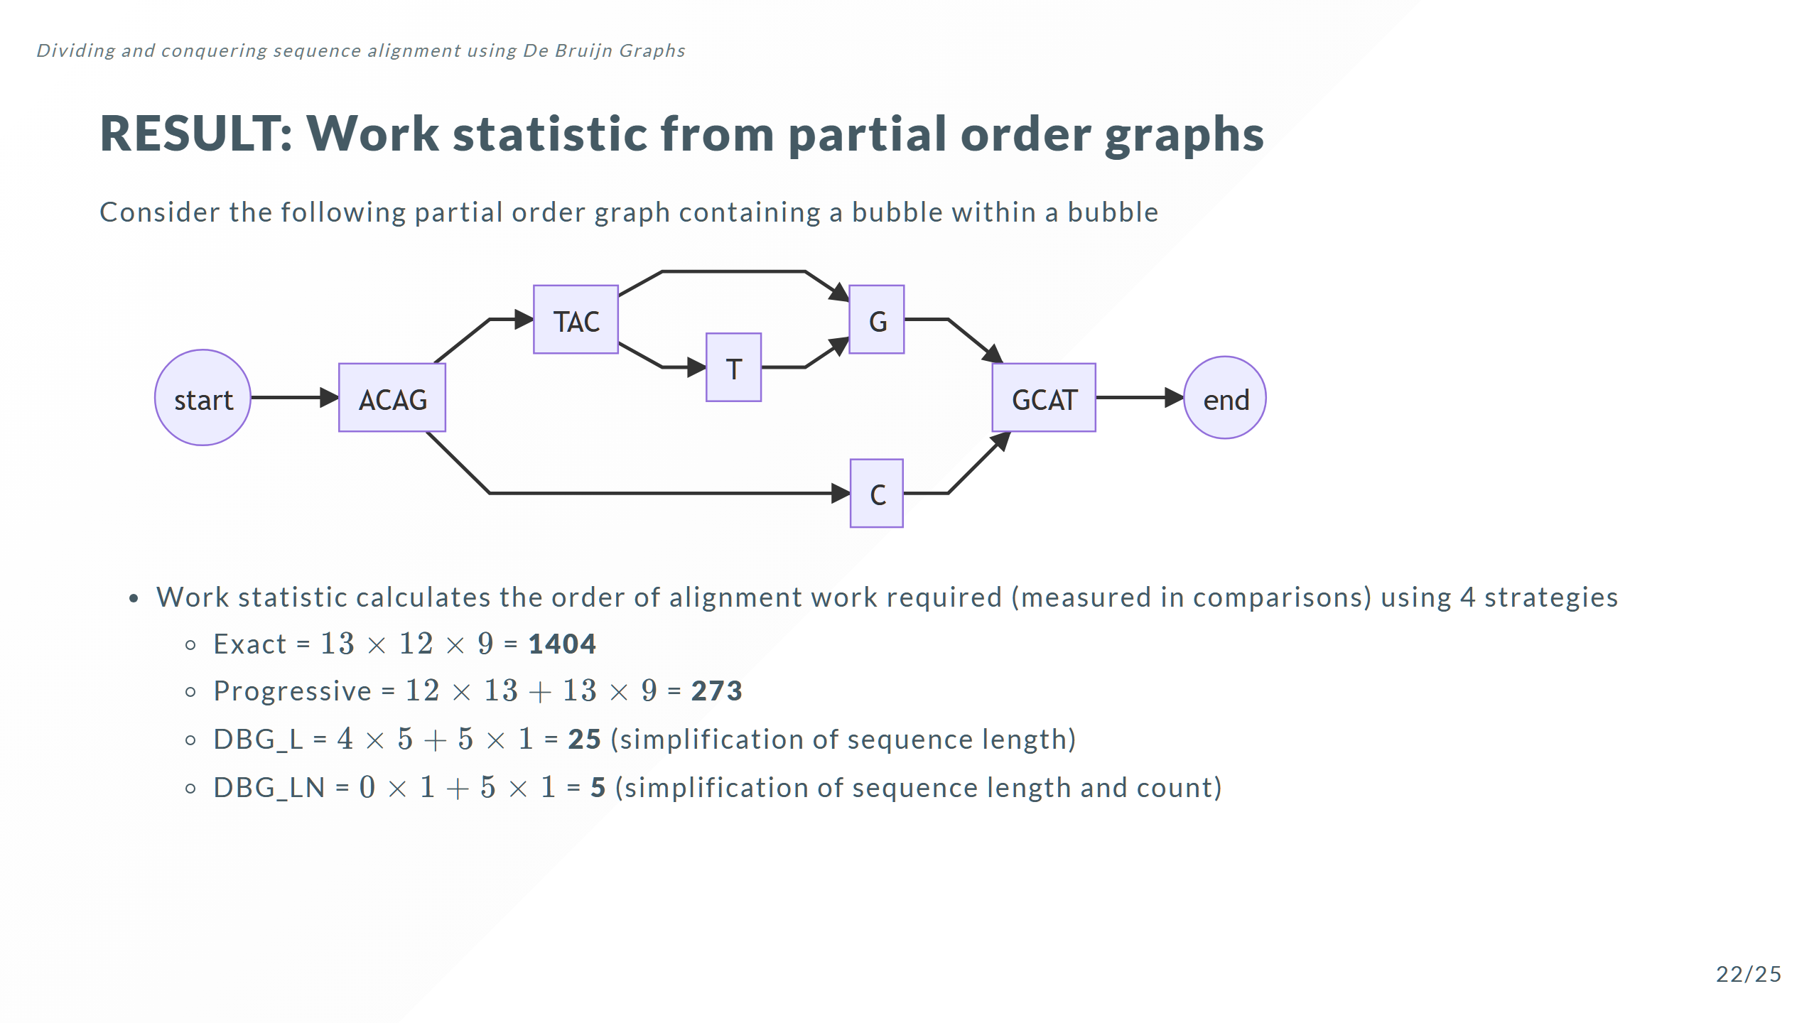
Notes:
Note: Gives the expected alignment work required, without actually aligning the sequences. So the work statistic can be used to rapidly quantify expected performance on a broad distribution of sequence classes

Slide 51
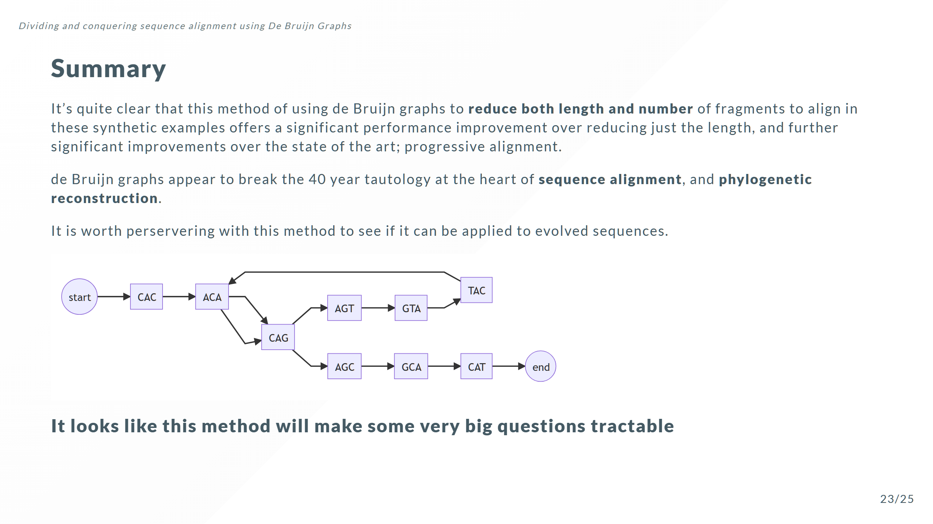

Slide 52
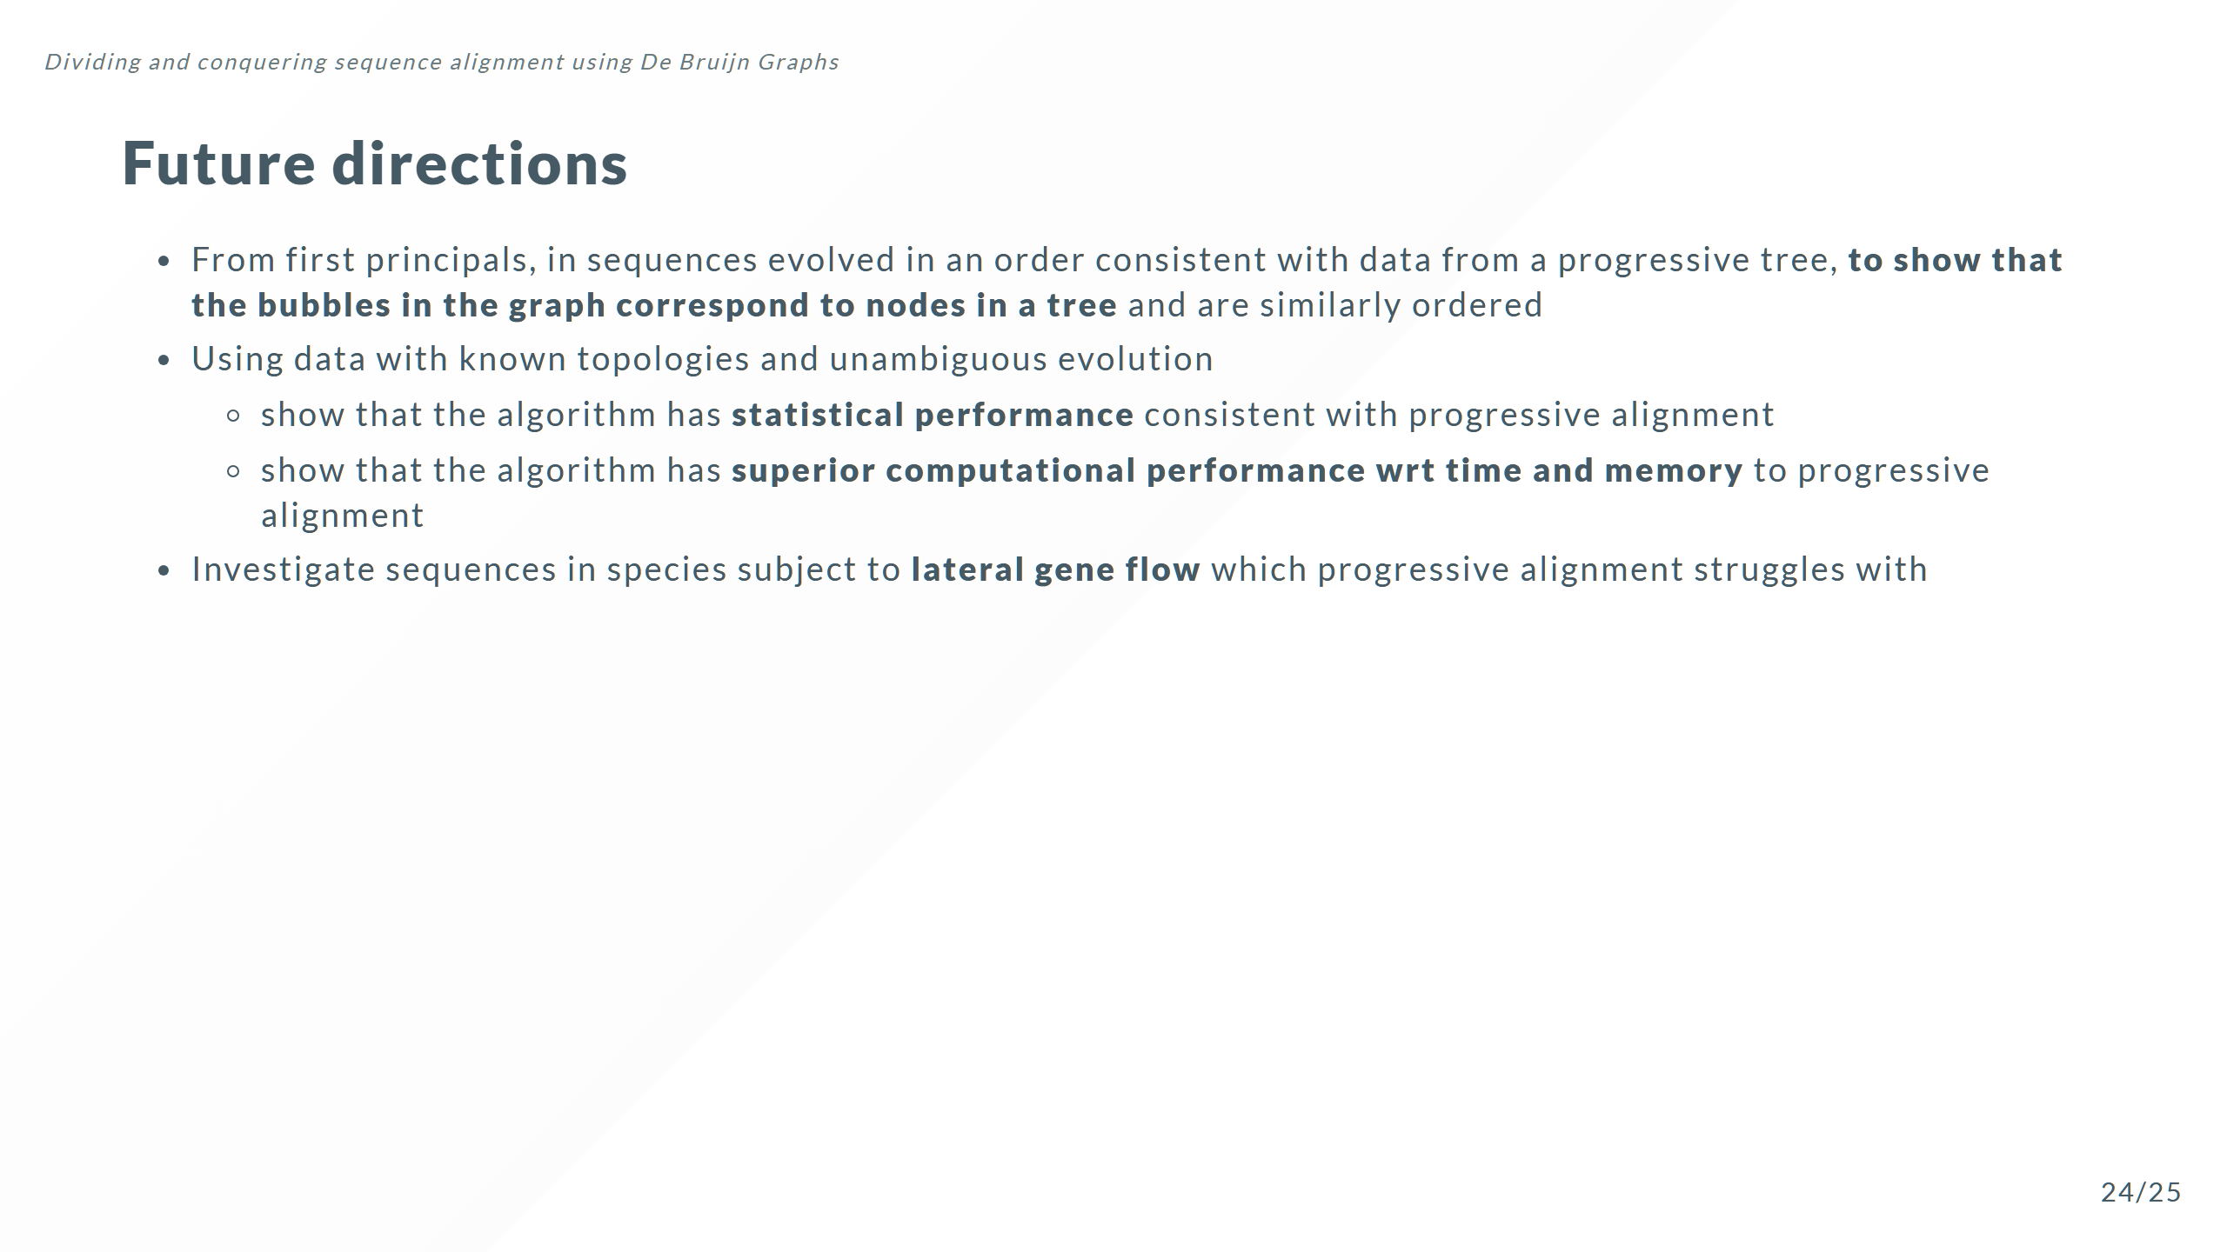

Slide 53
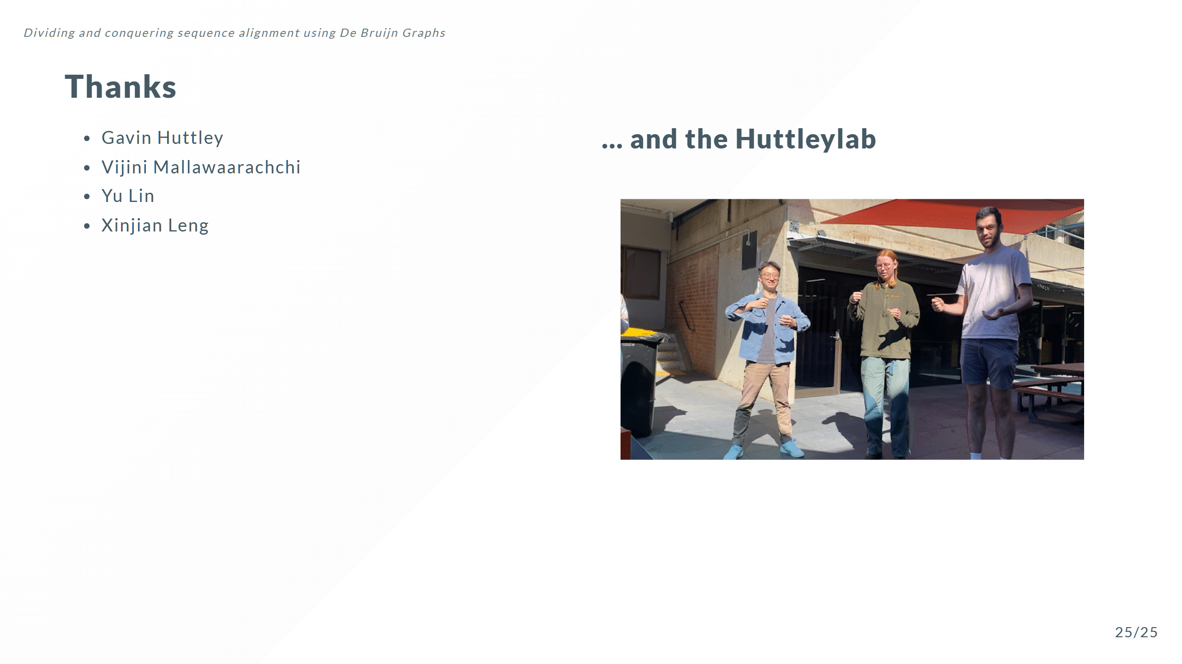


Slide 54


Slide 55


Slide 56


Slide 57


Slide 58


Slide 59


Slide 60


Slide 61


